Slide 1
Working Towards High School Diplomas
Hartsaw, K. Merrell, C.
Chief Executive Chief of Staff
Jones, B. Blackall, D.
President Principal

Slide 3
Below is a puzzle. Try to connect the nine dots with four straight liners without going back over any line or lifting your pencil.
Six sets are included so that you have plenty of practice space.

Slide 4
NINE DOT AND FOUR LINES

Slide 5
Solved

Slide 6
Creative Innovative Solutions
Challenging Assumptions
Looking at Problems from Different Perspective
Stimulating Creative Thinking
Unconventional Solutions
Career Readiness
Employability
Additional source of income to homes
Academic Credit

Slide 7
Model the Process
Career ACADEMY with a student-centered focus
Curriculum
Board of Directors
Community
Careers
STUDENT
Small Classroom
Parents and Family
Creative Scheduling
Professional Staff
Businesses
School District Support
Mentors
Process The Model

Slide 8
Pre-College Schedule
Flexibility for Employer and Student
Employment opportunities hours with an A & B block model
Support and Collaboration to promote teamwork

Slide 9
EDUCATIONAL PROGRAM IMPLEMENTATION
SECRETARY’S COMMISSION ON ACCHIVING NECESSARY SKILLS
U.S. DEPARTMENT OF LABOR
Reading
Math
Pre-employment/work
Life Skills
Career Exploration
Citizenship Skills
Critical Thinking

Slide 10
Supporting Students and Community
Dropout prevention
20 plus years Assisting students to graduate from High School & find employment.
Building relationships with District, schools, and local businesses.

Slide 11
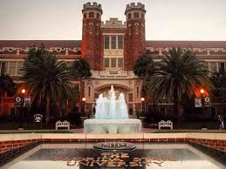
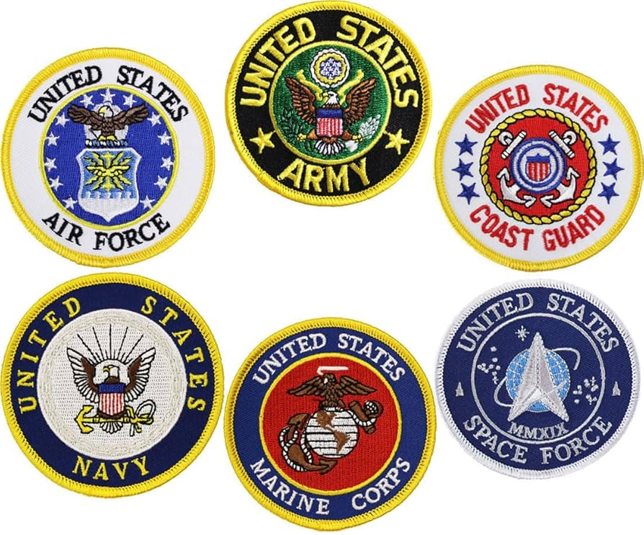
POST HIGH SCHOOL PATHWAYS
Military
University
Technical College

Slide 12
THANK YOU

