Slide 1
FLORIDA EDUCATION FINANCE PROGRAM (FEFP) FUNDING
Charter School Conference
November 2024

Slide 2
Topics
General FEFP Overview
Full-time Equivalent (FTE) Student Membership Survey Overview
FTE Recalibration
Components of the FEFP
Salary Increase Allocation
Class Size Reduction
Charter Revenue Worksheet
Charter School Administrative Fee

Slide 3
Florida Education Finance Program
Primary mechanism for funding operating costs of Florida school districts
Established by the Florida Legislature in 1973
Calculated five times per year based on FTE
Distribution of funds to school districts is based on the FEFP
Funded through both state and local revenue sources

Slide 4
Minimum Hourly Requirement
Section 1011.60(2), F.S., requires 180-day term or hourly equivalent. The hourly requirements are specified in rule 6A-1.045111, FAC.
720 Hours of Instructional Time for Prekindergarten through Grade 3 Students (180 days x 4 hours per day)
900 Hours of Instructional Time for Grades 4-12 Students (180 days x 5 hours per day)

Slide 5
FTE Eligibility
Each PK-12 student must meet the membership requirement to be eligible to be reported and the attendance requirement to be eligible for funding.
Meeting the membership requirement means that:
The student is officially assigned to a course or program by a school or district.
The school captures the student course schedule for each student on the membership roll during survey week on date certain.
Each student must be in attendance one of the five days of survey week or one of the six days prior to survey week in which school was in session.
Date Certain is always the Friday of survey week.

Slide 6
Virtual Charter Schools
Charter schools may offer virtual instruction to K-12 students under s. 1002.33, F.S.
All FTE must be reported on a successfully completed credit basis and is limited to 1.0 unweighted FTE per student.
1.0 unweighted FTE shall consist of six full credit completions or the prescribed level of content that counts toward promotion to the next grade level.
Credit completions may be a combination of full-credit courses and half-credit courses.

Slide 7
FTE Surveys
Survey Period 1 (July) is from the beginning of the fiscal year (July 1) to the beginning of the defined 180-day school year.
Survey Period 2 (October) is the first 90 days of the 180-day school year.
Survey Period 3 (February) is the second 90 days of the 180-day school year.
Survey Period 4 (June) is the period from the end of the 180 day school year to the end of the fiscal year (June 30).
All FTE reporting deadlines can be viewed at:
https://www.fldoe.org/core/fileparse.php/7574/urlt/2425-surveydates.pdf
The FEFP is calculated by the legislature and recalculated four times each year using projected and reported FTE as reported during the FTE surveys.

Slide 8
Hurricane Reporting Guidance Update
The survey attendance window is defined as the five days of survey week and the preceding six scheduled school days
However, two alternative windows are available to districts impacted by Hurricane Helene and/or Hurricane Milton.
Charter schools must use the attendance window selected by the district in which they are located.

Slide 9
Survey 2 Alternative Windows
Hurricane Helene
A school district that was closed for at least one day due to Hurricane Helene between September 27 and October 11 may use an alternative attendance window that is the 11 days that schools were in session immediately preceding Thursday, September 26, 2024
Hurricane Milton
A school district that was closed for at least one day due to Hurricane Milton between October 7 and October 11 may use an alternative attendance window that is the 11 days that schools were in session immediately preceding Monday, October 7, 2024.
A school district that was closed for both may use either attendance window.

Slide 10
Recalibration to 1.0
A student may not earn more than 1 FTE (except DJJ students, who are served during the summer).
School districts report all FTE regardless of the 1.0 FTE cap.
DOE recalibrates FTE to 1.0.
DOE recalibrates FTE to 0.5 if a student has enrollment in only one survey (Survey 2 or Survey 3).
FTE recalibration is annualized (Surveys 1, 2, 3, 4).
The 1.0 FTE cap includes:
All FTE for instruction provided by the district of enrollment.
All dual enrollment FTE.
All FTE for instruction provided by other school districts, including Florida Virtual School.

Slide 11
Recalibration to 1.0

Slide 12
FEFP Calculations
The FEFP is calculated five times each year.
First Calculation (May) - Completed by the Florida Legislature using projected FTE for all surveys.
Second Calculation (July) - Uses projected FTE from all surveys, includes certified school taxable values for school districts.

Slide 13
FEFP Calculations
Third Calculation (December/January) –First calculation of the year to include actual FTE. Uses actual FTE for October and projected FTE for February.
Fourth Calculation (April/May) –Uses actual FTE for October and February.
Final Calculation (September/October)

Slide 14
2024-25 Program Cost Factors
Basic Programs | Grade Levels | Cost Factor
101 | K-3 | 1.122
102 | 4-8 | 1.000
103 | 9-12 | 0.988
ESE Programs | Grade Levels | Cost Factor
111 | K-3 | 1.122
112 | 4-8 | 1.000
113 | 9-12 | 0.988
254 | K-12 | 3.706
255 | K-12 | 5.707
ESOL (ELL) | Grade Levels | Cost Factor
130 | K-12 | 1.208
Career Education | Grade Levels | Cost Factor
300 | 9-12 | 1.072

Slide 15
Base Funding Calculation
FTE
Full-Time Equivalent Student
X
PCF
Program Cost Factor
=
WFTE
Weighted Full Time Equivalent Student
X
BSA
Base Student Allocation 2024-25 = $5,330.98
X
CWF
Comparable Wage Factor
X
SDF
Small District Factor
=
BASE FUNDING

Slide 16
2024-25 FEFP Second Calculation
FTE Students 3,170,301.01 | × | Program Weights | = | Weighted FTE Students 3,490,164.88 | × | Base Student Allocation (BSA) $5,330.98 | × | Comparable Wage Factor (CWF) | × | Small District Factor (SDF) | =
Base Funding $18,838,314,295 | + | DJJ Supplemental Allocation $2,831,855 | + | Educational Enrichment Allocation $832,949,386 | + | ESE Guaranteed Allocation $1,293,529,266 | + | Mental Health Assistance Allocation $180,000,000 | + | Safe Schools $290,000,000 | +
Student Transportation Allocation $556,584,049 | + | .748 Mill Discretionary Compression $450,231,412 | + | Federally Connected Student Supplement $14,489,059 | + | State Funded Discretionary Contribution $45,942,523 | = | Gross State and Local FEFP $22,505,231,845 | - | Required Local Effort $10,377,115,280 | =
Net State FEFP $12,104,361,896 | + | Class Size Reduction $2,771,299,363 | + | State Funded Discretionary Supplement $616,070,303 | = | Total State Funding $15,491,731,562 | + | Required Local Effort $10,377,115,280 | + | .748 Mill Discretionary Local Effort $2,609,307,687 | =
 | + | Class Size Reduction $2,896,071,526 | Total Funding $28,478,154,529
Notes:
16

Slide 17
2024-25 Changes
The base student allocation (BSA) was increased by $191.25.
The Mental Health Allocation was increased by $20 million to a total of $180 million.
Transportation Allocation was increased by $20 million to a total of $556 million.
Safe Schools Allocation was increased by $40 million to a total of $290 million.

Slide 18
Salary Increase Allocation
The Classroom Teacher and Other Instructional Personnel Salary Increase Allocation (formerly TSIA) was rolled into Base Funding in 2023-24.
5.59 percent of Base Funding is used to maintain prior year increases
1.07 percent of Base Funding is used for 2024-25 salary increases.
Growth funds used to increase the minimum base salary and/or provide salary increases to teachers or instructional personnel.

Slide 19
ESE Guaranteed Allocation
Districts receive per-basic ESE FTE amount of $2,056.31 or their prior year funds per basic ESE FTE.
No change to charter funding.
Districts should continue to allocate these funds to charters based on the number of students in each matrix level and the 2000-01 ESE Funding amounts, as recommended in the Charter Revenue Estimate Worksheet.

Slide 20
Class Size Reduction
Class Size Reduction Allocation
Class Size funds are provided to meet the constitutional requirement that the class sizes for grades PK-3, 4-8, and 9-12 must be no greater than 18, 22 and 25 students, respectively, for core-curricula courses.
The following funds are provided (per WFTE):
CSR Factor per student
Grades PK-3 $ 950.92
Grades 4-8 $ 907.92
Grades 9-12 $ 910.12
WFTE
1,000.00
CWF
1.000
CSR $950,920
CSR Factor
$950.92

Slide 21
Class Size Compliance
Class Size Reduction Compliance
Class Size Maximums:
PK-3 = 18
4-8 = 22
9-12 = 25.
Measured at the school-wide average for charter schools.
Class Size Compliance Plans are due to FDOE by February 1.
Must include the signature of the charter’s school board designee.
No financial penalty due to noncompliance in 2024-25.

Slide 22
State-Funded Discretionary Supplement
$616,070,303 allocated to the State-Funded Discretionary Supplement.
The State-Funded Discretionary Supplement funds the non-voted discretionary millage for operations for students awarded a Family Empowerment Scholarship.
This is a 100% state-funded allocation and is not distributed to school districts or charter schools.
State-Funded
Discretionary
Supplement
Authority:
s.1011.62(16),
F.S.

Slide 23
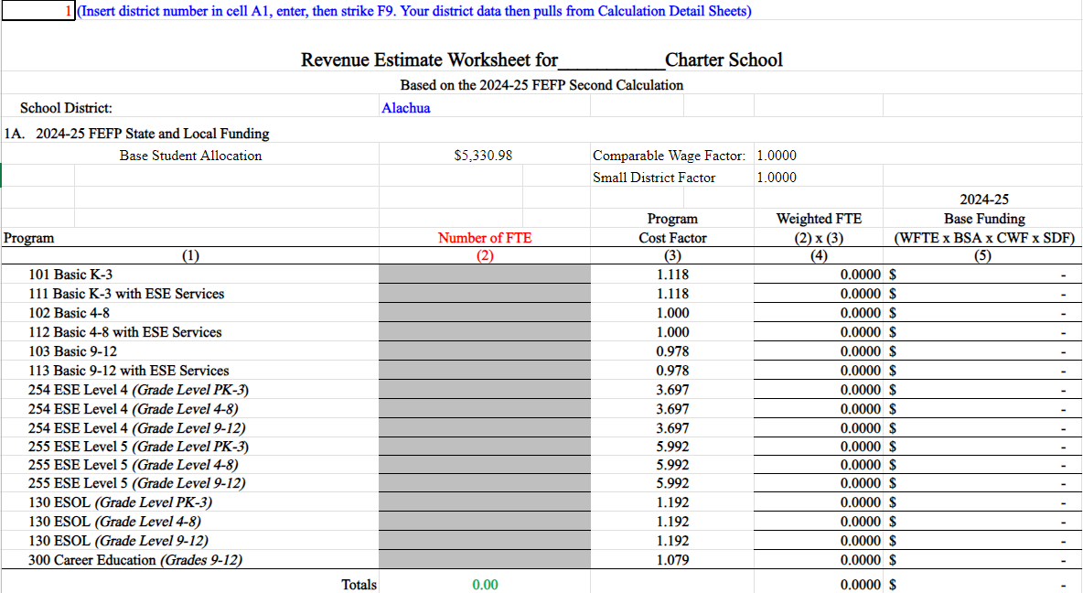
Revenue Estimate Worksheet
The Charter Revenue Worksheet can be found here:
https://www.fldoe.org/finance/fl-edu-finance-program-fefp/charter-school-revenue-estimate-worksh.stml

Slide 24
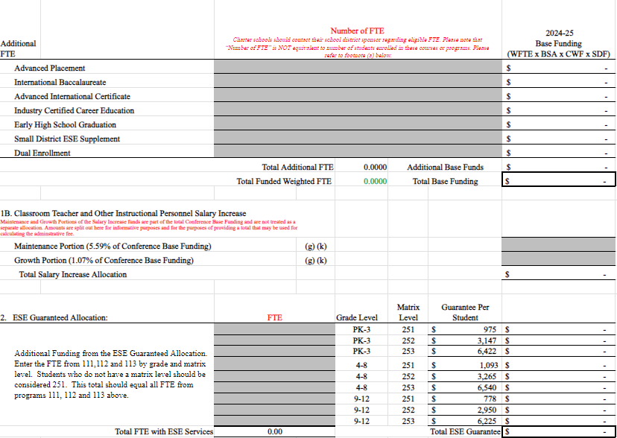
Revenue Estimate Worksheet

Slide 25
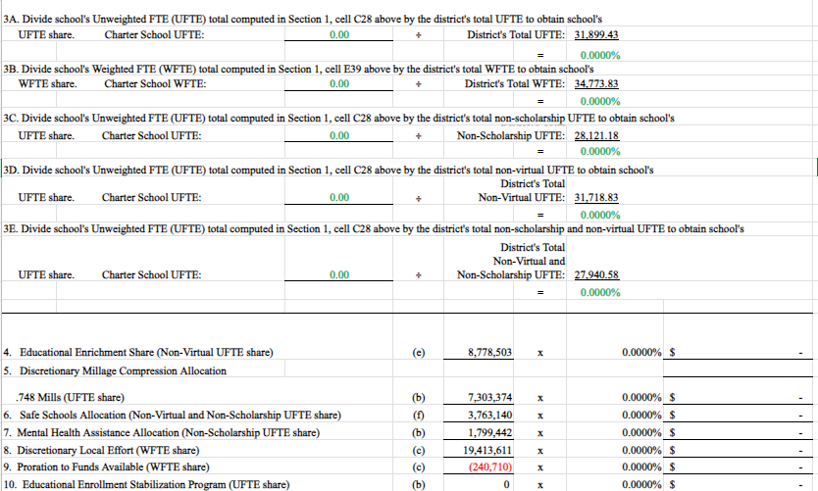
Revenue Estimate Worksheet

Slide 26
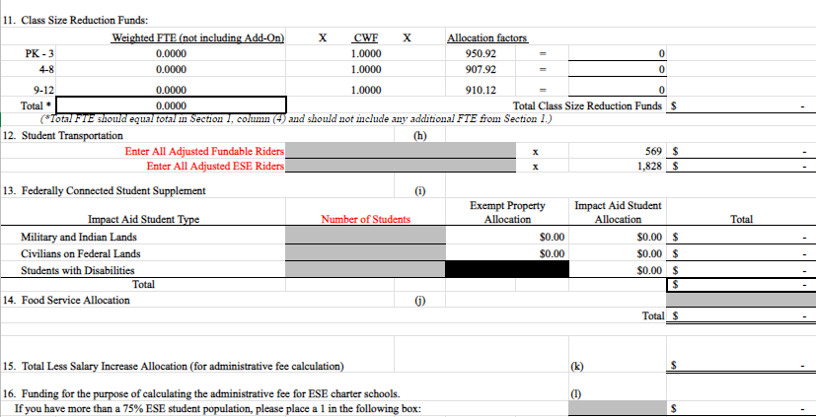
Revenue Estimate Worksheet

Slide 27
Administrative Fee
School district must provide certain services to charter schools in exchange for withholding an administrative fee:
Contract management
FTE and data reporting
ESE administration
Test administration
Information services
Other services related to the federal lunch program
Administrative
Fee
Authority:
s.1002.33(20),
F.S.

Slide 28
Administrative Fee
Administrative
Fee
Calculation
Total fee shall be calculated based upon up to 5 percent of the available funds listed below, except for when 75% or more of the students enrolled in the charter school are exceptional students as defined in 1003.01(3), F.S. in which case 5% of those available funds shall be calculated based on unweighted FTE:
FEFP, state and local
Discretionary Millage
Class Size Reduction (Categorical)
A sponsor may withhold only up to 5 percent for charter schools with an enrollment up to and including 250 students, or 500 students for charter schools that meet the requirements in s. 1002.33(20)3.a.(II), F.S.
A sponsor may not charge or withhold any administrative fee against a charter school for any funds specifically allocated by the Legislature for teacher compensation according to s. 1002.33(20)(a)4, F.S.
Authority:
s.1002.33(20),
s. 1002.33(17)
F.S.
*For high-performance charter schools, a sponsor may withhold a total administrative fee of up to 2% for enrollment up to and including 250 students per school.

Slide 29
Administrative Fee
Administrative
Fee
Calculation
Example: A charter school has 475 students, of which more than 75% are ESE.
Authority:
s.1002.33(20),
s. 1002.33(17)
F.S.
Since the school has more than 75% ESE students, a 1 is placed in the Excel cell to help calculate the 5% administrative fee, which can only be withheld for up to and including 250 students. Therefore, the amount that the 5% administrative fee should be based on is calculated as follows:
$$\$2,351,146 x \frac{250}{475}=\$1,237,445.26$$
The 5% administrative fee is then calculated on this amount:
$$\$1,237,445.26 x 0.05=\$61,872.26$$

Slide 30
Useful Tools
Charter School Revenue Estimating Worksheet https://www.fldoe.org/finance/fl-edu-finance-program-fefp/charter-school-revenue-estimate-worksh.stml
FEFP Calculations https://www.fldoe.org/finance/fl-edu-finance-program-fefp/fl-edu-finance-program-fefp-calculatio.stml
FTE General Instructions https://www.fldoe.org/finance/fl-edu-finance-program-fefp/fte-info/index.stml
FTE and Transportation Reporting Deadlines https://www.fldoe.org/core/fileparse.php/7574/urlt/2425-surveydates.pdf
Financial and Program Cost Accounting and Reporting for Florida Schools (Red Book) https://www.fldoe.org/finance/fl-edu-finance-program-fefp/financial-program-cost-accounting-repo.stml
Class Size http://www.fldoe.org/classsize/

Slide 31
Contact Information
Contact Information
Office of Funding and Financial Reporting
(850) 245-0405 http://www.fldoe.org/fefp/
Josh Bemis, Office of Funding and Financial Reporting
josh.bemis@fldoe.org
Mark Eggers, Assistant Deputy Commissioner
mark.eggers@fldoe.org

