Slide 1
Florida Charter School Conference Statewide Assessment Update
November 20, 2024
Catherine Altmaier
Process/Contract Support Manager
Office of Assessment

Slide 2
Topics
What’s New
Testing Requirements
Benchmark Reporting
Enhanced Score Reports
Florida Alternate Assessment (FAA) Standard Setting
Released Tests
Concordant/Comparative Scores
Independent Study
New Worlds Reading Scholarships

Slide 3
What's New

Slide 4
Grade 3 FAST ELA Reading Summer Administration
Beginning in 2025, we will offer the Grade 3 Florida Assessment of Student Thinking (FAST) English Language Arts (ELA) Reading in the summer.
A score of Level 2 or above can be used for promotion purposes.
Testing window TBD, likely in existing summer window.
No remote administrations.
Paper-based accommodations will be available for eligible students.

Slide 5
Science and Social Studies
Beginning with the 2024–25 school year, Science and Social studies assessments are fully adaptive.
Each item a student receives will be selected to meet blueprint requirements and will adjust item difficulty levels based on how the student responds.
Enhanced score report language will appear in reports beginning in Fall 2024.
For more information on computer-adaptive tests, see the following resources:
Florida's Statewide Computer-Adaptive Tests FAQ (PDF)
Florida Statewide Assessments Computer-Adaptive Testing Video

Slide 6
No More Florida Standards Assessments (FSA)
Spring 2024 was the final administration of Retake assessments aligned to the Florida Standards.
Students with these graduation requirements participate in FAST ELA Reading Retake or Benchmarks for Excellent Student Thinking (B.E.S.T.) Algebra 1 EOC assessments or may earn a concordant/comparative score.
Graduation Requirements for Florida’s Statewide Assessments.

Slide 7
Testing Requirements

Slide 8
Students to be Tested : ELA and Mathematics
FAST ELA Reading: all students in grades 3–10 participate in PM1, PM2, and PM3.
FAST Mathematics: all students in grades 3–8 participate in PM1, PM2, and PM3.
Students in middle grades enrolled in an Algebra 1 or Geometry end-of-course (EOC) course do not participate in FAST; they are required to take the EOC only.
B.E.S.T. Writing: all students in grades 4–10 participate in the spring.

Slide 9
Students to be Tested : EOC Assessments
Algebra 1, Biology 1, Civics, Geometry, U.S. History
All students enrolled in and completing a course associated with the EOC participate in the assessment.
Courses associated with EOC assessments are listed on the Fact Sheets:
B.E.S.T. Algebra 1 and Geometry EOC Fact Sheet
Science and Social Studies EOC Fact Sheet

Slide 10
Students to be Tested : Science
All students enrolled in grades 5 and 8 participate in the statewide science assessment in the spring.
Students in grade 8 enrolled in a Biology 1 EOC course do not participate in grade 8 Science; they are required to take the EOC only.
Grade 5 and grade 8 students enrolled in a science course that does not have an associated statewide EOC (e.g., physical science) are required to participate in the Statewide Science Assessment, unless they have taken the assessment in a previous grade as an above grade tester.

Slide 11
Students to be Tested : Retake Assessments
FAST ELA Reading
Any student who did not pass FAST PM3 in grade 10 is eligible to participate in the FAST ELA Reading Retake.
Retained grade 10 students and students enrolled in grade 11 or 12 take the Retake, not the grade 10 test.
Transfer and other new students in grades 11 and 12 may take the Retake, even if they have never taken the Grade 10 assessment.
B.E.S.T. Algebra 1 EOC
Any student who still needs to pass the Algebra 1 EOC may participate in any of the four B.E.S.T. Algebra 1 EOC administration windows.
Students may also satisfy their graduation requirement by earning a concordant or comparative score (see Graduation Requirements for Florida’s Statewide Assessments).

Slide 12
Students to be Tested : Florida Civic Literacy Exam (FCLE)
All students enrolled in a U.S. Government course are required to participate.
Courses associated with the FCLE are listed on the FCLE Fact Sheet.
Students not enrolled in one of listed courses who wish to take the assessment to satisfy the postsecondary graduation requirement are eligible to participate.

Slide 13
Benchmark Reporting

Slide 14
Downloadable Benchmark Report
Available now for grades 3–10 FAST assessments, a data file generated through the Florida Reporting System (FRS) provides benchmark performance by student, roster, school and district.
Each benchmark is listed with the students in the roster who saw an item measuring that benchmark and whether the student answered the question correctly.
The current layout was created in consultation with select District Assessment Coordinators and their respective district instructional staff.
Modifications may be made in subsequent years based on feedback from all district users.

Slide 15
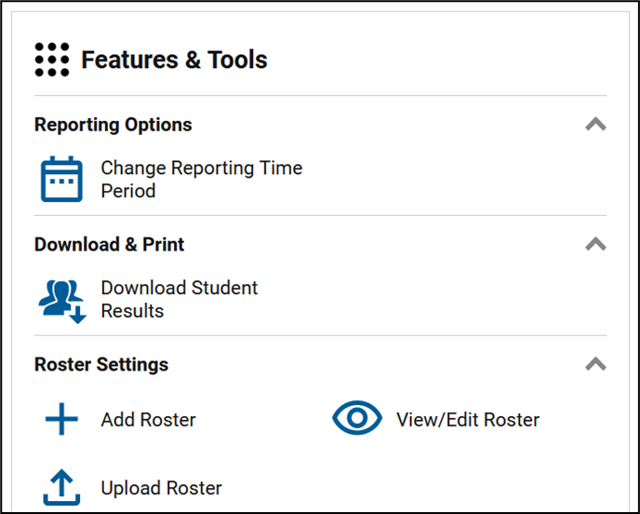
Downloadable Benchmark Report (cont.)
Using the “Download Student Results” feature in FRS, schools and districts will be able to build a file by selecting the test administration, specific assessments and students.
Users can then evaluate how the selected set of students performed on each assessed benchmark.

Slide 16
Enhanced Score Reports

Slide 17
Enhanced Reports: Science and Social Studies
Enhanced score report language for Science and Social Studies assessments will appear on student reports beginning with the Fall 2024 EOC administration.

Slide 18
Enhanced Reports – Science and Social Studies

Slide 19
Biology 1: “What These Results Mean”
Organisms, Populations, and Ecosystems See Florida State Academic Standards SC.912.L.14.7; SC.912.L.14.26; SC.912.L.14.36; SC.912.L.14.52 [SC.912.L.14.6]; SC.912.L.16.10; SC.912.L.16.13; SC.912.L.17.5 [SC.912.L.17.2, SC.912.L.17.4, SC.912.L.17.8, SC.912.N.1.4]; SC.912.L.17.9 [SC.912.E.7.1]; SC.912.L.17.20 [SC.912.L.17.11, SC.912.L.17.13, SC.912.N.1.3]; and SC.912.N.1.1 [SC.912.N.1.4, SC.912.N.1.6, SC.912.L.14.4].
Below Expectations
For example, your learner may be able to: Identify the basic structures of plant tissues and organs. Identify basic functions of the immune system and recognize that factors and/or pathogenic agents can affect individual and community health. Identify the basic anatomy of the human reproductive system and recognize some major changes that occur from fertilization to birth. Recognize that populations can be positively and/or negatively impacted by seasonal variations, succession and the amount of biodiversity in an ecosystem. Recognize that matter and energy move through an ecosystem.

Slide 20
Biology 1: “Next Steps”
Organisms, Populations, and Ecosystems See Florida State Academic Standards SC.912.L.14.7; SC.912.L.14.26; SC.912.L.14.36; SC.912.L.14.52 [SC.912.L.14.6]; SC.912.L.16.10; SC.912.L.16.13; SC.912.L.17.5 [SC.912.L.17.2, SC.912.L.17.4, SC.912.L.17.8, SC.912.N.1.4]; SC.912.L.17.9 [SC.912.E.7.1]; SC.912.L.17.20 [SC.912.L.17.11, SC.912.L.17.13, SC.912.N.1.3]; and SC.912.N.1.1 [SC.912.N.1.4, SC.912.N.1.6, SC.912.L.14.4].
Below Expectations
For example, have your learner: Practice matching the anatomy (structures) of a plant to their physiology (functions). Explore factors that affect blood flow through the cardiovascular system (e.g., diet, exercise and stress). Explore the basic functions of the immune system (e.g., recovery from a cold, vaccination response, wound healing). Practice matching the anatomy of the human reproductive system to its physiology and the major changes that occur from fertilization to birth. Analyze factors affecting population size, ecosystem changes and biodiversity. Use diagrams to trace matter through biogeochemical cycles (water cycle, carbon cycle). Describe energy pathways through different trophic levels of a food web or energy pyramid (e.g., producers, primary, secondary and tertiary consumers).

Slide 21
Interpreting the Enhanced Score Report
The information in this report is provided for students and families and is not intended for use in or as a replacement for classroom instruction.
Due to the relatively small size of each reporting category, neither individual nor combined reporting category performance should be used to infer overall performance.
A student’s overall score provides the most valid and reliable evidence of what the student knows and can do with respect to the state academic standards.
The Reporting Category Statements documents can be found on the Department website at the links below:
Grade 5 Science Reporting Category Statements
Grade 8 Science Reporting Category Statements
Civics Reporting Category Statements
Biology 1 Reporting Category Statement
U.S. History Reporting Category Statements

Slide 22
FAA Standard Setting

Slide 23
Florida Alternate Assessment: Standard Setting

Slide 24
Florida Alternate Assessment: Standard Setting
FAA―Performance Task: Standard Setting
Define the expectations associated with each performance level. These are known as the achievement level descriptions (ALDs).
Recommend cut scores for the four achievement levels.
FAA―Datafolio: Standards Validation
When there are changes to an assessment, a standards validation process is used to allow panelists to review the performance levels.​
The validation process is similar to the standard setting process, except instead of creating the performance levels, they are reviewed, then either approved or changes recommended.

Slide 25
Florida Alternate Assessment – 2024 Reporting
For the 2023–24 school year, scores were reported on the Florida Standards Alternate Assessment (FSAA) scale.
Scores from the 2023–24 school year were not used in 2023–24 school grades or accountability calculations.
The proposed scale scores aligned to B.E.S.T. Access Points are being presented to the State Board of Education today, November 20, 2024.
If adopted, new score scales will be in effect for the Spring 2024 test administrations.
Because FAA―Datafolio is only reported in the spring, if any adjustments are made to the scoring processes, they will apply to Spring 2024 results.

Slide 26
Released Tests

Slide 27
Released Tests
Section 1008.22(8), Florida Statutes (F.S.), requires the Department to publish each statewide, standardized assessment administered, excluding retakes, at least once on a triennial basis, with the initial publication occurring no later than June 30, 2024.
The initial publication of assessments was required to include, at a minimum, the grade 3 ELA Reading and Mathematics assessments, the grade 10 ELA Reading assessment and the Algebra 1 EOC assessment.
Additionally, the Department released Writing prompts and individual student Writing responses.
The Department releases public domain and commissioned passages and provide references to permissioned passages, which will not be able to be released as part of the interpretive product.

Slide 28
Proposed Released Test Timeline
Below is a proposed timeline for the release of operational tests in accordance with section 1008.22(8), F.S.
June 30, 2024 | June 30, 2025 | June 30, 2026
Grade 3 ELA Reading & Mathematics | Grade 5 ELA Reading & Mathematics | Grade 4 ELA Reading & Mathematics
Grade 6 ELA Reading & Mathematics | Grade 8 ELA Reading & Mathematics | Grade 7 ELA Reading & Mathematics
Grade 8 Science | Grade 5 Science | Biology 1
Grade 10 ELA Reading | Grade 9 ELA Reading
Algebra 1 | Geometry
Civics | U.S. History

Slide 29
Released Tests (cont.)
Each released test includes content that represents an operational test blueprint for each respective grade and subject.
Per statute, released content must have appeared on tests in the administration year immediately preceding release.
For ELA Reading and Mathematics assessments, this means content that was eligible to have been administered to students in either PM1, PM2 or PM3.
For grades 5 and 8 Science assessments and end-of-course assessments (Algebra 1, Geometry, Civics, Biology 1 and U.S. History), this means content that was eligible to have been administered to students in the spring administration immediately preceding the release.
Statute does not require FAST VPK–2 test content to be released.

Slide 30
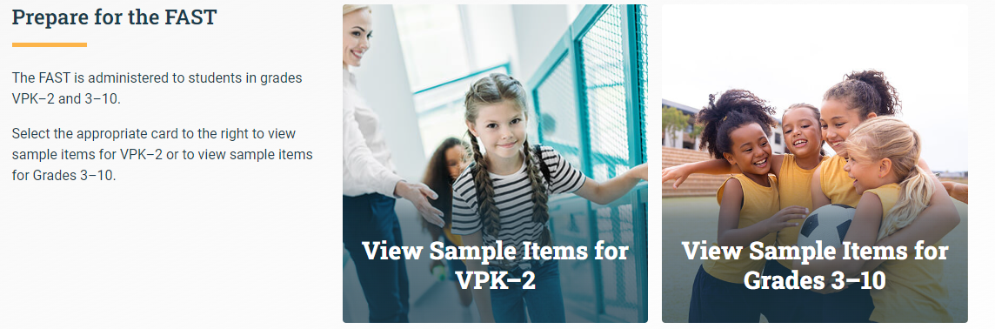
Released Tests (cont.)
Released tests are accessed through the Sample Items card on the Portal.
After you log in to the sample items site and select the grade level you want to see, select the “2024 Released Tests” tile to see the available released tests for that grade level.

Slide 31
Released Tests (cont.)
The Test Release Support Document is posted on the portal to provide additional information, including:
answer keys,
the percentage of students that answered each item correctly,
the reporting category that each item was reported in, and
item benchmark information.

Slide 32
Concordant/Comparative Scores

Slide 33
Concordant/Comparative Scores
The concordant/comparative scores currently established in Rule 6A-1.09422, Florida Administrative Code (F.A.C.), were originally adopted by the State Board of Education in July 2018 and are aligned to the Florida Standards Assessments.
In accordance with statute, now that a sufficient number of students have taken the Grade 10 FAST ELA Reading Assessment and the B.E.S.T. Algebra 1 EOC Assessment as well as various national assessments (e.g., ACT, CLT, SAT), the Department must determine new concordant/comparative scores aligned to these assessments.

Slide 34
Concordant/Comparative Scores (cont.)
Studies to determine which scores on national assessments align to the passing scores for the FAST Grade 10 ELA Reading Assessment and the B.E.S.T. Algebra 1 EOC Assessment are currently underway.
The Department anticipates presenting proposed concordant/comparative scores to the State Board of Education in summer 2025, to go into effect for the 2025–26 school year.

Slide 35
Concordant/Comparative Scores (cont.)
The following assessments are being considered:
Grade 10 FAST ELA Reading | B.E.S.T. Algebra 1 EOC*
ACT English and Reading subtests (averaged) | ACT Math
CLT10 Verbal Reasoning and Grammar/Writing sections (sum) | CLT10 Quantitative Reasoning
CLT Verbal Reasoning and Grammar/Writing sections (sum) | CLT Quantitative Reasoning
PreACT Secure Reading and English (averaged) | PreACT Secure Math
PSAT 10 Reading and Writing | PSAT 10 Math
PSAT/NMSQT Reading and Writing | PSAT/NMSQT Math
SAT Reading and Writing | SAT Math
*B.E.S.T. Geometry EOC will continue to be available as an option for meeting the Algebra 1 EOC assessment graduation requirement.

Slide 36
Implementation Timeline
Students who have already met the assessment graduation requirements via the previous concordant or comparative scores will not be required to earn the new scores that will be in place under the revised rule.
Students enrolled in high school at the time the revised scores are adopted will be able to use the old scores or the new scores.
Students who enter high school after the adoption of the new scores will be required to meet the new scores.
For information on current concordant/comparative scores, see the Graduation Requirements for Florida’s Statewide Assessments document.

Slide 37
Independent Study

Slide 38
Independent Study
Section 1008.22(14), F.S., requires an independent review of the coordinated screening and progress monitoring system, FAST, to be completed by January 31, 2025. The review must, at a minimum:
Analyze the feasibility and validity of using PM1 or PM2 results, or both, in lieu of using the PM3 score for purposes of demonstrating a passing score, promotion to grade 4, meeting graduation requirements and calculating school grades in accordance with s. 1008.34, F.S.
Provide options for further reducing the statewide, standardized assessment footprint.
Analyze the feasibility and validity of remotely administering FAST.
Look at student acceleration based on FAST results.
Look at the incorporation of content from ELA instructional materials adopted by the Commissioner of Education pursuant to s. 1006.34, F.S., in test items within FAST.
Analyze the impact of the FAST system in terms of student learning growth data as measured by the formula approved under s. 1012.34(7), F.S.

Slide 39
New Worlds Scholarships

Slide 40
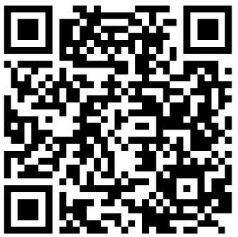
New Worlds Scholarship Accounts
Parents of eligible students have access to scholarship accounts, worth $1,200 each, for instructional materials, curriculum, part-time tutoring, summer and after-school programs to improve literacy or mathematics skills.
Effective July 1, 2024, the New Worlds Scholarship Accounts program expanded to include eligible VPK–5 students who:
have a substantial deficiency in early literacy or early mathematics skills;
have a substantial deficiency in reading or mathematics;
exhibit characteristics of dyslexia or dyscalculia; or
scored below a Level 3 on the most recent statewide, standardized ELA or Mathematics assessment.
Notes:
1 minute (4/30)
Facilitator Notes: ELLs are prioritized. HB 1361 (2024) expanded eligibility to include VPK students who have a substantial deficiency in early literacy or early math skills.

Slide 41
QUESTIONS? Catherine.Altmaier@fldoe.org

