Slide 1
Florida’s Individuals with Disabilities Education Act (IDEA)-Funded State Projects Supporting Families
2024 Florida Charter Schools Conference
Bureau of Exceptional Education and Student Services
Notes:
What/Where: 2024 Florida Charter Schools Conference - Orlando, FL
Welcome! This presentation provides an overview of Individuals with Disabilities Education Act (IDEA) funded state projects implemented by the Florida Department of Education (FDOE) Bureau of Exceptional Education and Student Services (BEESS) that support students with disabilities.

Slide 2
Florida Department of Education’s (FDOE) Mission & Vision
The mission of Florida’s Early Learning-20 education system shall be to increase the proficiency of all students within one seamless, efficient system, by allowing them the opportunity to expand their knowledge and skills through learning opportunities and research valued by students, parents and communities.
Florida will have an efficient world-class education system that engages and prepares all students to be globally competitive for college and careers.
From: Section 1008.31, Florida Statutes (F.S.), and FDOE’s Strategic Plan (2021)
Notes:
FDOE’s mission and vision places emphasis on the fact that students with disabilities are students first. READ SLIDE.

Slide 3
FDOE’s Goals
Highest Student Achievement
Seamless Articulation and Maximum Access
Skilled Workforce and Economic Development
Quality Efficient Services
From: Section 1008.31, F.S., and FDOE’s Strategic Plan (2021)
Notes:
Our goals for all students, including students with disabilities, are summed up by the FDOE Strategic Plan. READ SLIDE.

Slide 4
Title V, Chapter 19, Section 39.0016 of Florida Statutes
“Improving educational results for children with disabilities is an essential element of our public policy of ensuring equality of opportunity, full participation, independent living, and economic self-sufficiency for individuals with disabilities…”
Notes:
Title five, chapter 19, section 39.0016, Florida Statutes, states that. READ SLIDE.

Slide 5
IDEA-Funded State Projects
What are IDEA-funded state projects?
Notes:
You are probably wondering, “What are IDEA-funded state projects?”
An IDEA-funded state project is a state and/or federally funded project that provides support and services to students with disabilities.

Slide 6
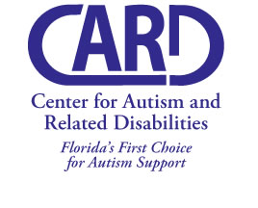
Centers for Autism and Related Disabilities (CARD)
The purpose of CARD is to enhance the lives of individuals by helping them become valued members of their communities. CARD offers free supports within the natural contexts of all settings, such as homes, child-care programs, schools, work and community businesses and programs.
Notes:
Previously approved for the ASD Contacts Meeting.
Read slide.

Slide 7
Centers for Autism and Related Disabilities (CARD)
CARD provides consultations to caregivers and professionals on how best to work with an individual with a disability to:
Teach new skills
Understand and resolve challenging behavior
Include individuals with Autism Spectrum Disorders and related disabilities in typical school and community settings
Develop meaningful communication skills
Help families find support groups
Provide trainings and informational materials
Refer families to federal, state and local service agencies
Support families in planning for the future
Train on how to work effectively with individuals with Autism Spectrum Disorders and related disabilities
Notes:
Previously approved for the ASD Contacts Meeting.
State the resources available through CARD.

Slide 8
Centers for Autism and Related Disabilities (CARD) Sites
Florida Atlantic University (FAU) http://coe.fau.edu/centersandprograms/card/index.php
Florida State University (FSU) https://fsucard.com/
University of Florida-Gainesville (UF/GV) http://card.ufl.edu/
University of Florida-Jacksonville (UF/JX) http://www.hscj.ufl.edu/pediatrics/autism/
University of South Florida (USF) http://card-usf.fmhi.usf.edu/
University of Central Florida (UCF) http://www.ucf-card.org/
University of Miami (UM-NSU) https://www.card.miami.edu/
Notes:
State the location of CARD sites.

Slide 9
Critical Initiatives in Visual Impairment (CIVI)
The primary focus and purpose of CIVI is to respond, through two initiatives, the Personnel Preparation Initiative and the Florida Low Vision Initiative. Both help to address critical issues related to services for students with visual impairments in the state of Florida.
Notes:
Read slide.

Slide 10
Critical Initiatives in Visual Impairment (CIVI) Florida Low Vision Initiative
Low vision services to students include:
Free, clinical low vision exams
Prescribed, portable near and/or distance optical aids
Training in the use of devices
Notes:
State the resources available through CIVI.

Slide 11
Critical Initiatives in Visual Impairment (CIVI)
CIVI Project Coordinator
Eileen Bischof (bischof@fsu.edu)
FLVI Project Manager
Kim Roberts (kmroberts@fsu.edu)
Online TVI Program Manager
Susan Garner (s.garner@fsu.edu)
Notes:
State the contact information for CIVI.

Slide 12
Florida Diagnostic & Learning Resources System (FDLRS)
FDLRS provides an array of instructional and technical support services to school district Exceptional Student Education programs statewide. The four central functions of each FDLRS Associate Centers are Child Find, Parent Services, Human Resource Development and Technology. FDLRS includes Associate Centers that serve all Florida's school districts. These centers collaborate with districts, agency and support personnel, administrators and students with disabilities.
Notes:
Read slide.

Slide 13
FDLRS Provided Services
Services for students include:
Child Find
FDLRS Child Find, in coordination with the school districts, locates children who are potentially eligible for services under the Individuals with Disabilities Act (IDEA) and provides service coordination for diagnostic screening, placement, training and support.
Family Services
FDLRS Parent & Family Services Specialist assist in the development of family-friendly programs, training and support for services for children with disabilities and the support of partnerships between schools and parents to support student achievement.
Resource Development
FDLRS Resources Development is available in areas of classroom behavior management, instructional strategies, differentiated instruction, Universal Design for Learning, explicit instruction, secondary transition and collaborative teaching.
Technology
FDLRS technology support personnel provide services in multiple areas including assistive technology, instructional technology, Universal Design for Learning, Accessible Educational Materials (AEM) and virtual instruction.
Notes:
State the resources available through FDLRS.

Slide 14
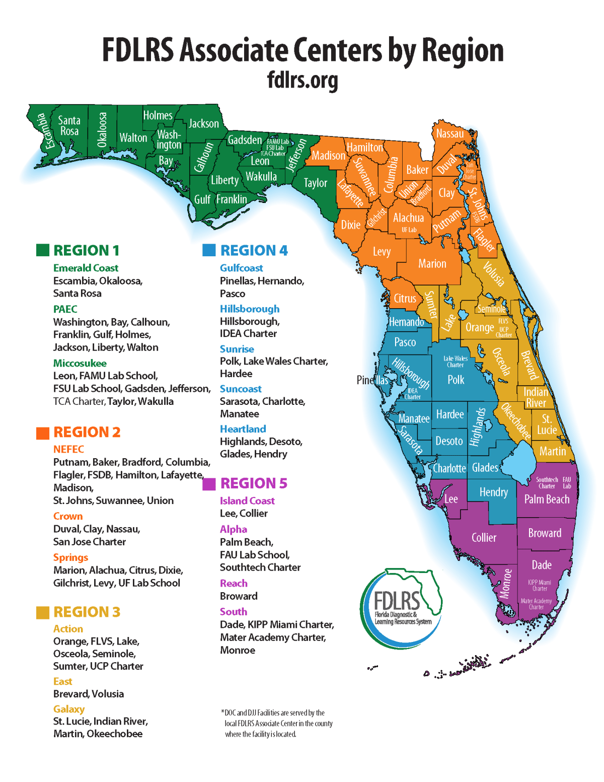
Notes:
State the location of the FDLRS sites.

Slide 15
FLDRS Multidisciplinary Centers (MDC)
A network of six regional Multidisciplinary Educational Services Centers provide multidisciplinary diagnostic evaluations for pre-school and school-aged children with complex academic, medical, emotional and/or behavioral needs.
Notes:
Read slide.

Slide 16
FLDRS MDC Provided Services
Services for children include:
Diagnostic Evaluations
Psychological assessment of children and adolescents
Specialized evaluations of children suspected of having an Autism Spectrum Disorder or Attention Disorder
Specialized evaluations for bilingual children
Audiological, speech and language evaluations
Therapeutic Interventions
School-based individual and group health services with children and adolescents
Participation on school-based intervention teams
Academic and behavioral consultations
Referral to and collaboration with appropriate community-based agencies or resources
Notes:
State the resources available through FDLRS MDC.

Slide 17
FLDRS MDC Sites
Keiser University Multidisciplinary Center (KUMDC) https://kumc.keiseruniversity.edu/
FSU Multidisciplinary Evaluation and Consulting Center https://mdc.fsu.edu/
University of Florida Multidisciplinary Diagnostic & Training Program -Gainesville (FDLRS/UF MDTP) http://mdtp.pediatrics.med.ufl.edu/
University of Florida Multidisciplinary Center -Jacksonville (UF/JX) http://www.hscj.ufl.edu/pediatrics/diagnostic-and-learning-resources/
University of South Florida Interdisciplinary Center for Evaluation and Intervention (ICEI) http://icei.fmhi.usf.edu
University of Miami Linda Ray Intervention Center (UM) https://lindaraycenter.miami.edu/
Notes:
State the location of the FDLRS MDC sites.

Slide 18
Project 10: Transition Education Network
Project 10 provides training and technical assistance, including product development and dissemination, to assist school districts and other stakeholders in building capacity to implement secondary transition at the school, district and state-level. Project 10’s mission is to improve post-school academic, employment, independent living and community participation outcomes.
Notes:
Read slide.

Slide 19
Project 10: Transition Education Network
Regional Transition Representatives
Region 1: Tracy Dempsey
tracydempsey@usf.edu
Region 2: Leigh Ann Hale
hale37@usf.edu
Region 3: Kim Thorne
kthorne1@usf.edu
Region 4: Federico Valadez
fvaladez@usf.edu
Region 5: Lisa Friedman-Chavez
Lfchavez@usf.edu
Region 6: Nicole Klees
enklees@usf.edu
Project 10 Leadership:
Donna Phillips, Ed.D. Director and Principal Investigator dphillips5@usf.edu
Franklin Coker, Ed.S. Assistant Director fjcoker@usf.edu
Notes:
State the location and contact information for the Project 10 sites.

Slide 20
Clarke Schools for Deaf and Hard of Hearing Auditory Oral Program
Clarke Schools provides children who are deaf or hard of hearing with the listening, learning and spoken language skills they need to succeed. The project focuses on children ages birth to three, preschool and early education through age 7. Clarke Schools offer in-person or tele-services including speech and language therapy, parent trainings and community resources for children and families without access to funding.
Notes:
Read slide.

Slide 21
Clarke Schools for Deaf and Hard of Hearing Auditory Oral Program
Alisa Demico, M.S., CCC-SLP, LSLS, Certified AVT Director - Clarke Schools for Hearing and Speech
ademico@clarkeschools.org
Phone: 904-880-9001
https://www.clarkeschools.org/
Notes:
State the contact information for the Clarke Schools for Hearing and Speech.

Slide 22
Debbie University of Miami School for Deaf and Hard of Hearing Auditory Oral Program
Debbie UM provides children who are deaf or hard of hearing with the listening, learning and spoken language skills they need to succeed. The project focuses on children ages birth to three, preschool and early education through age 7. Debbie UM offers in-person or tele-services including speech and language therapy, parent trainings and community resources for children and families without access to funding.
Notes:
Read slide.

Slide 23
Debbie University of Miami School for Deaf and Hard of Hearing Auditory Oral Program
Lynn W. Miskiel, M.A., CCC-SLP/A, ​
LSLS Cert AVEd​
lmiskiel@miami.edu​
Kathleen C. Vergara, M.A. CED
kvergara@med.miami.edu
Notes:
State the contact information for Debbie UM..

Slide 24
Bridge to Speech
Bridge to Speech provides opportunities for families to choose auditory oral education programs for their children who are deaf/hard of hearing ages 3 to 6. They provide faculty certified as Listening and Spoken Language Specialists. They provide full time school services, part time virtual services and support following transition to general education settings. Bridge to Speech encourages parent/family involvement and professional learning opportunities for families.
Notes:
Read slide.

Slide 25
Bridge to Speech Available through contacting the Clarke Schools or University of Miami Debbie Institute
Alisa Demico, CCC-SLP, LSLS, Certified AVT
ademico@clarkeschools.org
Lynn W. Miskiel, M.A., CCC-SLP/A, ​LSLS Cert AVEd​
lmiskiel@miami.edu​
Kathleen C. Vergara, M.A. CED
kvergara@med.miami.edu
Notes:
State the contact information for the Bridge to Speech programs at the Clarke Schools and Debbie UM.

Slide 26
Florida Instructional Materials Center for the Visually Impaired (FIMC-VI)
FIMC-VI offers a variety of free services to stakeholders. FIMC-VI supports districts in the procurement or production and distribution of accessible instructional materials (braille, large print). FIMC-VI partners with local community volunteer services for braille services. They work with American Printing House for Blind (APH) products, provide a loan library for stakeholders, hold student and family events, offer programs for the visually impaired and technical assistance to school districts.
Notes:
Read slide.

Slide 27
FIMC-VI
Elizabeth Anderson - Supervisor
eanderson@fimcvi.org
Tiffany Conrad - Coordinator
tconrad@fimcvi.org
Notes:
State the contact information for FIMC-VI.

Slide 28
Resource Materials and Technology Center for the Deaf and Hard of Hearing (RMTC)
RMTC-D/HH supports families and school personnel by researching current national and state initiatives, procuring interventions, the development of curricula and assessments and utilizing data to assist stakeholders in implementing instructional practices for students.
Notes:
Read slide.

Slide 29
RMTC
Carmelina Hollingsworth, FCCM
Project Director
c.hollingsworth@rmtcdhh.org
rmtcdhh.org
Notes:
State the contact information for RMTC.

Slide 30
Educational Interpreter Project (EIP)
The Educator Interpreter project (EIP) supports students who are Deaf and Hard of Hearing (DHH), Deaf Blind and Deaf Disabled. They collaborate with Local Education Agencies to provide supports. EIP collaborates with other IDEA funded state projects, provides workshops and hosts quarterly meetings. EIP supports educational interpreters who provide services for students who are DHH.
Notes:
Read slide.

Slide 31
EIP
Hearing Clinic Phone: 813.974.8804 FAX: 813.905.9819 hearingclinic@usf.edu | Speech Language Clinic Phone: 813.974.9844 FAX: 813.905.8928 speechclinic@usf.edu | Bolesta Center Phone: 813.974.8804 FAX: 813.905.9819 http://bolesta.cbcs.usf.edu/contact.html
LSH Advising (Tampa Campus) lshadvise@usf.edu | ASL Interpreting & Deaf Studies Advising (Tampa Campus) ASLadvise@usf.edu | Deaf Studies Minor Advising (Tampa Campus) ASLadvise@usf.edu
Hands On USF Interpreting Services (HOUSF) Phone: 813.974.1578 housf@usf.edu | Sarasota Campus Advising / BA Program Phone: 941.359.4330 cristyner@usf.edu | CSD Administration Phone: 813.974.2006 FAX: 813.974.0822
Mailing Address (Tampa Campus) Department of Communication Sciences & Disorders University of South Florida 4202 E. Fowler Avenue, PCD1017 Tampa, FL 33620-8200
Jennifer Francisco
jmfrancisco@usf.edu
Notes:
State the contact information for EIP.

Slide 32
The Multiagency Network for Students with Emotional Behavioral Disabilities (SEDNET)
SEDNET is a network of 19 regional projects that are comprised of the major child serving agencies, community-based service providers, students and their families. Within this framework, SEDNET focuses on developing interagency collaboration and sustaining partnerships among professionals and families in the education, mental health, substance abuse, child welfare and juvenile justice systems serving children and youth with and at-risk of emotional-behavioral disorders.
Notes:
Read slide.

Slide 33
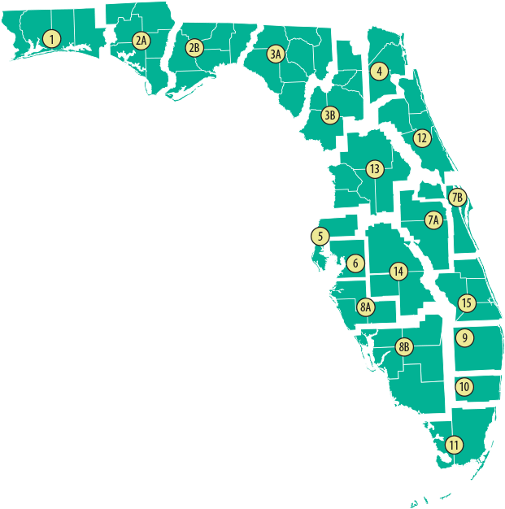
The Multiagency Network for Students with Emotional Behavioral Disabilities (SEDNET)
SEDNET Administration Project's contact information
Principal Investigator and Executive Director, SEDNET
Dr. Charlene Grecsek 140 7th Avenue South, SVB 112 St. Petersburg FL 33701 | (727) 314-3906 FAX: (727) 876-4660 cgrecsek@usf.edu
Notes:
State the contact information for SEDNET.

Slide 34
Discussion
How do charter schools contact these projects and find other resources provided by the Florida Department of Education?
Notes:
Ask question.
How do charter schools contact these projects and other resources?
Circulate in the room to hear responses from participants.

Slide 35
Thank you
Contact Information
Patricia Bodiford
Senior Educational Program Director
Bureau of Exceptional Education and Student Support Services
Patricia.Bodiford@fldoe.org
850-245-0475
www.FLDOE.org
Notes:
Thank you!

