Slide 1
Office of Professional
Practices Services
Office of Professional Practices Services:
Updates and Reminders
November 20, 2024

Slide 2
What to expect?
Today will give you a better understanding of who and what should be reported to the Office of Professional Practices Services.
What to include in your reporting packet, timely reporting and how to avoid reporting errors will be discussed.
This session will also help you build awareness and be proactive about supporting your staff in understanding recent cases and how to make good choices.

Slide 3
Section (s.) 1012.796, Florida Statutes (F.S.), Complaints against teachers and administrators; procedure; penalties
Requires the department to investigate legally sufficient complaints of educator misconduct.
Requires each charter school or private school that participates in the state scholarship program to file in writing all legally sufficient complaints on certified individuals within 30 days of knowledge.
Requires each charter school or private school that participates in the state scholarship program to provide unredacted documents to the department and all information known or collected by the district or school.
Requires the complaint and all information obtained by the department to be exempt from public record until conclusion of the investigation.

Slide 4
Legally Sufficient
“…ultimate facts which show a violation occurred as provided in s. 1012.795 and defined by rule of the State Board of Education….”

Slide 5
Who and what to report to PPS?
1.
The person holds or has applied for:
athletic coaching certificate
2
The district or school’s review substantiates all or part of the allegation is legally sufficient.
3
The legally sufficient complaint supports a violation of s. 1012.795, F.S., or 6A-10.081, Florida Administrative Code (F.A.C.).
temporary Florida educator certificate
professional Florida educator certificate

Slide 6
Section 1012.795, F.S. – Common Violations
(1)(a) - Obtained or attempted to obtain an educator certificate by fraudulent means.
(1)(b) - Knowingly failed to report actual or suspected child abuse as required in s. 1006.061, F.S.
(1)(f) - Has been convicted or found guilty of, has had adjudication withheld for, or has pled guilty or nolo contendere to a misdemeanor, felony, or any other criminal charge, other than a minor traffic violation.
(1)(p) - Has violated test security as provided in s. 1008.24, F.S.

Slide 7
Rule 6A-10.081, F.A.C. –
Common Violations (Continued)
(2)(a)1. - Shall make reasonable effort to protect the student from conditions harmful to learning and/or to the student’s mental and/or physical health and/or safety.
(2)(a)5. - Shall not intentionally expose a student to unnecessary embarrassment or disparagement.
(2)(b)3 - Shall not use institutional privileges for personal gain or advantage.
(2)(b)4. - Shall accept no gratuity, gift or favor that might influence professional judgment.

Slide 8
Rule 6A-10.081, F.A.C. –
Common Violations (Continued)
(2)(c)1. - Shall maintain honesty in all professional dealings.
(2)(c)8. - Shall not submit fraudulent information on any document in connection with professional activities.
(2)(c)13. - Shall self-report within forty-eight (48) hours to appropriate authorities (as determined by district) any arrests/charges involving the abuse of a child or the sale and/or possession of a controlled substance.

Slide 9
What to include in your reporting packet?
Reporting Form
Investigative Report
Victim / Witness Statements
Employment Action (if any)
Class / Team / Field Trip Roster
Evidence

Slide 10
Evidence
Photographs / Videos
Communications
  Emails
  Text Messages
  Letters / Cards
Financial Records / Audits
Documents
Testing Information
Reasonable Suspicion Observation Forms

Slide 12
Contact Information
Office of Professional Practices Services (PPS)
325 West Gaines Street, Suite 224
Tallahassee, Florida 32399-0400
850.245.0438
www.myfloridateacher.com

Slide 13
Rule 6A-10.084, F.A.C.,
Disqualification List
Office of Professional Practices Services:
Updates and Reminders
November 20, 2024

Slide 14
Purpose of the Disqualification List
The Disqualification List includes all educational support employees, instructional personnel and administrative personnel who have been convicted of a disqualifying offense or engaged in sexual misconduct with a student.
The rule went into effect on June 1, 2022.
The rule sets forth the criteria for placing a qualified individual on the Disqualification List and removal from the list, as well as the responsibilities of the employing entities that report persons for inclusion on the list.
Notes:
We will be reviewing the purpose of the Disqualification List, the Disqualification List Database, how to search the database and how to submit an individual for inclusion on the Disqualification List.

Slide 15
Roles of Reporting Entities
It is the responsibility of a reporting entity to:
    1. Ensure that only persons subject to the list as set forth in this rule are submitted to the department for placement on the Disqualification List;
    2. Designate a person responsible for providing information and responding to department inquiries related to the Disqualification List; and
    3. Provide written notice to any person submitted for inclusion on the Disqualification List.
Notes:
The reporting entity will be responsible for ensuring that qualified individuals are submitted to the Department for inclusion on the list and designating a person to be responsible for submitting information and responding for additional requests. In order for an employing entity to report an individual, they will be required to issue either a Final Order or Final Report, that includes appeal notice, outlining the individual’s misconduct. Both Charter Schools and Private Schools who accept scholarship funds are reporting entities.

Slide 16
Roles of Reporting Entities (continued)
    4. Review the Disqualification List prior to hiring any employee. Individuals on the Disqualification List are disqualified from employment with any school district, charter school, or private school that participates in the state scholarship program.
Notes:
The reporting entity will be responsible for ensuring that qualified individuals are submitted to the Department for inclusion on the list and designating a person to be responsible for submitting information and responding for additional requests. In order for an employing entity to report an individual, they will be required to issue either a Final Order or Final Report, outlining the individual’s misconduct. Both Charter Schools and Private Schools who accept scholarship funds are reporting entities.

Slide 17
Role of the Department
It is the responsibility of the department to:
1. Host the site for the Disqualification List and serve as the administrator for the list;
2. Notify reporting entities of any additional information needed in order for the department to include a person on the list; and
3. Consider requests for removal from the list.
Notes:
The website for the Disqualification List will be monitored by the Department and each employing entity will have log-in credentials. Some of the information that will need to be provided by the employing entity include the employee’s: Name, Last 4 Digits of the SSN, Date of Birth, Name of Employer, Separation Type, Violation Type, and Date of Separation. There will also be a comment section for additional information.

Slide 18
Who will be included on the list?
Employees who have engaged in sexual misconduct with a student;
Employees who have a qualifying disposition for an offense listed in s. 435.04, F.S., as required by s. 1012.315, F.S.; or
An individual whose authority to own or operate a private school in this state has been permanently denied or revoked by the Commissioner of Education.
Notes:
School Districts, Charter Schools, and Private Scholarship Schools are required to report employees who have engaged in sexual misconduct with a student or have a qualifying disposition for an offense listed in section 1012.315, F.S. The Commissioner of Education will be required to report individuals whose authority to own or operate a private school has been permanently denied or revoked. Please note that the underlying conduct must have occurred after June 1, 2022.

Slide 19
Who will be included on the list? (continued)
An educator who has had their Florida Educator Certificate permanently revoked by the Education Practices Commission.
An individual who has been permanently denied a Florida Educator Certificate by the Education Practices Commission.
Notes:
.

Slide 20
Steps to ‘Log In’ to the Database through Single Sign-on (SSO)
https://portal.fldoesso.org/PORTAL/Sign-On/SSO-Home.aspx
Contact the local information technology (IT) administrator for access to the ‘Staff Terminations and Disqualification List’ application. You can find the contact information on the SSO support page.
http://fldoe.org/disqualificationlist
Notes:
The link at the top of the page will take you to the Single Sign-on Portal. Prior to use, District and Charter Schools will need to Read Bullet.
The second link also take you to the Single Sign-on Portal.

Slide 21
Steps to ‘Log In’ to the Database through Single Sign-on (SSO) (Continued)
https://portal.fldoesso.org/PORTAL/Sign-On/SSO-Home.aspx
Private School users need to send an email to Randy.Kosec@fldoe.org with the following information to gain an account:
  User Name / Title
  Email Address
  School Name
  School ID Number
  Telephone Number
  County in which the school is physically located
Notes:
The link at the top of the page will take you to the Single Sign-on Portal. Prior to use, Private Schools will need to Read Bullet.
The second link also take you to the Single Sign-on Portal.

Slide 22

Single Sign-on Page
Notes:
Once at the Single Sign-on Page, select “Educators” tile.

Slide 23

Single Sign-on Page (continued)
Notes:
Next you will need to select your District from the list on the right-hand side of the page.

Slide 24
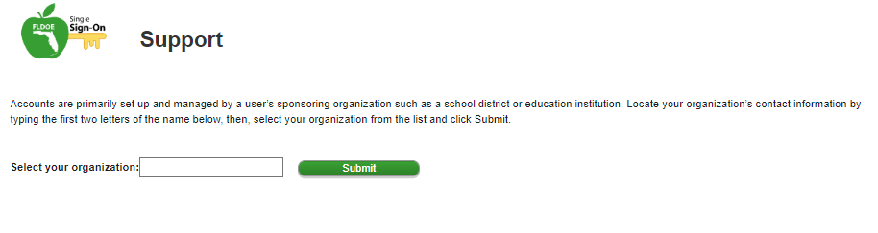
Single Sign-on Support
https://portal.fldoesso.org/PORTAL/Sign-On/Resources/Support.aspx
User Roles:
SSO Role/Group Name | Description
DQ Charter Users | Charter school users
DQ Comm Office Users | Commissioner’s office users
DQ District Users | District users
DQ DOE Admin Users | Florida Department of Education (FDOE) Admin users
DQ EPC Users | Education Practices Commission (EPC) users
DQ Private Users | Private school users
Notes:
The “support” page will allow you to enter your District’s name and search for your District’s Single Sign-on administrator’s contact.

Slide 25
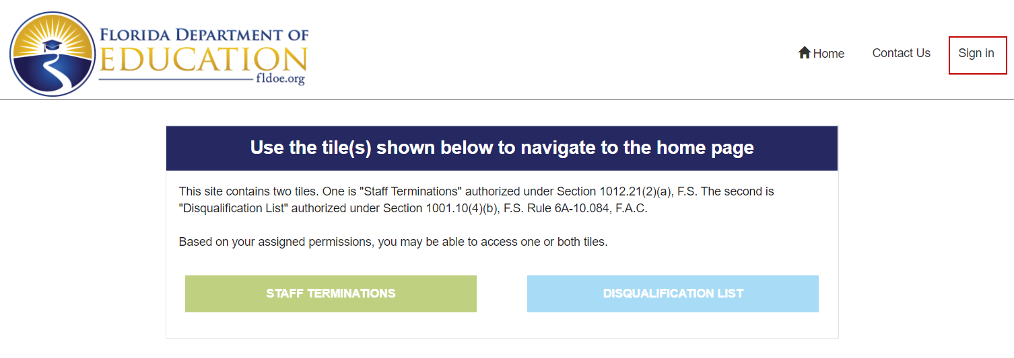
Notes:
Now you will be at the “Sign In” page. In the upper right, click Sign In and enter your credentials.

Slide 26
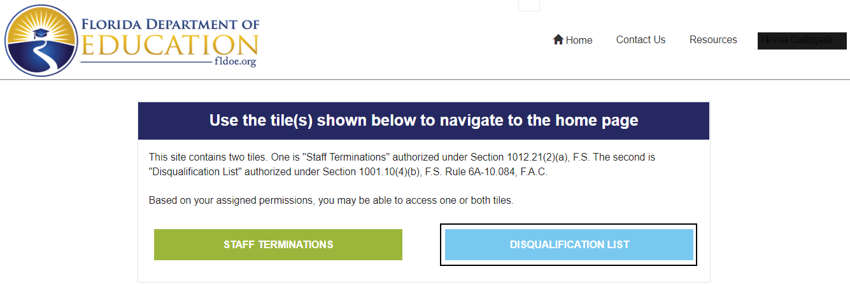
Database Location
Click
Notes:
You will now click “Disqualification List.”

Slide 27
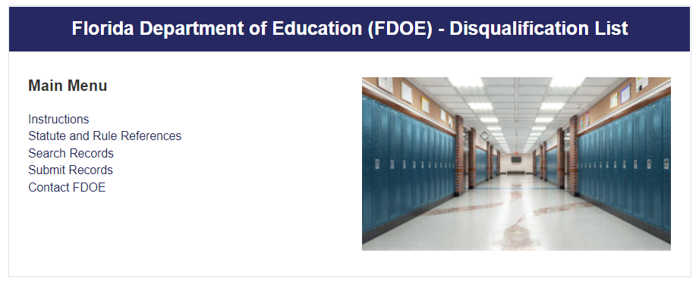
Main Menu (continued)
Notes:
To search records, click “Search Records.”

Slide 28
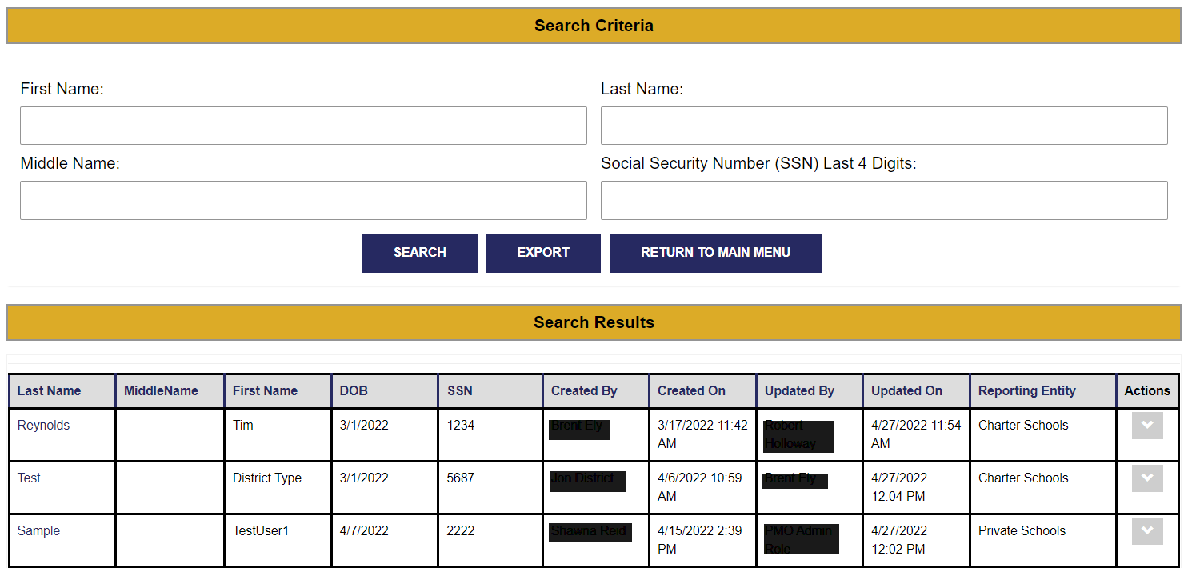
Searching Records
Notes:
Once you have clicked “Search Records” you will be able to search by any of the four (4) criteria.
First Name
Last Name
Middle Name
Social Security Number (Please note, only the last four (4) digits)
By using more “Search Criteria,” you will come up with smaller “Search Results.” Once you have entered your “Search Criteria” click “Search.”

Slide 29
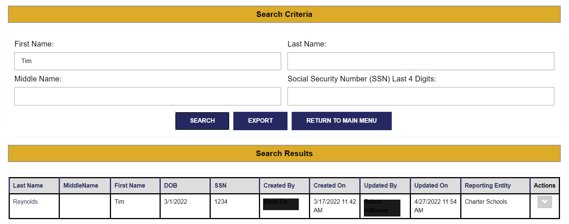
Search Results
Notes:
As you can see, the search results include additional data including the individual’s date of birth, when and who created the record, when and who updated the record and actions. Please note, that the “Created By” would be the employing entity and where the “Affidavit of Separation” would be retained.
Also, you may leave the “Search Criteria” blank and click “search.” This will populate a “master list” with all individuals included on the Disqualification List.
The search results will appear in an exportable format, should you need to use the search results.
The “Actions” will allow you to view the individual’s record and details.

Slide 30
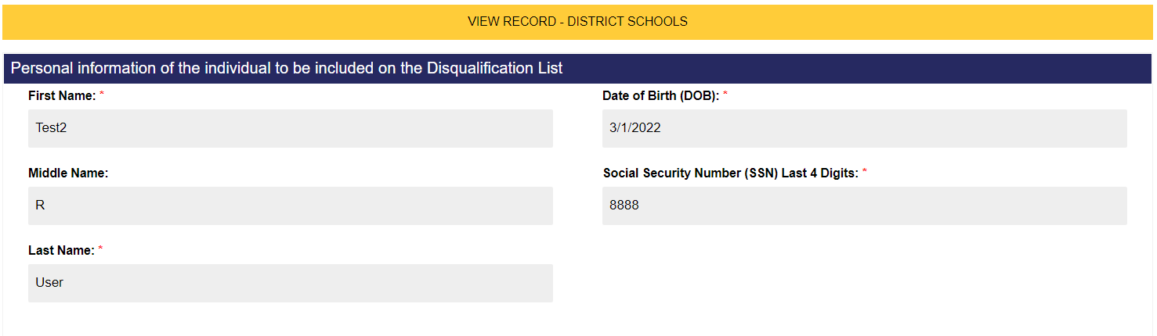
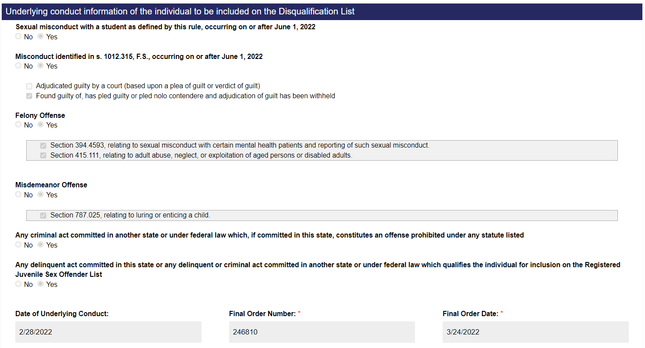
Notes:
Once in the “Actions” screen you will first see the individual’s personal information.
The second section will contain information regarding the “underlying conduct” that lead to the individual’s inclusion on the Disqualification List. Please note that this will be the same information that employing entities will be required to submit.

Slide 31
Main Menu (continued)
Notes:
To submit an individual for inclusion on the Disqualification List, click “Submit Records.”

Slide 32
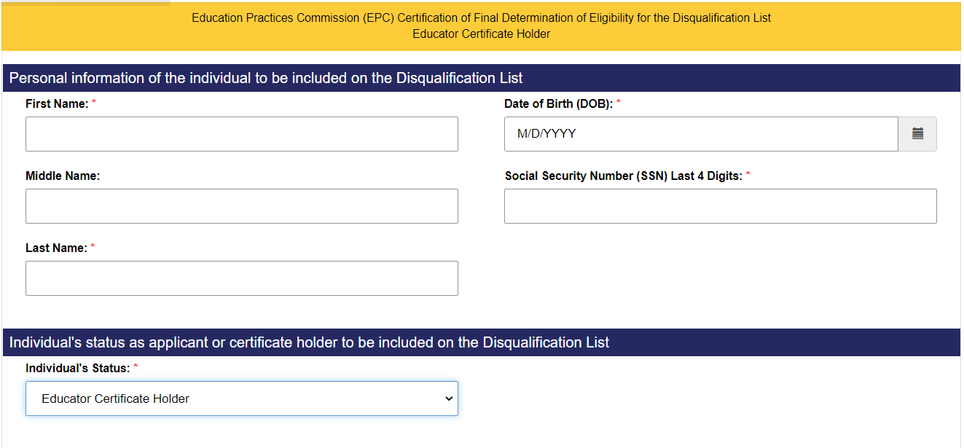
Submit Records
Notes:
Once you select “Submit Records” the employing entity will be taken into their screen. You will notice that in the gold bar, it says Education Practices Commission. This bar will change based on the user to reflect if they are a Charter School, District School or Private School. All of the requested information is nearly identical to ensure consistency.
Please note, that the employing entity is required to complete all fields with an asterisks.
First Name
Last Name
Date of Birth
Social Security Number (Last four (4) digits)
One difference listed here that will only apply to the Education Practices Commission, is they must select if the individual being submitted is an applicant or a certified educator. Charter Schools, District Schools and Private Schools will only be reporting employees, so this field would not be applicable to them.

Slide 33
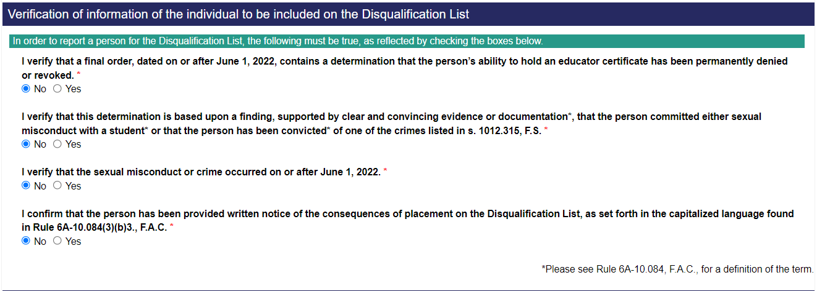
Submit Records (continued)
Notes:
Please note that all four (4) confirmations and verifications are required by Rule 6A-10.084, F.A.C.; therefore, “yes” must be selected before the record can be submitted.
Read Questions

Slide 34
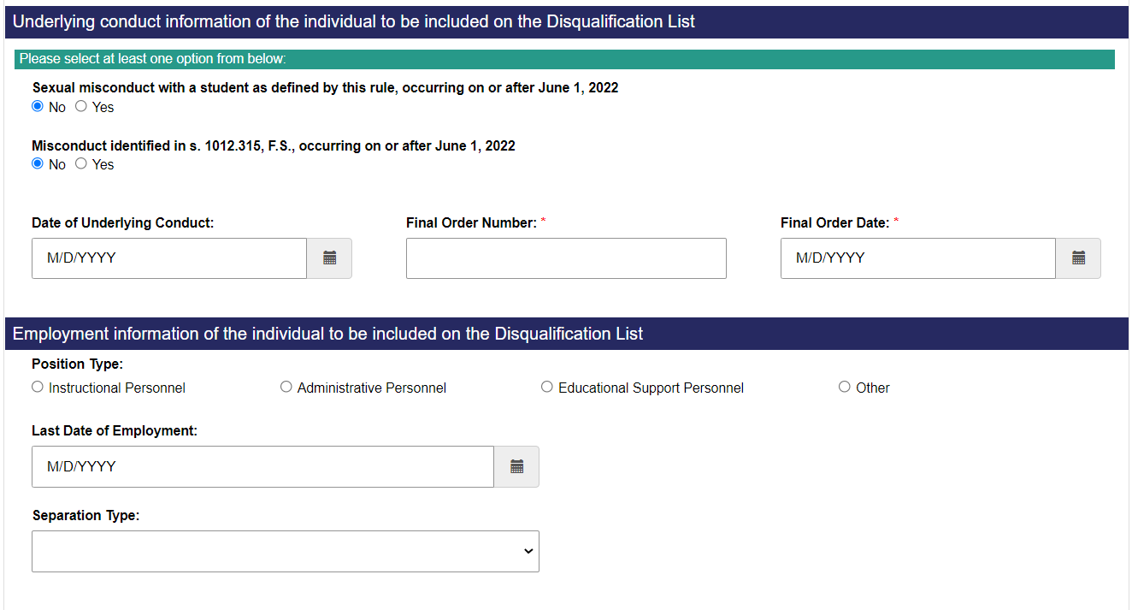
Submit Records (continued)
Notes:
In the Underlying Conduct Information section, the required Final Order Number and Final Order Date will appear for District Schools and the Education Practices Commission users. Users for Charter Schools and Private Schools will see Final Report Number and Final Report Date.
Employing entities should be able to complete all of the information requested in the Employment Information section; however, users for the Education Practices Commission may not be able to complete all entries.

Slide 35
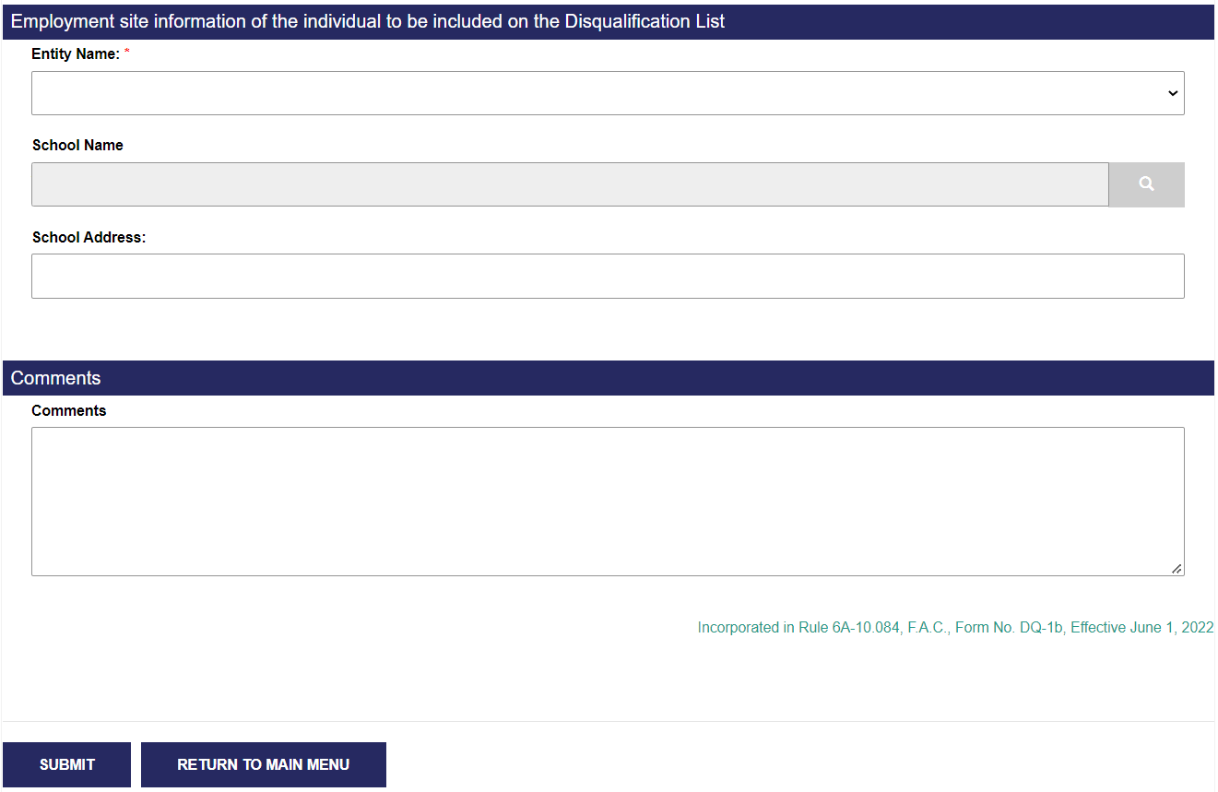
Submit Records (continued)
Notes:
Employing entities should be able to complete the Employment Site Information. The “School Name” will be a searchable field based on the employing entity type. District Schools will only see the schools associated with their District. They will also be able to select the District Office for individuals who do not have a “home school” such as maintenance workers.
Charter Schools and Private Schools will only be able to select from schools identified by the Office of School Choice.
Users are able to add any additional comments before clicking “Submit.” Please note that all entries will not be saved unless “Submit” is clicked. Once an individual has been submitted to inclusion onto the Disqualification list, the Office of Professional Practices Services must first review and approve the submission for the individual to appear on the Disqualification List.

Slide 37
Notes:
I am happy to take any questions at this time.

Slide 38
Background Screenings and Fingerprints
Office of Professional Practices Services:
Updates and Reminders
November 20, 2024
Notes:
Good morning,
On October 14, 2022, DPS Memo #: 2022-151, was distributed regarding Legislative changes to background screenings and fingerprints.

Slide 39
2023 Legislative Changes to Background Screenings and Fingerprints
Beginning on March 1, 2025, or when the Agency for Health Care Administration (AHCA) determines, the definition of “specified agency” in s. 435.02(7), F.S., will be amended to include:
  The Department of Education
  Each District Unit under s. 1001.30, F.S.
  Special District Units under s. 1011.24, F.S.
  The Florida School for the Deaf and the Blind
  The Florida Virtual School
  Virtual instruction programs
  Charter schools
Notes:
On March 1, 2025, or when the Agency for Health Care Administration determines, the definition of “specified agency” will be changed to include the educational entities listed.
By using the Clearinghouse, “Specified Agencies” will all be able to access the fingerprint results for individuals already included in the Clearinghouse. If an individual has been fingerprinted by District A for a teaching position, but will also now be coaching in District B, District B will be able to access the fingerprints in the Clearinghouse.
Additionally, if a mental health counselor was fingerprinted by the Department of Health, you would be able to access their fingerprints when hiring them to provide services in your school.

Slide 40
2023 Legislative Changes to Background Screenings and Fingerprints (continued)
  Hope operators
  Private schools that participate in scholarship programs
  Alternative schools under s. 1008.341, F.S.
  Regional workforce boards providing services
  Local licensing agencies approved pursuant to s. 402.307, F.S.

Slide 41
2023 Legislative Changes to Background Screenings and Fingerprints (continued)
The previously mentioned educational entities will be granted access to the Care Provider Background Screening Clearinghouse operated by the AHCA.
The Clearinghouse will not be operational until March 1, 2025, at the earliest.
Education staff will be phased into the Clearinghouse based on the “rescreening” schedule.
Notes:
The Clearinghouse will not be accepting fingerprint results for educational entities until March 1, 2025, at the earliest.
Fees will be similar prices, but the $6.00 per year retention fee, will have to be paid up front for 5-year increments.
According to AHCA, once an educator is added to the Clearinghouse, the employer will have access to “hit” notifications from both FDLE. Beginning in June of 2025, the employer will begin receiving “hit” notifications from the FBI.

Slide 42
2023 Legislative Changes to Background Screenings and Fingerprints (continued)
Once the Clearinghouse is accepting educational employees:
  Charter schools and alternative schools will no longer be required to file fingerprints with their local school district.
  Background and employment screenings will be conducted by each employing entity.
Notes:
The Department of Education, Florida Department of Law Enforcement and the Agency for Health Care Administration will provide additional information and guidance regarding the Clearinghouse as it becomes available.

Slide 44
Notes:
I am happy to take any questions at this time.

