Slide 1

Beyond the Checklist: Mastering Compliance and Monitoring in Charter Schools
Dr. Kia Sweeney Scott, FACSA President
Marianne Blair,
FACSA Executive Director

Slide 2
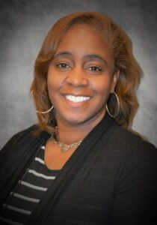
SPEAKER BIO- Kia Scott, Ed.D
Career Path
Newark, New Jersey
  Teacher
  Whole School Reform Facilitator
  Literacy Coach
Academic Manager – school for at-risk girls
Orange County Public Schools
  Senior Administrator
  Director
  Senior Director for School Choice Services
Professional Experience & Education
FDOE CSP Grant Reviewer
FDOE Charter Appeal Commission
Florida Association of Charter School Authorizers (FACSA)
KIPP Leadership Design Fellowship
Orange County Public Schools Leadership Development Program
BA – Howard University
MA – Fairleigh Dickinson University
Ed.D – Walden University

Slide 3
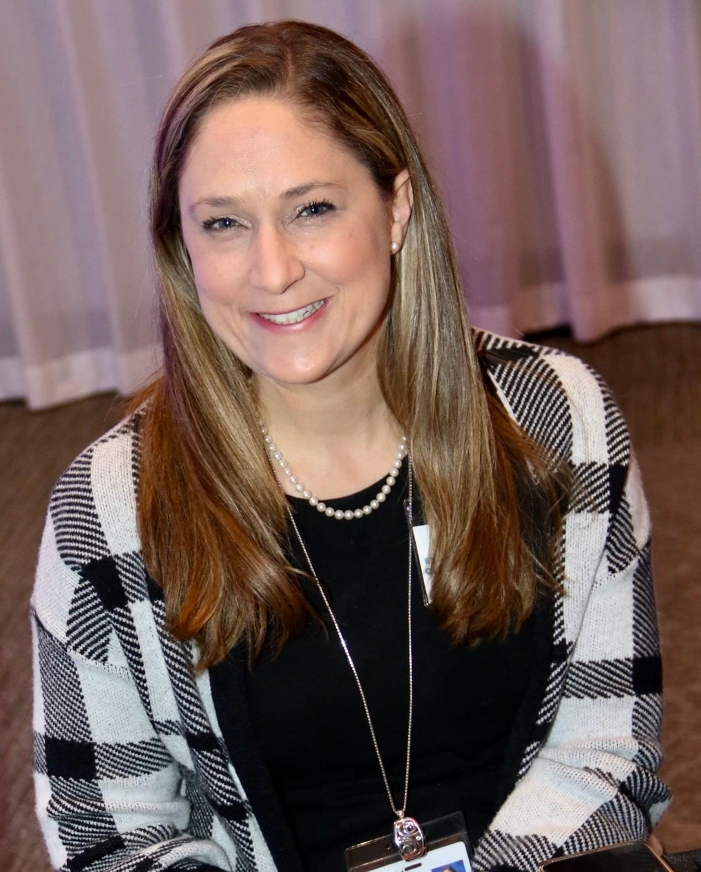
SPEAKER BIO- Marianne Blair, M. Acc.
Career Path
Business Ed. Teacher and Academy Coordinator, Pine Ridge High School, Deltona FL
Adjunct Professor, Stetson University
Specialist of Industry Certification and Career Tech Ed. Curriculum, Volusia County Schools
Specialist of School Choice, Volusia County Schools
Professor of Accounting, Stetson University
FACSA, Executive Director
Professional Experience & Education
FACTE Presenter and Teacher Mentor
Florida Association of Charter School Authorizers (FACSA), Director
BA – Stetson University
M. Acc.– Stetson University
CPA Candidate 2024

Slide 4

Presentation Agenda
OVERVIEW OF PRESENTATION GOALS
Understand compliance, charter law and best practices
Explore strategies for oversight
IMPORTANCE OF COMPLIANCE IN CHARTER SCHOOLS
Protects student interests
Ensures funding and support
Shift from reactive to proactive approaches

Slide 5

The Regulatory Landscape
FEDERAL, STATE, AND LOCAL FRAMEWORKS
Florida Charter Law
Florida Principles and Standards Framework
Key players: authorizers, state departments, school boards, and governing boards
IMPORTANCE OF UNDERSTANDING REGULATORY LANDSCAPE
Navigating complexities for effective oversight
Ensuring alignment with educational goals

Slide 6

FLORIDA Charter Law
FS 1002.33 is the Charter School Statute that provides details for both Operators And Authorizer Responsibilities
FS 1002.33(5)(b) STATES THE SPONSOR’S DUTIES:
Authorizing
Oversight And Monitoring Of Compliance
Technical Support

Slide 7

Charter Law – Oversight F.S. 1002.33
F.S. 1002.33(2): GUIDING PRINCIPLES; PURPOSE
F.S. 1002.33(5): SPONSOR DUTIES
The sponsor shall monitor and review the charter school in its progress toward the goals established in the charter.

Slide 8
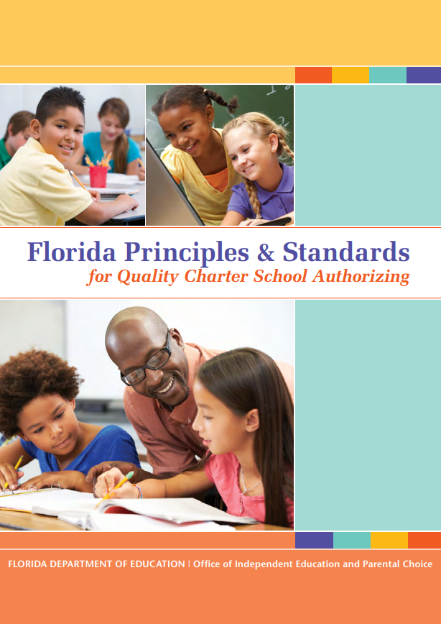
Standard 4 – Ongoing Oversight and Evaluation
A QUALITY SPONSOR:
Conducts contract oversight that competently evaluates performance and monitors compliance
Ensures schools’ legally entitled autonomy
Protects students' rights
Informs intervention
Termination, and renewal decision
Provides annual public reports on school performance

Slide 9

Moving Beyond Compliance
Defining Compliance vs. Oversight
  Compliance: meeting minimum requirements
  Oversight: proactive and continuous monitoring
The shift towards proactive monitoring
  Emphasis on improvement over mere adherence
  Engaging stakeholders in the process
  Encouraging innovation and best practices
  Cultivating leadership and accountability

Slide 10
Why is Monitoring Important?
Accountability: Ensures charter schools meet the performance standards and goals outlined in their charters.
Compliance: Verifies adherence to legal and regulatory requirements.
Financial Oversight: Protects public funds by ensuring proper financial management and transparency.
Educational Quality: Maintains high educational standards and improves student outcomes.
Equity: Ensures that all students, regardless of background, have access to quality education and resources.
  Overall, effective monitoring helps maintain the integrity, quality, and efficiency of charter schools.​

Slide 11
Overseeing Academic, Financial, and
Operational Performance
Prioritizing Academic Performance*
Financial and Operational Performance*
Building Relationships
By working together, organizations and charter schools can leverage their strengths and address common challenges, ultimately leading to a more effective and equitable education system.
*Required per F. S. § 1002.33(5): Sponsor Duties

Slide 12
Developing Robust Monitoring Systems
Creating dashboards for easy access to metrics
Key Components of Effective Monitoring
Comprehensive data collection and analysis
Regular audits and assessments
Continuous evaluation processes
Establishing feedback mechanisms
Utilizing peer reviews and self-assessments
Data-driven decision-making strategies
Leveraging technology for real-time data

Slide 13

When Does Monitoring Take Place?
Monthly Monitoring
Renewal Process
    Required in statute to monitor charter contract at end of term (five years initially)
High Stakes Review

Slide 14
MONITORING ACADEMIC PERFORMANCE
ANNUAL ACADEMIC REVIEW TIMELINE
STATUTORY REQUIREMENTS
Year 1
By October 15 of the first year, the school provides achievement goal
Year 2:
By October 15 of the second year, the school provides achievement goals for the remaining years, up to maximum of four years or the end of contract term
Ongoing
Annually, the school reports its performance against the academic goals
Annually
Sponsor must review academic goals within 30 days of receipt
F.S. § 1002.33(2): Guiding Principles; Purpose
F. S. § 1002.33(8): Causes for Nonrenewal
The sponsor shall make academic achievement for all students the most important factor
F. S. § 1002.33(5): Sponsor Duties
Monitor and review the charter’s progress toward the goals established in the charter
Florida Standard Contract: Section 2 – Academic Accountability
The annual objectives must include goals around growth and proficiency on state assessments

Slide 15

Examples of Compliance Monitoring and
Oversight Practices
Financial Performance
Operational Performance
Enrollment
Health and Safety
Fire, building, health, and food service inspections
Marjory Stoneman Douglas requirements
Mental health plans
Governance: board meetings, board actions
Monthly and quarterly reports
Annual financial audit from each charter school
Federal funds and grants

Slide 16

What Tools are Used to Monitor
Charter Schools?
Pre-Opening Checklist
Annual Report
Compliance Monitoring Software Program
Site Visit Resources
Renewal Package
Monitoring Checklists and Tools
School Accountability Reports

Slide 17
Conducting Site Visits
Sponsors conduct site visits for different purposes.
Builds communication between the authorizer and charter school
Observes the education program and operations in action
Informs continuous improvement for charter schools
Provides additional data to assess progress toward charter goals
Informs the annual report and renewal decision

Slide 18

Site Visit Activities
School walk-through: walk through of school to observe school culture, facility, safety, learning environment
Classroom observations: observe fidelity to their model and best practices for instructing students with disabilities and English learners
Document review: review documents such as:
  IEP records
  teacher credential documents
  school safety plans
  enrollment documents

Slide 19

Effective Communication Strategies
BUILDING TRANSPARENT RELATIONSHIPS
Regular updates and reports to stakeholders
Open lines of communication with families and communities
IMPORTANCE OF COLLABORATION AMONG STAKEHOLDERS
Engaging teachers, parents, and community leaders
Establishing advisory councils or committees
Setting expectations for reporting
Utilizing various channels (meetings, newsletters, social media)

Slide 20


Compliance Frameworks in Colorado and California
https://nn4da.org/
OVERVIEW OF COMPLIANCE IN COLORADO
Key regulatory bodies: Colorado Department of Education (CDE), State Charter School Institute
Primary legislation: Colorado Charter Schools Act
Accountability measures: performance frameworks based on academic achievement, growth, and financial health
Key compliance areas: enrollment practices, financial reporting, and special education requirements

Slide 21

Compliance Frameworks in Colorado and California
https://nn4da.org/
OVERVIEW OF COMPLIANCE IN CALIFORNIA
Key regulatory bodies: California Department of Education (CDE), local school districts as authorizers
Primary legislation: California Charter Schools Act of 1992
Accountability measures: charter renewal criteria focusing on academic outcomes and fiscal solvency
Key compliance areas: transparent governance, student demographics, and accountability plans

Slide 22

Compliance Frameworks in Colorado and California
https://nn4da.org/
Comparative Insights
Differences in authorizer roles and oversight mechanisms
Emphasis on community engagement and stakeholder input in both states
Importance of adapting to state-specific regulations for effective management

Slide 23
Key Takeaways
Summary of Insights
Importance of a balanced interpretation of regulations
Proactive strategies lead to better outcomes
Actionable steps for participants
Immediate steps to implement in their schools
Resources for continued learning and development
Call to Action
Encourage networking among attendees
Promote sharing of best practices post-presentation

Slide 24

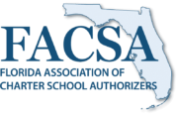
Thank you
What questions do you have?

