Slide 1

Developing and Maintaining a Support System:
How School Leaders and Board Members Can Work as a Team
FCSC + SCS 2024

Slide 2

Welcome and Introduction
Kathleen Schoenberg, attorney with the Arnold Law Firm, a full-service law firm serving charter schools throughout Florida, www.arnoldlawfirmllc.com
FDOE approved governance trainer who has provided governance training to charter schools since 2003.

Slide 3
Panelists
Dr. Kristine Bennett, Board Member, Terrace Community Middle School
Dr. Sherika Evans, Former Executive Director, Suncoast School for Innovative Studies
Christine Mentis, Governance Program Director, Florida Charter Institute

Slide 4
Agenda
Common problems and how to avoid them.
Building trust between the board and the school management.
Elements of an exceptional board.
Panel discussion.

Slide 5
Common Problems
School leaders feel that the board is not doing enough, or that the board is involved with issues that should be handled by school management.
Board members feel that the school leader is over-stepping his/her authority or not providing the board with sufficient information.
No clear division of roles and responsibilities which can lead to dissension.
Perception of lack of professional competence in areas such finance, management or operations.
School leaders feel that the board members are micro-managing the school.

Slide 6
Examples of Micromanaging
Hiring/firing/disciplining employees (who don’t report to the board).
Routinely stopping by the school during school hours to “see how things are going.”
Contacting school faculty and staff directly to discuss their job performance.
Publicly second guess the school leader’s decisions.
Deciding that the school needs different vendors.

Slide 7
Avoidance of Common Problems
What does it mean to serve on your school’s board?
Expectations and time commitment.
Orientation and training – role of governance versus management.
Trust between board and school leader.

Slide 8
Governance vs. Management
There should be clear communication about:
How the board defines it roles and responsibilities.
How the board defines the roles and responsibilities of the school leader.
How the board views the working relationship between itself and the school leader.
Written job descriptions.

Slide 9
Governance vs. Management
Clearly define how the relationship between the board and the school leader works:
Responsibility | Board of Directors | School Leader
Finance | Approves annual budget Reviews financial reports Adopts financial policies Ensures internal controls are in place | Prepares annual budget with input from staff and finance committee Oversees preparation of reports Implements financial policies Implements financial controls

Slide 10
Building Trust
A charter school has the challenge of creating a culture of trust that survives a changing membership.
What is a culture of trust?
  Board members and school leaders can openly discuss/disagree without hurt feelings.
  Board must be able to rely on the information it is given.

Slide 11
Mechanisms for Building Trust
Providing easy access to the school’s organizational and financial documents.
Incorporating a culture of positive dissent in board meetings.
Welcoming honest feedback in annual evaluations of the school leader.
Welcoming honest feedback in evaluating the board; engaging in self-assessment.
Developing a culture of inquiry.

Slide 12
Exceptional Boards:
Are energized by a deep commitment to the work of the school.
Seek to add value.
Purposefully develop the elements of board leadership, structure and practices.
Develop individual board members and the board as a whole.
Strive to promote a working environment that encourages collaboration, engagement, trust, respect and flexibility.

Slide 13
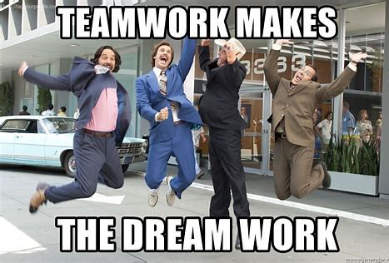

Slide 14
Panel Discussion
Dr. Kristine Bennett, Board Member, Terrace Community Middle School
Dr. Sherika Evans, Former Executive Director, Suncoast School for Innovative Studies
Christine Mentis, Governance Program Director, Florida Charter Institute
Teamwork is the ability to work together toward a common vision. The ability to direct individual accomplishments toward organizational objectives. It is the fuel that allows common people to attain uncommon results.
-Andrew Carnegie

Slide 15
Contact Information
Kathleen W. Schoenberg, Esq.
Tel: (561) 350-3343
E-mail:
kathleen@charterschooltraining.com
kathleen@arnoldlawfirmllc.com
www.charterschooltraining.com
www.arnoldlawfirmllc.com

