Slide 1

FCEE BUDGET GAME
Fall Budget Game: August 5, 2024 – December 27, 2024
Spring Budget Game: January 10, 2025 – May 30, 2025
NATIONAL BUDGETING SIMULATION

Slide 2


A GREAT WAY TO TEACH THIS ESSENTIAL CONTENT

Slide 3

PLAYING THE GAME
PAY YOURSELF FIRST
LIVE A BALANCED LIFE
The goal of the game is to build an emergency savings fund with monthly savings targets
Students also learn about building their credit score by keeping a healthy balance of debit and credit
They learn to make responsible buying decisions that balance their needs and their wants.
Students will be encouraged to invest in products and services that foster a higher quality of life.

Slide 4

HOW IT WORKS
Students take on the role of a college student with a part-time job for 6 months
Then in a full-time job for 12 months
They manage variable income and expenses while trying to strike a balance between working, studying and socializing
Teachers get a birds-eye view of their class activity with summary reports showing decision breakdowns and overall financial health for every student

Slide 5

GET THE MOST
OUT OF THE GAME
Throughout the semester, students experience 18 simulated months.
Each month takes about 20 minutes to complete
At the start of each simulated month, students review their fixed monthly expenses and the weekly income from their job. They also set a savings goal.

Slide 6

REALISTIC AND EASY TO USE
Students navigate their day-to-day life, incurring daily expenses and earning extra money while trying to increase their net worth and savings
Regular tasks include transferring money from checking to savings, paying off their credit card on time, improve their credit score, and making work versus socializing decisions

Slide 7

DECISIONS MATTER
Student choices throughout the game will have a big impact on their overall financial health.
Going cheap on their car insurance might help this month’s cash flow, but next month might bring a fender bender putting the student in the red.
Students must pay their bills on time to avoid penalties and an erosion of their credit score.

Slide 8
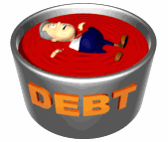
CURRICULUM
Seamlessly integrated into the game are pop-up quizzes that must be completed to continue, introducing topics like:
Needs vs. Wants
Credit Card Debt
Net Worth
Variable Expenses
Mortgages

Slide 9

CURRICULUM
Additional assignments include articles, videos, interactive calculators, and assessments with easy reporting for progress reports. Some examples:
What is a Stock?
Budgeting and Spending Skills
Preparing for Retirement
Starting a Business
Buy vs. Lease Calculator

Slide 10

MINI-GAME FEATURES
Interactive mini-games teach students skills like issuing their first check
Earn more money with puzzle games when students pick up extra hours at work.

Slide 11

INTEGRATING THE GAME
INTO YOUR CLASSROOM
Each simulated month of assignments takes around 10 minutes to complete
Teachers can have students play the game all at once or schedule time each week to play a portion of the game.
Students can view each other’s badges and game score rankings.

Slide 12

SETTING UP THE GAME
Go to floridasms.com
Hit the big red “Teachers-register for free” button.
Fill out the registration form noting that you’ll have access to both games.
Each student will need a unique log-in for the Budget Game
Once you hit register a list of log-ins will be sent to the email you designated.

Slide 13
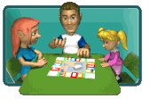
STARTING THE GAME
Each student starts the game with:
$700 in checking/$300 in savings
$250 credit card limit
450 Credit Score
Zero Quality of Life Points
CC Limit goes up as CS goes up

Slide 14

SETTING UP THE BUDGET
Students initially decide on how much they’ll pay in rent, cell plan, TV/Internet plan and groceries.
There is a trade-off between frugality and quality of life
At the beginning of each month, students are told what they can expect to earn and spend
There are ways to make extra money

Slide 15

SETTING A SAVINGS GOAL
Students will be asked to set a savings goal
The most successful players meet their goal monthly
The game encourages players to save at least 10% of their income
The student should set an attainable goal that can be met monthly to maximize game points

Slide 16
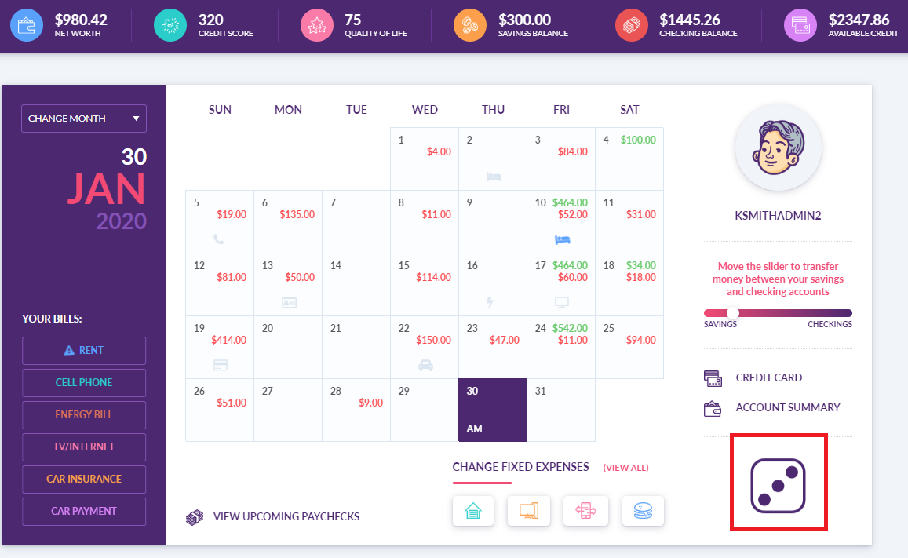
PLAYING THE GAME
The game board is the monthly calendar
Progress through the game by rolling the dice on the bottom right - they will move forward a half-day for each number.
Advancing forward through the calendar, they will get bills, paychecks, unexpected expenses, and need to decide how to allocate their time.
Students will earn more money per hour if they choose the "Study" option on the weekends, or "Professional Development" after they graduate

Slide 17

SUCCESSFUL PLAYER’S STRATEGY
Spend only where they see value
Use their credit card responsibly, it must be used and repaid to build a credit score
Quality of Life should not be ignored in the name of frugality. Splurge occasionally.
Deterrents pop-up if they don’t balance
Meet the monthly savings goal, max points if a 10% goal is consistently met.
Save up an emergency fund. Bonus points are earned if $500-$1000 is transferred.

Slide 18
INSTRUCTIONAL VIDEOS
Student Tutorial Video
Teacher Webinar Video
Lesson plans
Budgeting Lesson Plans

