Slide 1

Raising Your ELA Scores Through Writing:
Simple and Easy

Slide 2

Lisa Collum
Owner and Author of Top Score Writing
Lisa@topscorewriting.com

Slide 3

AGENDA
State testing information
  Rubrics
  Sample papers
  Information
Progress Monitoring
  Checklists
  Tracking forms
  Anecdotal notes
Setting the foundation
Text-based expository writing
Text-based argumentative writing
Additional activities and strategies

Slide 4
STATE WRITING ASSESSMENT

Slide 5
FLORIDA ASSESSMENT OF STUDENT THINKING
(FAST)
https://www.fldoe.org/accountability/assessments/k-12-student-assessment/best/
Three tests per year (2022-2023 field test)
  PM1 and PM2 will be used for informational purposes.
  PM3 will be a summative assessment and used for accountability.
Testing Windows
  PM1: August 15-September 30
  PM2: December 5-January 27
  PM3: May 1-June 2
Tests will be computer-adaptive through Cambium.

Slide 6
FAST STATE ASSESSMENT RUBRIC
12 POINTS TOTAL
Purpose/Structure: 1-4 points
Development: 1-4 point
Language: 1-4 points
4 = Above grade level
3 = Within range of grade level
2 = Approaching the range of grade level
1 = Below grade level

Slide 7
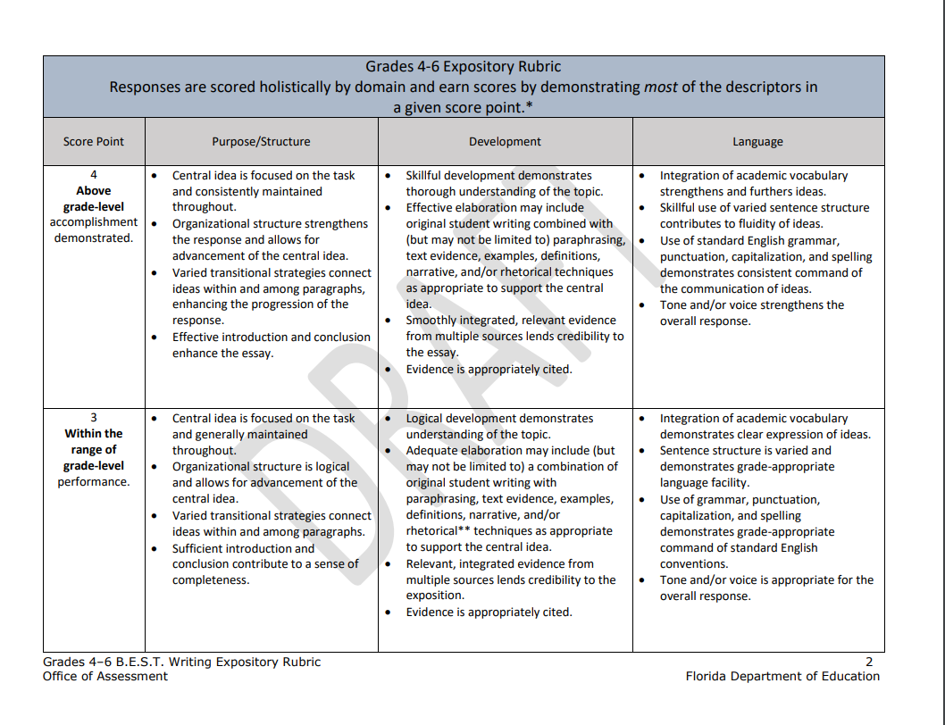

FAST
GRADE 4-6 RUBRIC:
EXPOSITORY
Teaching Tip: The writing skills expected at each score point are often the same; it is the quality of these skills that differs from score to score.

Slide 8
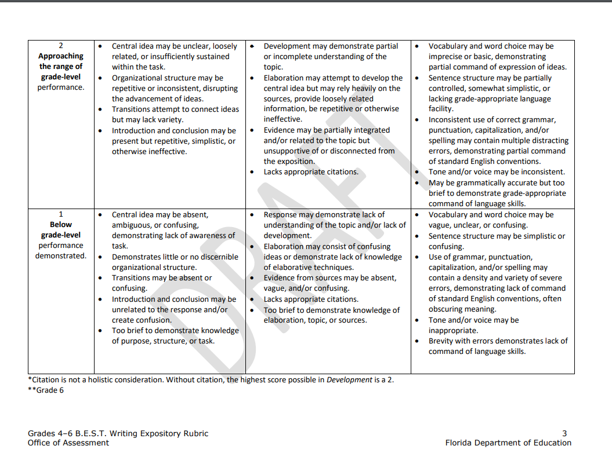
FAST
GRADE 4-6 RUBRIC:
EXPOSITORY

Slide 9
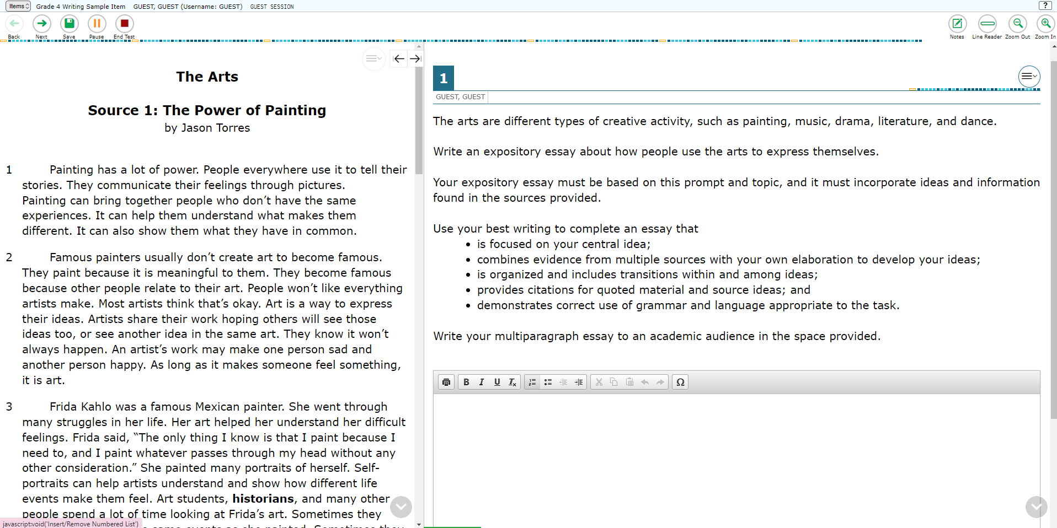
EXAMPLE EXPOSITORY TEST

Slide 10
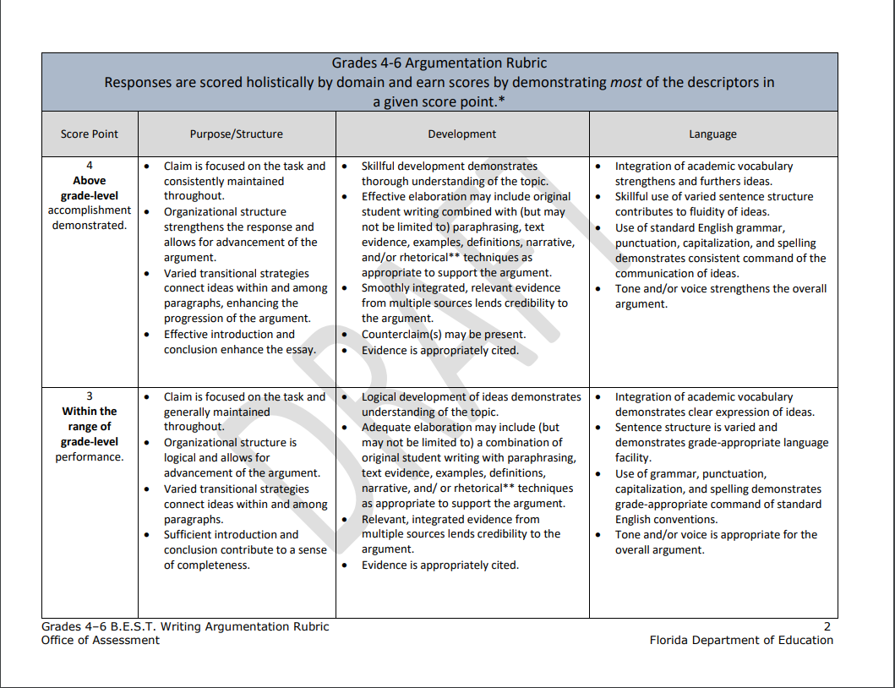
FAST
GRADE 4-6 RUBRIC:
ARGUMENTATIVE

Slide 11
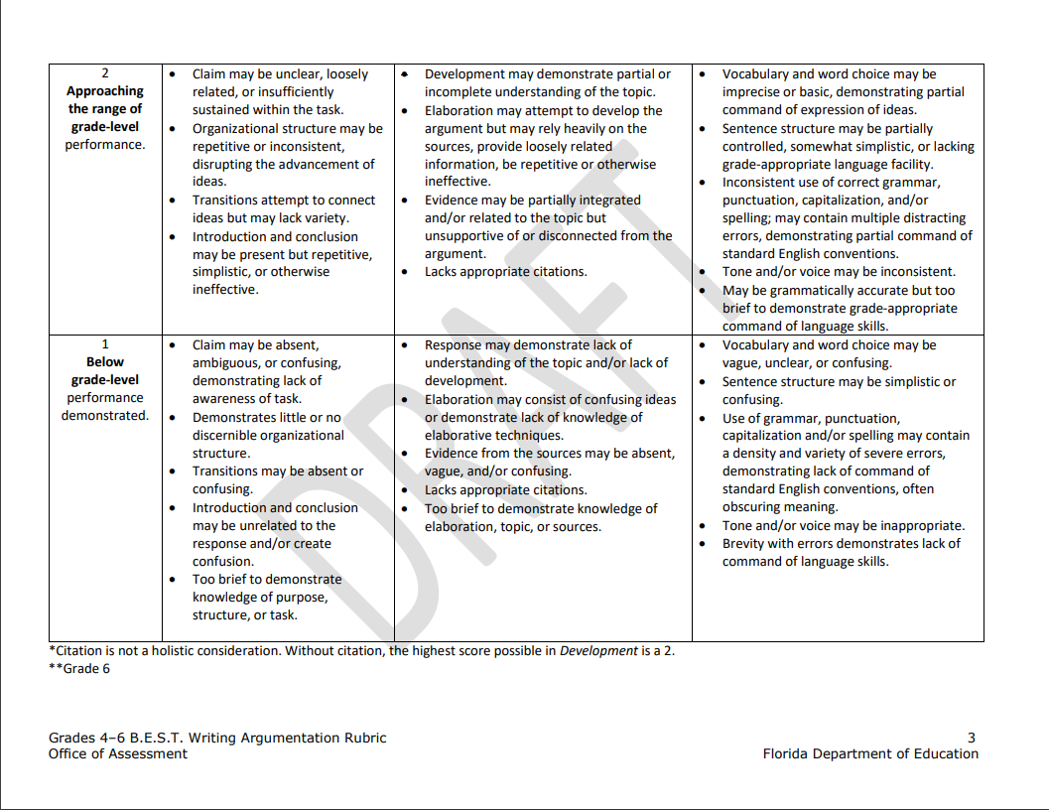
FAST
GRADE 4-6 RUBRIC:
ARGUMENTATIVE

Slide 12
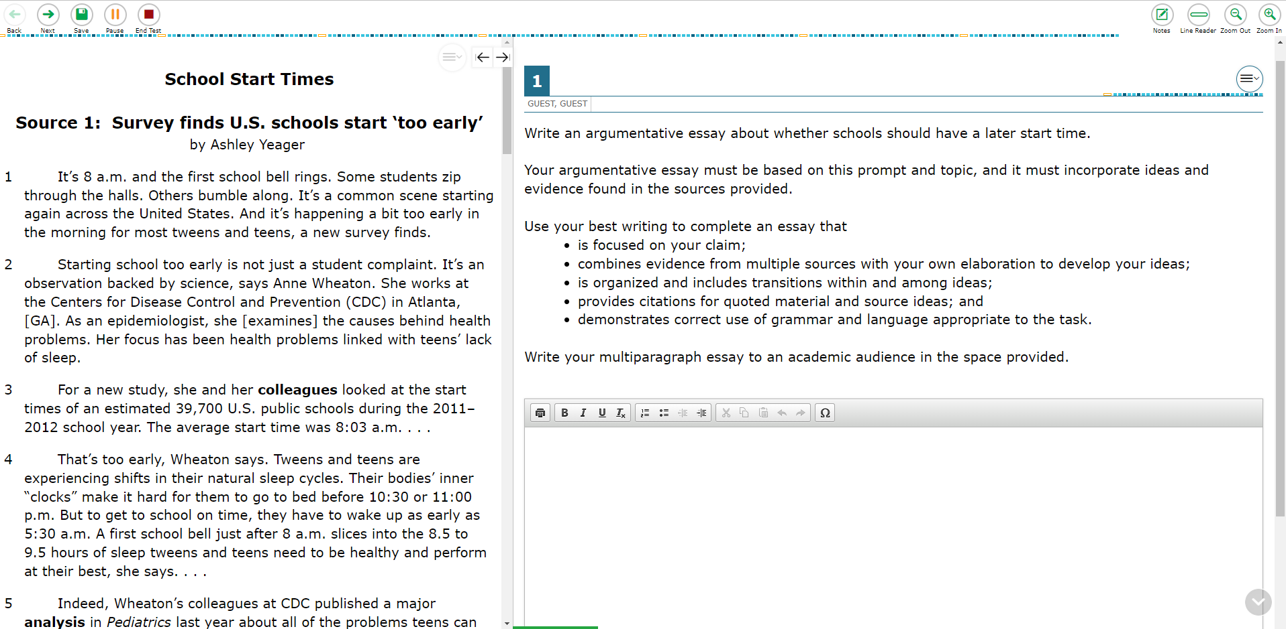
EXAMPLE ARGUMENTATIVE TEST

Slide 13
FAST STATE RUBRIC - MAIN POINTS
Purpose/Structure
Central idea focused on task (prompt)
Central idea maintained throughout the essay
Clear, logical organizational structure
Little or no loosely related info
Varied transitional strategies that connect ideas within and among paragraphs
Effective introduction and conclusion
Development
Demonstrates understanding of the topic
Relevant evidence from multiple sources
References to sources
Definitions, quotations, and examples
Elaboration based on evidence
Language
Academic vocabulary
Varied sentence structure
Punctuation, capitalization, and spelling grade-level appropriate
Tone/voice appropriate

Slide 14
RUBRICS vs.
SCORING SAMPLERS
Print out the sample papers and rubrics from your state website.
Use the scoring samplers to understand the nuances of the rubric.
Scoring writing can be subjective - score how the state does.
Use the sample papers while scoring.
Score with your peers in order to develop a consistent grading system within your school.
**FAST Scoring Samplers have not been released yet.
Teaching Tip: Use the sample papers while teaching; print out poster size.

Slide 15
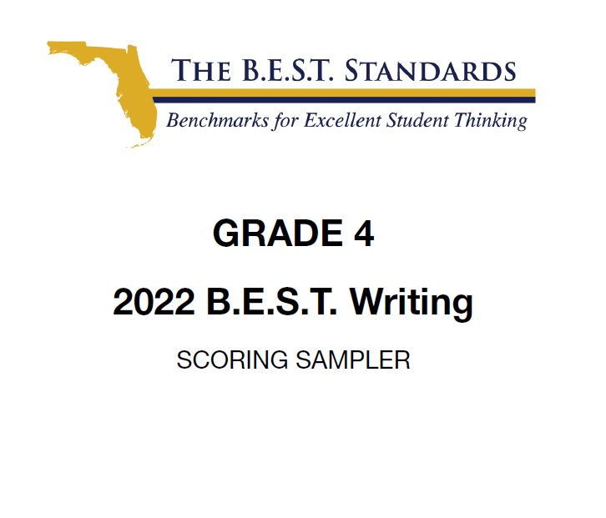
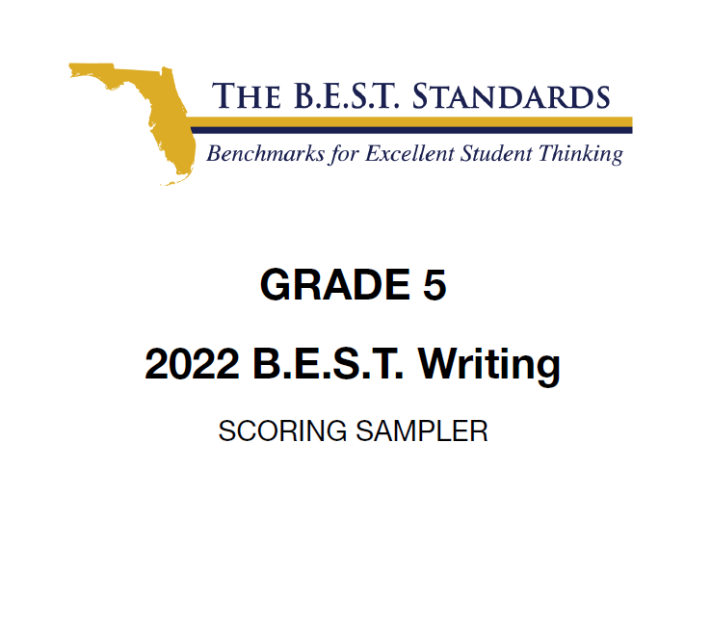
F.A.S.T. STATE ASSESSMENT
SAMPLE PAPERS

Slide 16
FAST STATE ASSESSMENT
SAMPLE PAPERS
Essays that scored a 12:
Three out of the four essays that earned a perfect score were five paragraphs and at least one full page typed.
All essays had a very consistent structure and way of organizing ideas/topics.
All used a great deal of both external and internal transition words.
Each essay included evidence from multiple sources and cited specifically where the evidence was from.
Every essay had a great deal of “original writing” that elaborated on the evidence.
Argumentative essays can be written in either 1st or 3rd person and should at least mention both sides of the issue/topic.

Slide 17
FAST STATE ASSESSMENT
SAMPLE PAPERS
Essays that scored a 7-9:
,
Overall essays, are shorter; six of the eight that scored within this range are only half a page.
All included four or five organized and structured paragraphs.
Essays consistently used external transitions, but internal transitions were less frequent and less sophisticated.
In all essays, evidence was included from multiple sources; however, there was less evidence used to support each topic/reason and citations were at times unspecific or missing.
Essays included less original writing and less analysis of the text.
Some essays included writing that lacked clarity or did not vary in sentence structure. Overall, the essays used a moderate amount of general/imprecise words and made more frequent grammatical errors.

Slide 18
FAST STATE ASSESSMENT
SAMPLE PAPERS
Essays that scored a 6 or below:
Essays were all very brief; all were less than half a page.
Essays either did not fully address prompt, misinterpreted prompt, or the central idea/claim was confusing.
All essays lacked structure and/or organization of ideas.
Evidence frequently came from only one source and often did not include a citation.
Elaboration either repeated evidence, was confusing, or was too brief.
Essays utilized basic, vague word choice. There were consistent, distracting grammatical errors throughout.

Slide 19
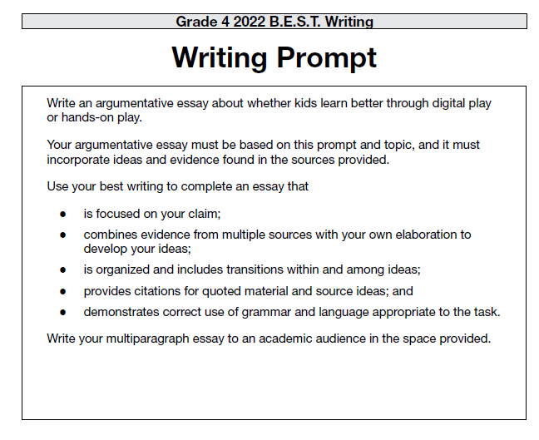
FAST STATE ASSESSMENT
SAMPLE PAPERS

Slide 20
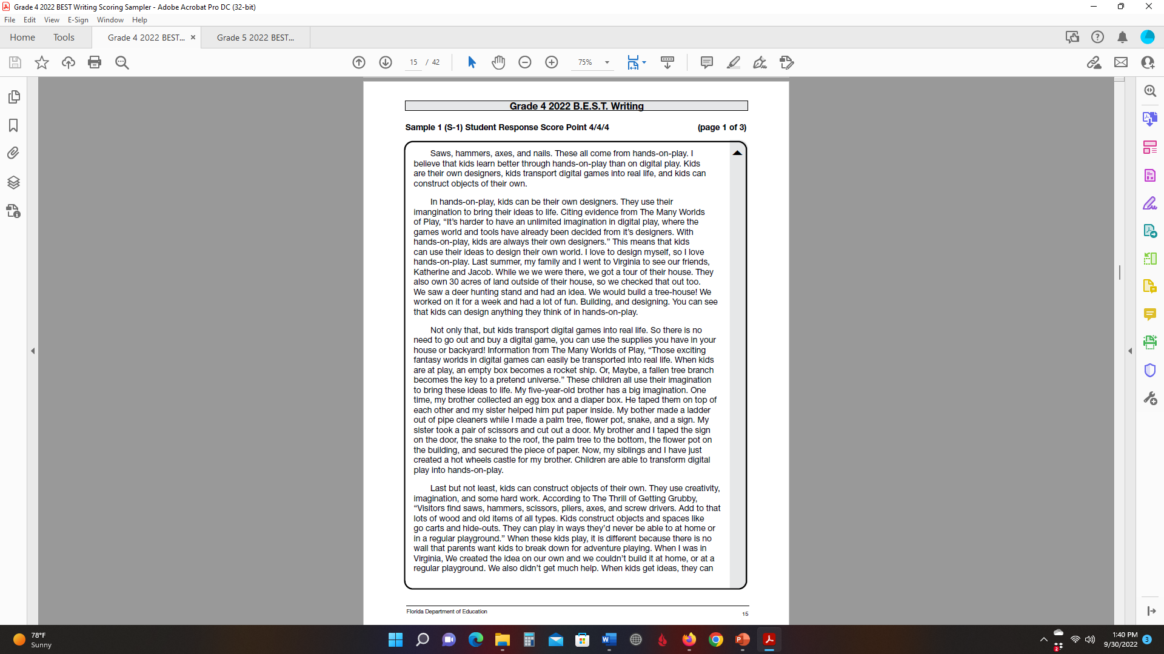

Slide 21
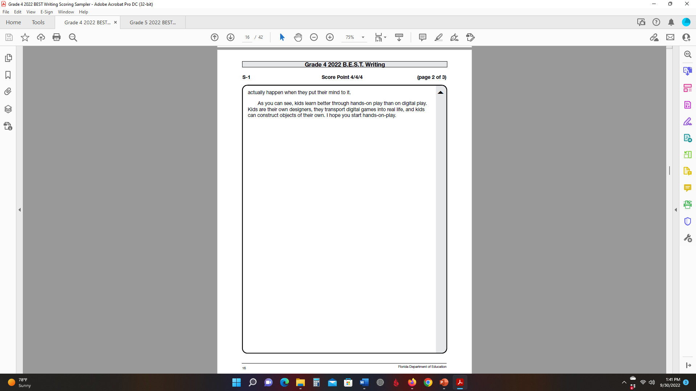

Slide 22
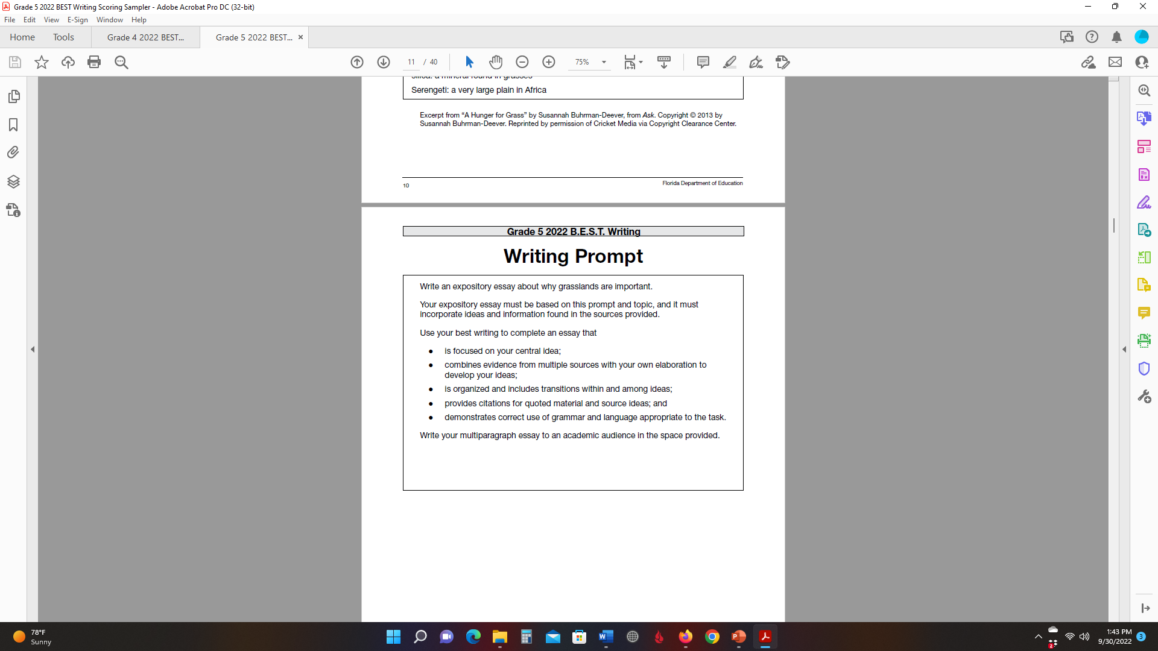
FAST STATE ASSESSMENT
SAMPLE PAPERS

Slide 23
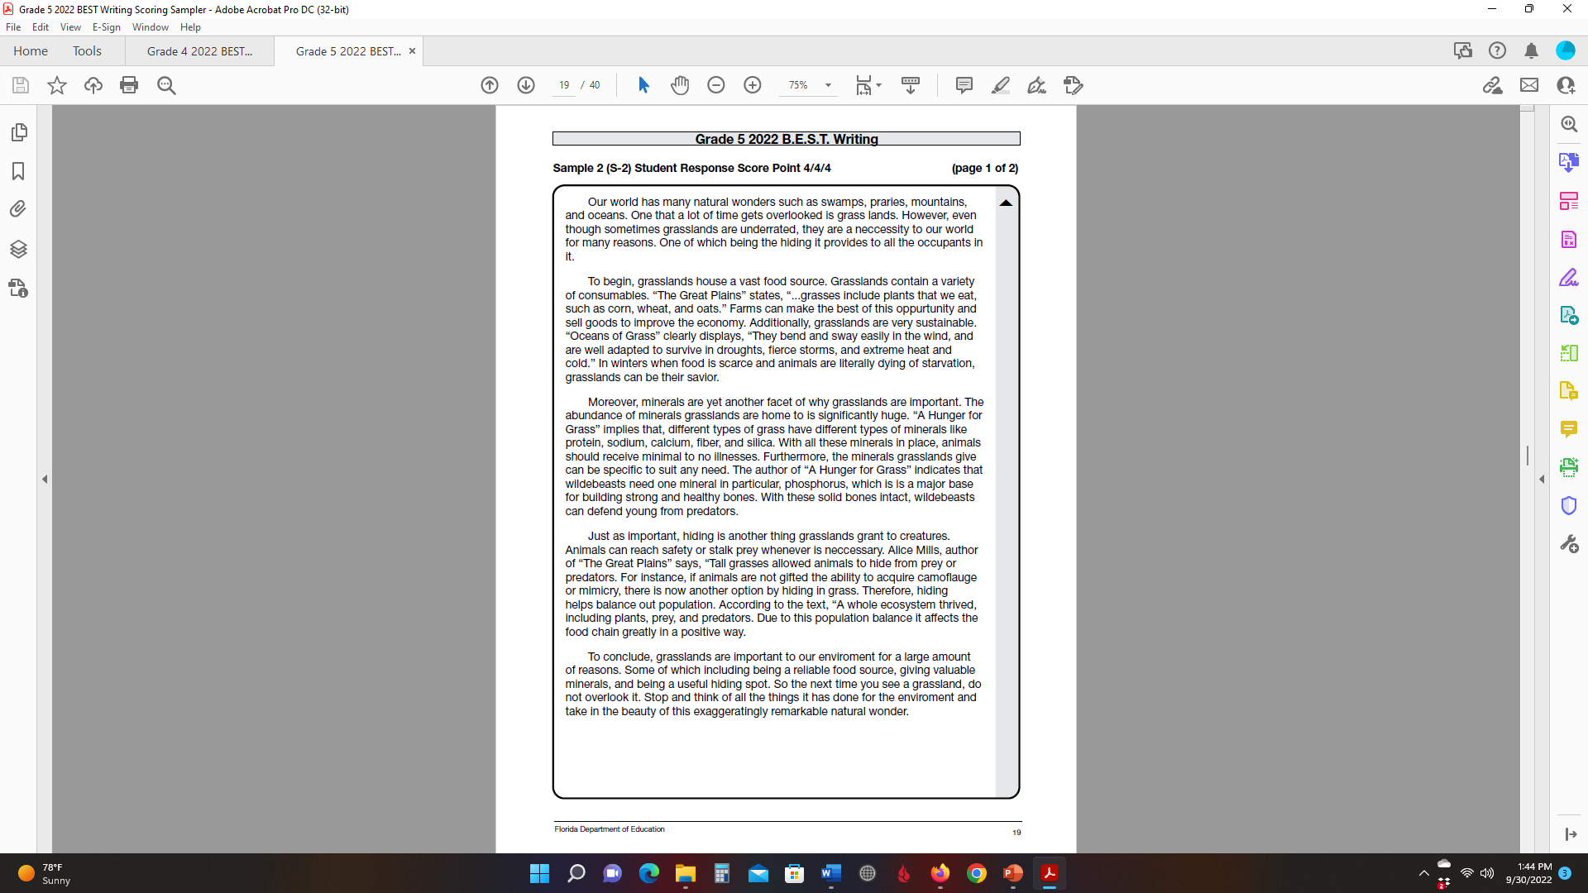

Slide 24

STATE WRITING ASSESSMENT
PREP & REVIEW
6-8 Weeks Prior to the Test:
Revisit lessons
Individualize lessons based on assessment results
Prompt practice
Timed practice (work on pacing & stamina)
Simulation tests (teachers, rooms, time, etc.)
Small groups
Peer teaching

Slide 25
TESTING TIME:
PACING AND TIME MANAGEMENT
Know the time limit for your state’s assessment. Create anchor charts that divide the writing process into clear steps and assign an appropriate amount of time to each.
Reading 20-30 min
Planning 10-15 min
Writing 60-75 min
Editing Any extra time
Writing Breakdown:
60-75 Minutes
1st paragraph 5-10 min
2nd paragraph 15-20 min
3rd paragraph 15-20 min
4th paragraph 15-20 min
5th paragraph 5-10 min
Teaching Tip:
Example pacing charts for a two-hour test.

Slide 26

TESTING PLAN
Who is testing your students?
Where is everyone testing?
Have you practiced the testing plan
so that students can see who they
are testing with and where?
Plan on conducting at least two mock assessments before test day so students will be familiar with the person and environment.
Make sure the person in front of them knows the “language” and is a “nice” person.
Always practice with the state writing materials/testing format.

Slide 27
MOCK ASSESSMENTS
For students who will be administered paper-based writing assessments, create a testing template that mimics the format they will be presented with.
Include the exact number of planning and response pages that will be provided.
Within the Test and Answer Book, place the text sets that students will read and the prompt to which students will respond in the same order they will appear during the state writing assessment.
For students who will be administered computer-based writing assessments, create a testing scenario that mimics the state writing test. Provide students with passages in the same way the state will.
Have students type their essays during mock assessments.
*Students should practice typing skills throughout the year. A variety of free and low-cost programs are available online for students to use at school and home.

Slide 28
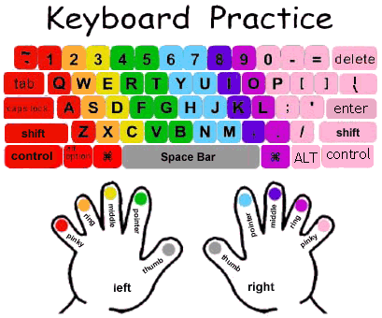
DEVELOPING KEYBOARDING SKILLS
Free programs:
  Typing.com
  Typing Club
  Type 2 Learn
  Fast Fingers
  Monkey Type
Low-cost programs:
  Mavis Beacon-multiple programs/levels $20-25 each
  Typing Master-$20 for lifetime access
Practice opportunities:
Morning work
Center assignment,
Homework,
Type final versions of essays using Google Docs or MS Word
Mock assessments

Slide 29
PROGRESS MONITORING

Slide 30
Assess
Multiple Tests for Every Genre
WE HAVE THE TOOLS TO MAKE PROGRESS MONITORING EASY
Identify Strengths &
Weaknesses
Informal Assessment Checklist
Observe Development
Anecdotal Notes
Differentiate Instruction
Lessons & Resources for Beginning & Advanced
Writers
Track
Performance
Progress Monitoring Tracking Forms

Slide 31
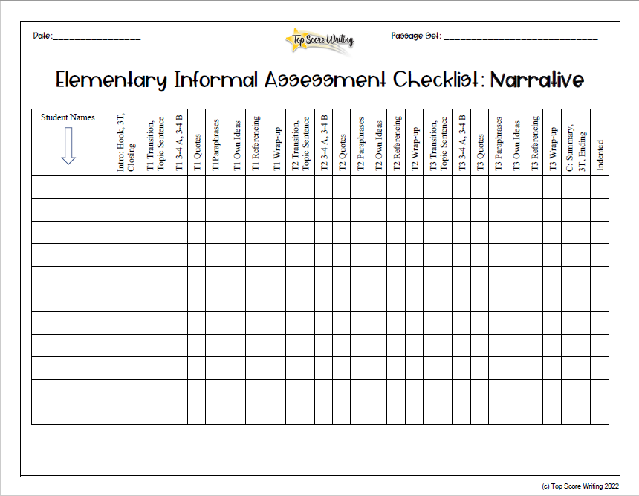
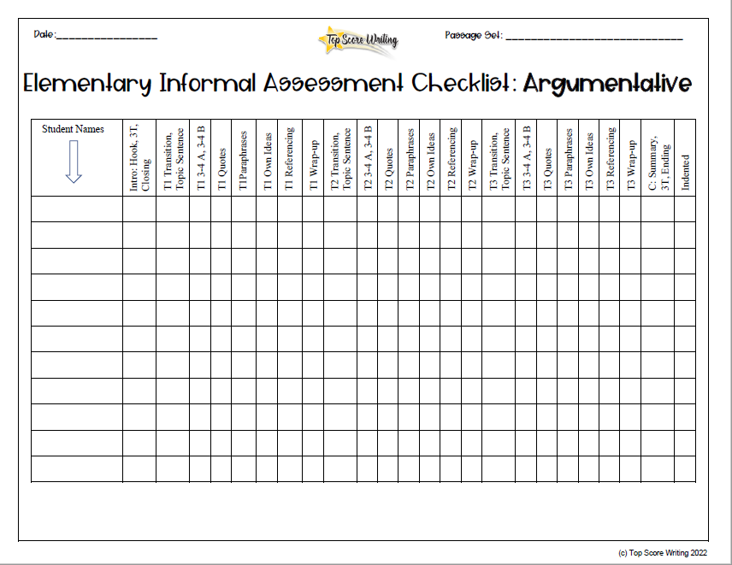
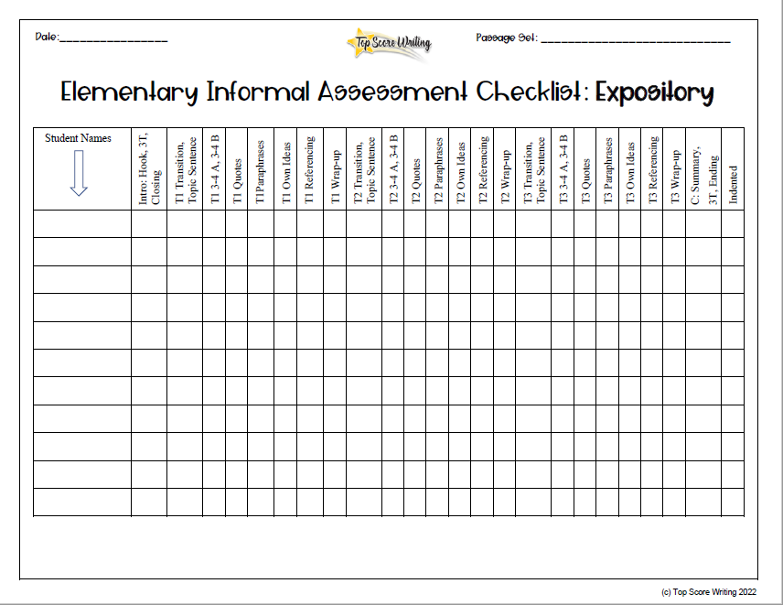
INFORMAL ASSESSMENT CHECKLISTS
IDENTIFY
INDIVIDUAL STRENGTHS AND WEAKNESSES

Slide 32
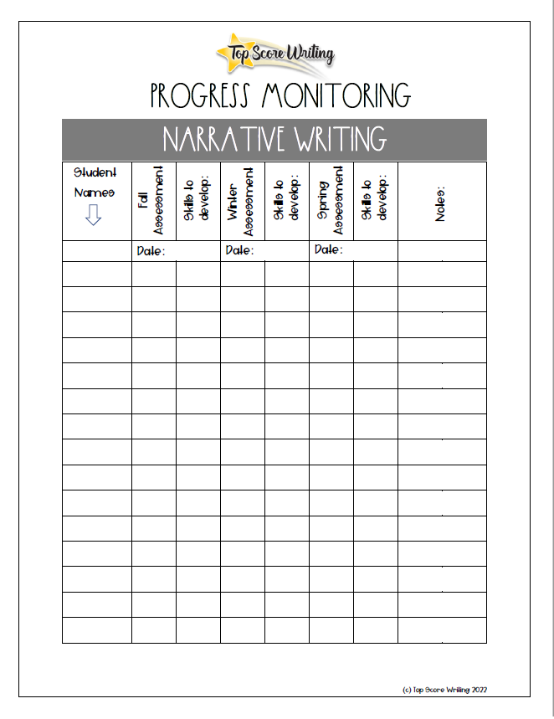
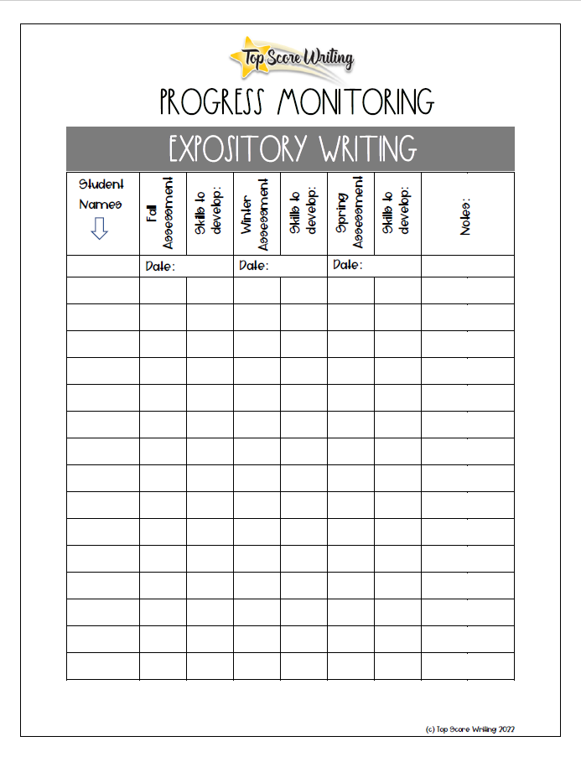
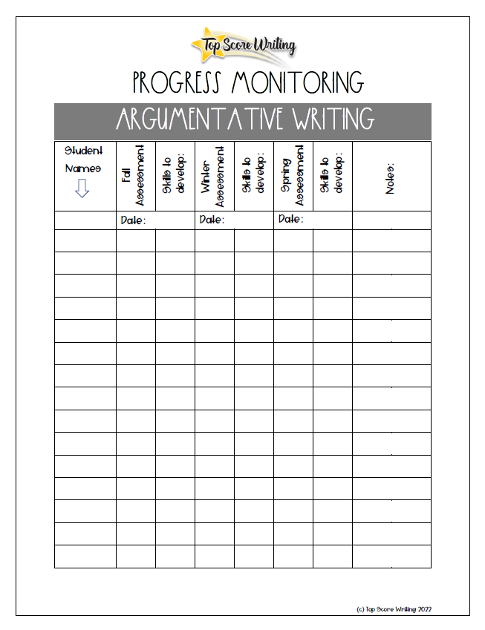
PROGRESS
MONITORING
TRACKING
FORMS
TRACK GROWTH

Slide 33
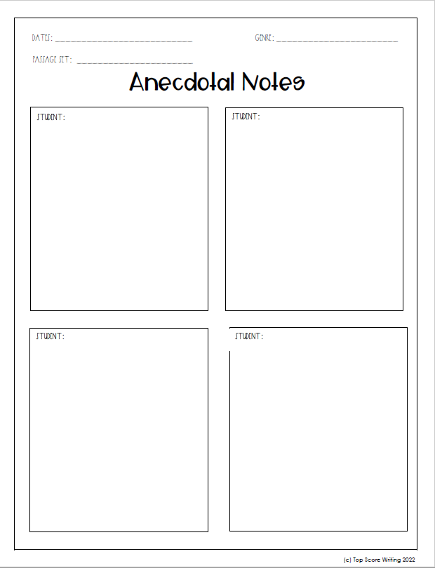
ANECDOTAL
NOTES
DIFFERENTIATE INSTRUCTION AND RECORD OBSERVATIONS

Slide 34


From ideas…
Where kids struggle:
organization and planning
To paper

Slide 35
NON-TEXT-BASED
EXPOSITORY WRITING
SETTING THE FOUNDATION

Slide 36
PLANNING
I ______________
R1 _____________ a.________
b.________
R2 _____________ a.________
b.________
R3 _____________ a.________
b.________
C ______________
Teaching Tip:
To help students generate ideas for subtopics, ask them to TEACH their reader about each R.

Slide 37
PLANNING example
Prompt: Everyone has a favorite activity. Think about your favorite activity. Now explain why this activity is your favorite.
I basketball
R1 shoot a. 3-pointer b. dunk
R2 dribble a. court b. legs
R3 win a. championship b. trophy
C basketball

Slide 38
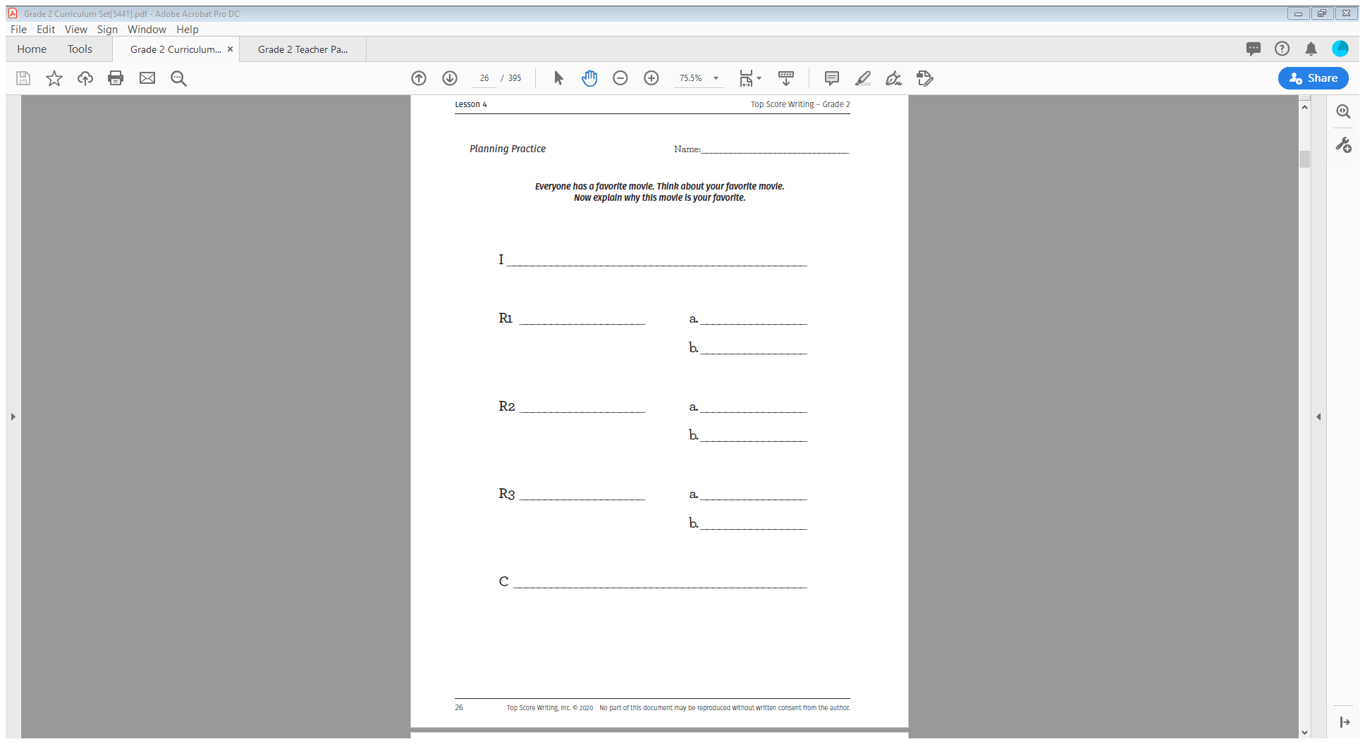
STUDENT PLANNING SHEET
I basketball
R1 shoot a. 3-point b. dunk
R2 dribble a. court b. legs
R3 win a. championship b. trophy
C basketball
Activity sheet
Blank paper

Slide 39
INTRODUCTION
“I” PARAGRAPH
Structure: 3-4 Sentences
  Hook
  State 3 reasons
  Closing statement
What is your favorite activity? My favorite activity is basketball because you can shoot the ball, dribble down the court, and win. Basketball is the best sport in the world!

Slide 40
Middle paragraph structure
3A, 3B
For R1, R2, and R3:
Topic Sentence (T)
3 sentences about A (3-4A)
3 sentences about B (3-4B)
R1 First, I like basketball because you can shoot the ball. One way to shoot is by making a three-pointer. You have to make sure you stand behind the white three-point line. Then, shoot it with a lot of force so it will make it into the basket. You can also make a shot by dunking. First, you have to run fast across the court. Then jump as high as you can and push it through the net.

Slide 41
Middle paragraphs
R1 First, I like basketball because you can shoot the ball. One way to shoot is by making a 3-pointer. You have to make sure you stand behind the white three-point line. Then, shoot it with a lot of force so it will make it into the basket. You can also make a shot by dunking. First, you have to run fast across the court. Then jump as high as you can and push it through the net.
R2 Second, I like basketball because you can dribble the ball. You can steal the ball from the other team and dribble down the court. Once you start dribbling, make sure you don’t stop and then move. If you do this, the referee will call traveling. Another way to dribble is between your legs. You have to make sure you use both hands and pass the ball back and forth under your legs. This confuses the other players and then you can get around them.
R3 Third, I like basketball because you can win. If your team makes the most points, you will win the game. After winning most of the games, your team will make the playoffs and go for the championship. Winning the championship is every team’s dream. In addition, your team will win a trophy. The first-place team usually gets the tallest trophy. The trophy comes with a small plaque on the front that has your team's name and the year.
Key
Topic Sentence
A
B

Slide 42

COMPLETE MIDDLE PARAGRAPHS
R1, R2, R3
Structure: 9-10 sentences
  Topic sentence
  3-4 sentences about A
  3-4 sentences about B
  Wrap-up

Slide 43
EXAMPLE R1
First, I like basketball because you can shoot the ball. One way to shoot is by making a 3-pointer. You have to make sure you stand behind the white three-point line. Then, shoot it with a lot of force so it will make it into the basket. You can also make a shot by dunking. First, you have to run fast across the court. Then, jump as high as you can and push it through the net. Shooting is the best part about basketball!
Topic (T) – red
3-4 A – green
3-4 B – blue
Wrap-up (W) - purple

Slide 44
CONCLUSION
“c” PARAGRAPH
Shooting the ball, dribbling down the court, and winning are the reasons I enjoy playing basketball so much. I think that basketball is the best sport on earth! I hope that everyone gets to play basketball at least once in their lifetime.
Structure: 3-4 Sentences
-Restate 3 reasons
-Thought and/or feeling
-Ending sentence

Slide 45
TEXT-BASED
EXPOSITORY WRITING

Slide 46
EXPOSITORY PLANNING:
ITC OUTLINE
I ______________________
T1 ______________________ a. _____________
b. _____________
T2 ______________________ a. _____________
b. _____________
T3 ______________________ a. _____________
b. _____________
C ______________________
3 big topics from the text
a/b =
details or examples
When writing text-based informative/expository essays,
the 3 topics must come from the passage set.

Slide 47
PLANNING
ORGANIZATION
Prompt: Write an informative essay to present to your class about alligators. Use information from the passages in your essay.
Did you know that the largest ever recorded alligator measured 19.2 feet? Alligators are interesting because there are two different species, they are a type of reptile, and they live in various habitats. Alligators aren’t as scary once you learn more about them.
First, there are two different species of alligators in the world. According to the text Alligators at Risk, the most well-known type of alligator is the American alligator. The American alligator lives in the wetlands of the Southern United States. It was listed under the Endangered Species Act, and it was illegal to hunt them. Another type of alligator species is the Chinese alligator. The author states in Alligators at Risk that the Chinese alligator looks very similar to the American alligator. However, these reptiles are much smaller. There are also far fewer Chinese alligators than American alligators because they are listed as critically endangered. Alligators are fascinating animals, and it is important to know the similarities and differences between the two species.
Second, alligators are animals classified as reptiles. Based on the information in Alligators at Risk, alligators fall into the category of reptiles because they are cold-blooded. Cold-blooded means their environment controls their body temperature, and they have scales for protection. When their body temperature is too low, they warm up by laying in the sun. Similarly, alligators are classified as reptiles because they lay eggs in nests. Baby alligators are either male or female based on the temperature of the nest that the eggs are in. In the article Alligators at Risk, it states that if the nest is above 93 degrees the eggs will be male, and if it is cooler than that the eggs will end up being female. After learning about the characteristics of reptiles, I can understand why alligators are classified this way.
Third, alligators are adapted to live in various habitats. In paragraph one of Habitats, it says that you can find alligators in freshwater habitats like rivers, as well as brackish habitats such as swamps. Brackish means the water is saltier than fresh water, but not as salty as seawater. Freshwater and brackish water habitats are the perfect places for alligators to live and lay eggs. Another habitat alligators live in are holes that they create in swamps. According to the text Habitats, the author says they dig these holes by using their body parts such as their feet and tail. Alligator holes are very useful because they help alligators keep cool in the hot weather and also camouflage them from their prey so that they can capture meals easily. It is important to know where alligators like to live so that we can make sure we protect those areas from destruction.
In conclusion, alligators are remarkable because there are two different species, they are a type of reptile, and they live in various habitats. I think everyone should learn more about alligators so they can understand this mysterious creature. Alligators are an important part of their ecosystem.
I alligators
T1 species a. American
b. Chinese
T2 type of reptile a. cold-blooded
b. eggs
T3 habitats a. freshwater
b. holes
C alligators

Slide 48
EXPOSITORY PROMPTS
Passage Set:
    Alligators at Risk
    Alligator Habitats
Prompt: Write an informative essay to present to your class about alligators. Use information from the passages in your essay.
Teaching Tip:
Use different prompts based on the same text set to easily differentiate task complexity.

Slide 49
EXPOSITORY PROMPTS
ANALYZING PROMPTS
As easy as 1…2…3…
What are the keywords?
Circle them.
2. What is this prompt asking us to write about?
Restate the prompt in your own words.
3. Is this prompt asking us to write about anything specific or just a topic in general?
  Decide if this is an open-ended, general information prompt or if it is requiring a response based on a specific topic.
Teaching Tip:
There are multiple lessons at the beginning of each section focused just on analyzing prompts.

Slide 50
EXPOSITORY PLANNING
EXAMPLE
Prompt: Write an informative essay to present to your class about alligators. Use information from the passages in your essay.
I alligators
T1 species a. American
b. Chinese
T2 type of reptile a. cold-blooded
b. eggs
T3 habitats a. freshwater
b. holes
C alligators
Teaching Tip:
Remind students to write their plans in the same way they would write a shopping list.

Slide 51
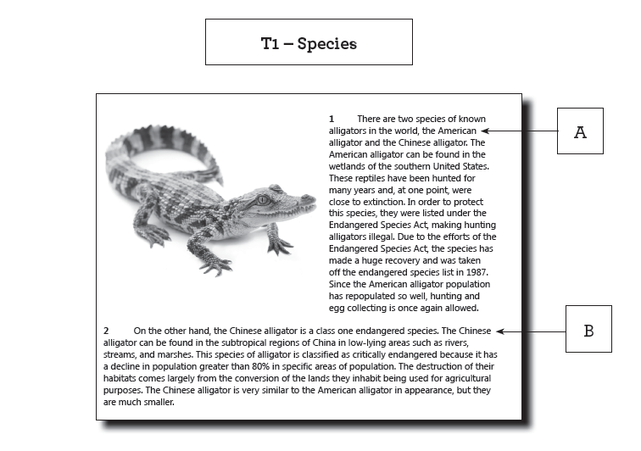
EXPOSITORY PLANNING
BOXING AND LABELING
I alligators
T1 species a. American
b. Chinese
T2 type of reptile a. cold-blooded
b. eggs
T3 habitats a. freshwater
b. holes
C alligators

Slide 52
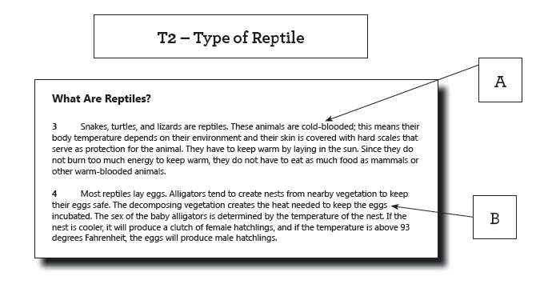
EXPOSITORY PLANNING
BOXING AND LABELING
I alligators
T1 species a. American
b. Chinese
T2 type of reptile a. cold-blooded
b. eggs
T3 habitats a. freshwater
b. holes
C alligators
Teaching Tip:
Text-based check: students should be able to box and label every topic on their plans in the passages.

Slide 53
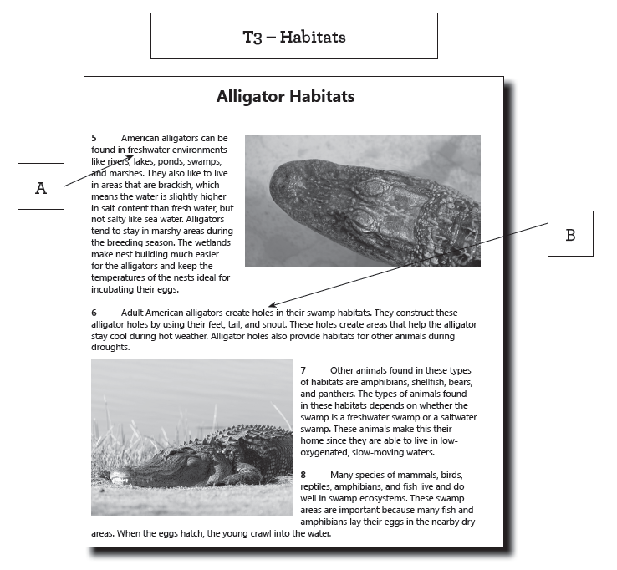
EXPOSITORY PLANNING
BOXING AND LABELING
I alligators
T1 species a. American
b. Chinese
T2 type of reptile a. cold-blooded
b. eggs
T3 habitats a. freshwater
b. holes
C alligators

Slide 54
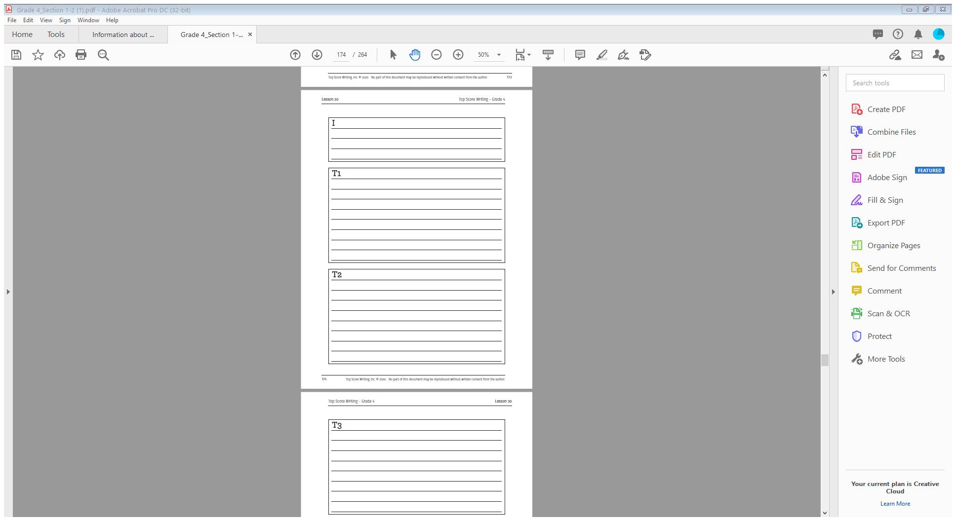
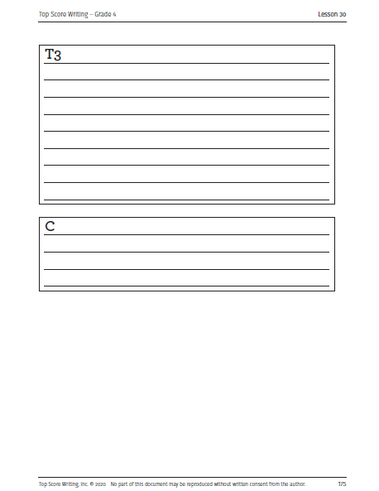
BUILDING
AN ESSAY:
ONE PIECE
AT A TIME

Slide 55
EXPOSITORY Introduction
“I” paragraph
Key
Hook
3 topics
Closing statement
There are many ways students can structure an introduction paragraph.
Key
Hook
3 topics
(split into 2-3 sentences)
Teaching Tip:
Create anchor charts with each structure and an example paragraph.

Slide 56
SCAFFOLD STUDENTS UNDERSTANDING
Start by teaching structure…
T1, T2, T3
Topic sentence
3-4A
3-4B
Wrap-up sentence
…then teach elaborative techniques.
T1, T2, T3
Topic sentence
3-4A (quotes, paraphrases, own thoughts and ideas)
3-4B (quotes, paraphrases, own thoughts and ideas)
Wrap-up sentence

Slide 57
Middle paragraphs
T1, t2, t3
I alligators
T1 species a. American
b. Chinese
T2 type of reptile a. cold-blooded
b. eggs
T3 habitats a. freshwater
b. holes
C alligators
First, there are two different species of alligators in the world. According to the text Alligators at Risk, the most well-known type of alligator is the American alligator. American alligators live in the wetlands of the southern United States. They were listed under the Endangered Species Act, and it was illegal to hunt them. Another type of alligator species is the Chinese alligator. The author states in Alligators at Risk that the Chinese alligator looks very similar to the American alligator. However, these reptiles are much smaller. There are also far fewer Chinese alligators than American alligators because they are listed as critically endangered. Alligators are fascinating animals, and it is important to know the similarities and differences between the two species.
Key
Topic sentence
3-4A
3-4B
Wrap-up

Slide 58
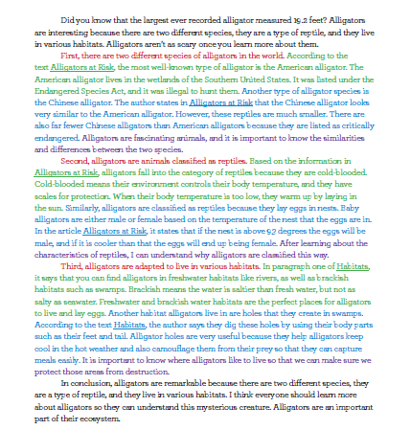
STRUCTURE
Prompt: Write an informative essay to present to your class about alligators. Use information from the passages in your essay.
I alligators
T1 species a. American
b. Chinese
T2 type of reptile a. cold-blooded
b. eggs
T3 habitats a. freshwater
b. holes
C alligators

Slide 59
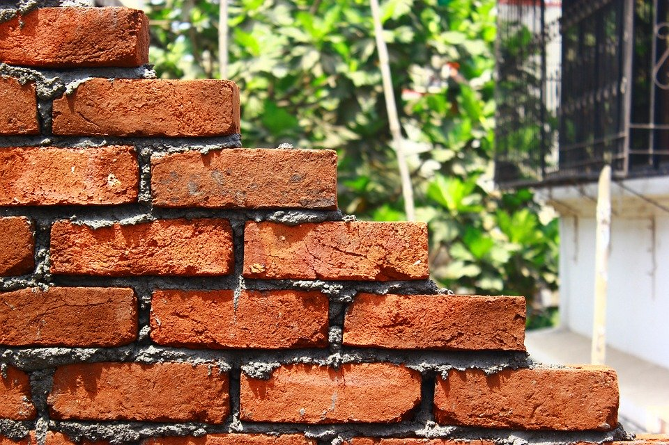
TEACHING THE MIDDLE PARAGRAPHS
ONE PIECE AT A TIME
Paraphrasing
Referencing
Overview of elaborative techniques
Quotes
Own thoughts and ideas

Slide 60
OVERVIEW OF ELABORATIVE TECHNIQUES
There are three ways to write the support in the
A and B sentences.
Students should try to use a variety of these in each middle paragraph (T1, T2, and T3).
  Take exact words from the text (direct quote)
  Restate information from the text in their own words (paraphrasing)
  Include their own thoughts and ideas about topics in the text

Slide 61
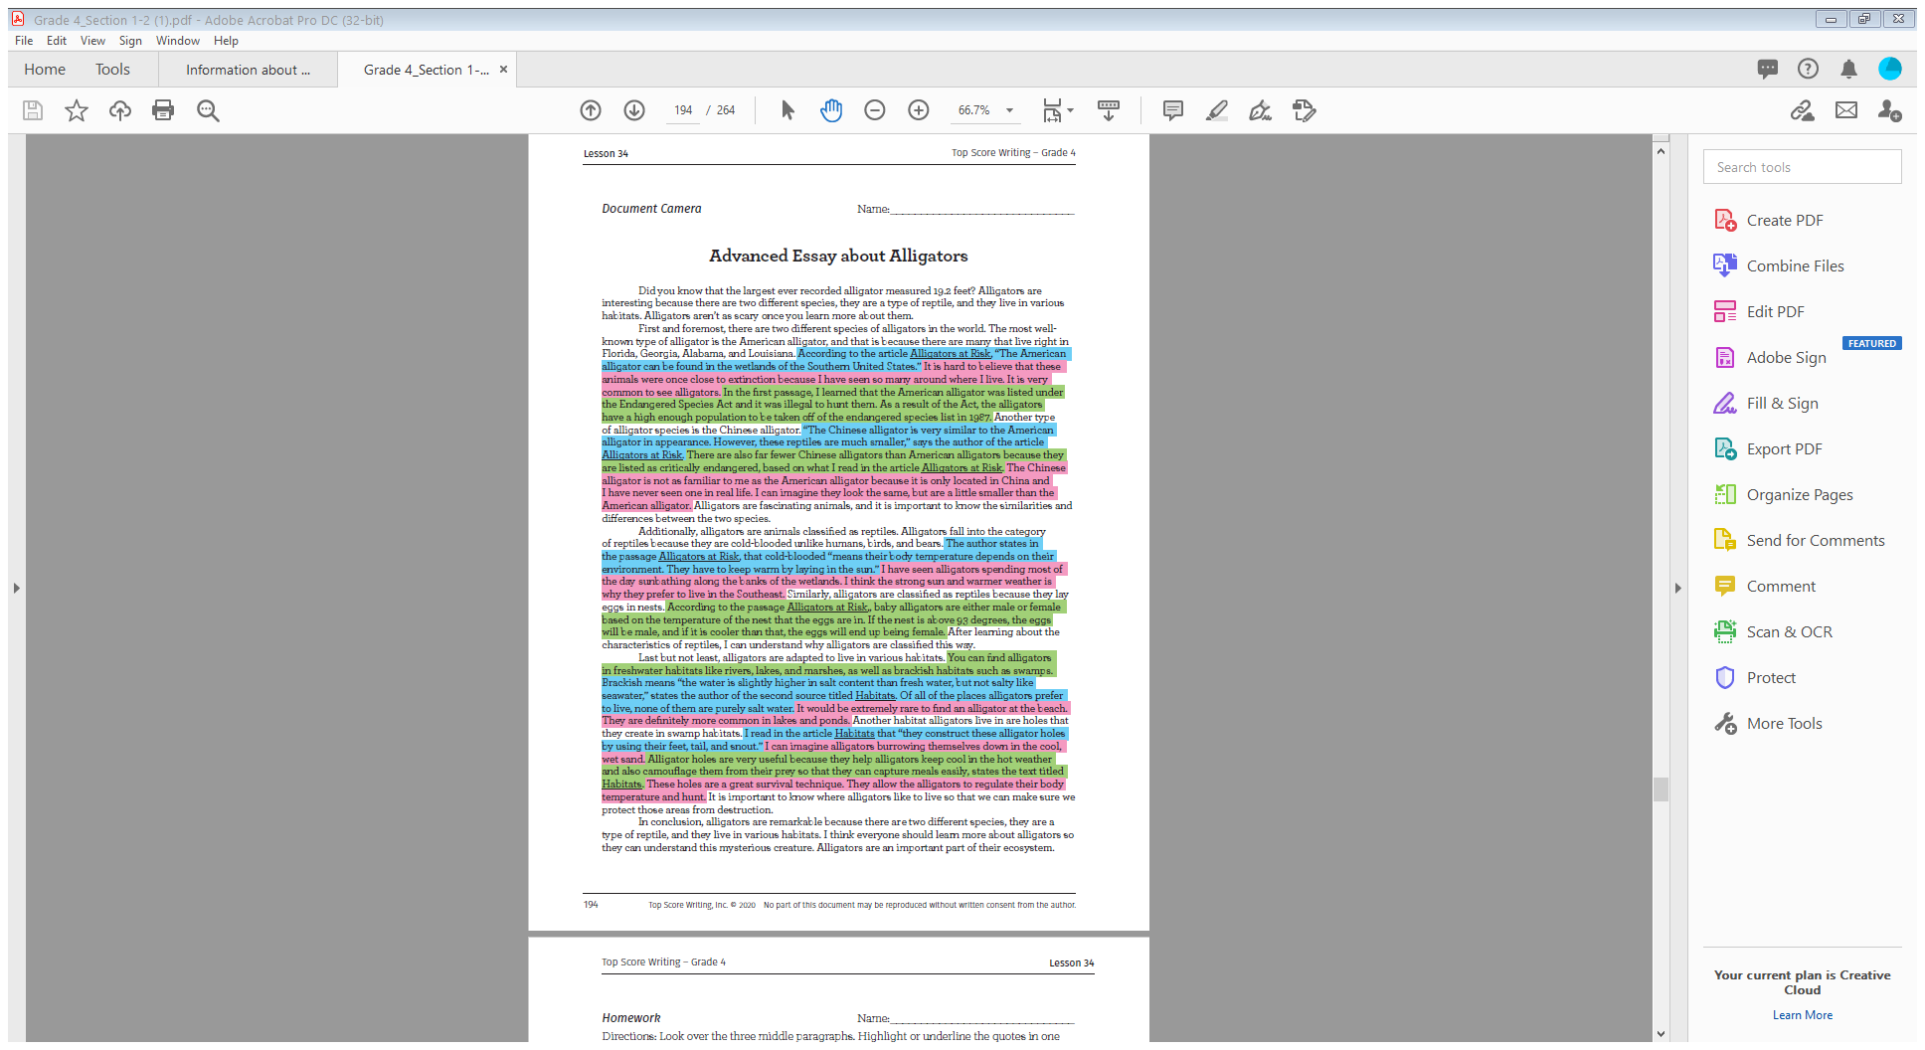
OVERVIEW OF ELABORATIVE TECHNIQUES
Key
Quotes
Paraphrases
Own thoughts and ideas
Teaching Tip:
Focus on the balanced use of elaborative techniques. There is no formula!

Slide 62
MIDDLE PARAGRAPHS
T1, T2, T3
Topic sentence
3-4 A (quote, paraphrasing, own ideas)
3-4 B (quote, paraphrasing, own ideas)
Wrap-up sentence
Balance of quotes, paraphrasing,
and own thoughts/ideas
Teaching Tip:
Create an anchor chart with a color-coded paragraph.

Slide 63
CONCLUSION
“C” PARAGRAPH
I alligators
T1 species a. American
b. Chinese
T2 type of reptile a. cold-blooded
b. eggs
T3 habitats a. freshwater
b. holes
C alligators
In conclusion, alligators are interesting to learn about. Alligators are remarkable because there are two different species, they are a type of reptile, and they live in various habitats. I think everyone should learn more about alligators so they can understand this mysterious creature.
KEY
Overview/summary
Restate 3 topics
Thought or feeling

Slide 64
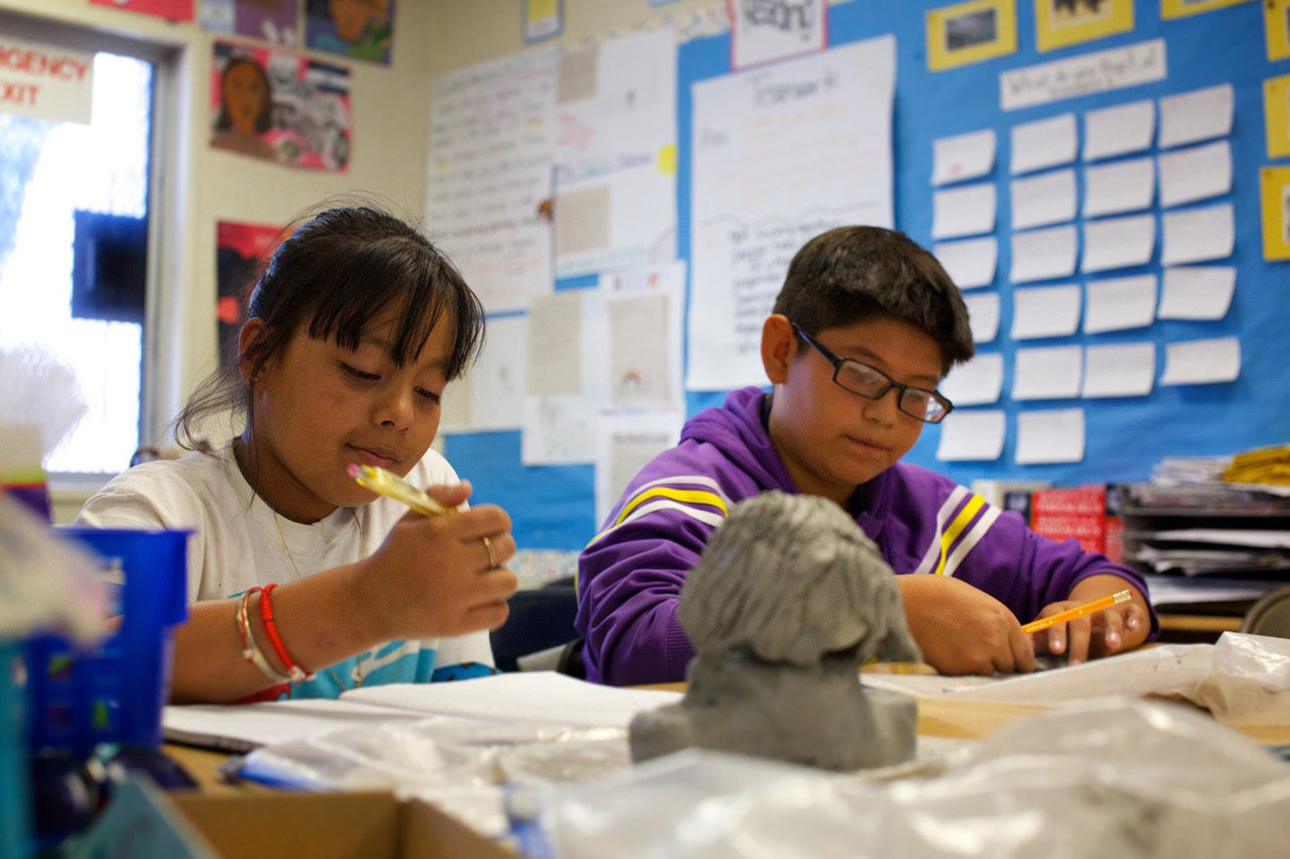
REVIEW AND REVISE
SELF-assess, self-correct & individualize
Conferencing
Skill groups
Revisions
Self-assessing with highlighters
Checklists
Partner checklists

Slide 65
TEXT-BASED
ARGUMENTATIVE WRITING

Slide 66
OPINION/ARGUMENTATIVE PLANNING: IRC OUTLINE
N
N
I ______________________
R1 ______________________ a. _____________
b. _____________
R2 ______________________ a. _____________
b. _____________
R3 ______________________ a. _____________
b. _____________
C ______________________
N
3 big reasons from the text
a/b =
details or examples
When writing text-based opinion/argumentative essays, the 3 reasons must come from the passage set.

Slide 67
OPINION/ARGUMENTATIVE PRACTICE
I yes – recess
R1 health benefits a. body b. energy
R2 social a. happy b. friends
R3 laws a. 20 minutes b. free play
C yes – recess
Prompt: You have read several sources about recess in schools. Write an opinion essay about whether or not schools should be required to provide students with recess time. Use information from the texts to support your opinion.
Teaching Tip:
Use questioning strategies to guide students to generate a/b subtopics.

Slide 68
OPINION/ARGUMENTATIVE INTRODUCTION
“I” PARAGRAPH
Clearly states opinion
j
Do you think schools should be required to give students recess time? In my opinion, schools must provide recess for students because there are many health benefits, kids improve social skills, and laws protect recess time. You can’t expect kids to concentrate all day without a break!
Teaching Tip:
Have students underline their opinion when self-assessing.
Key
Hook
3 reasons
Closing statement

Slide 69
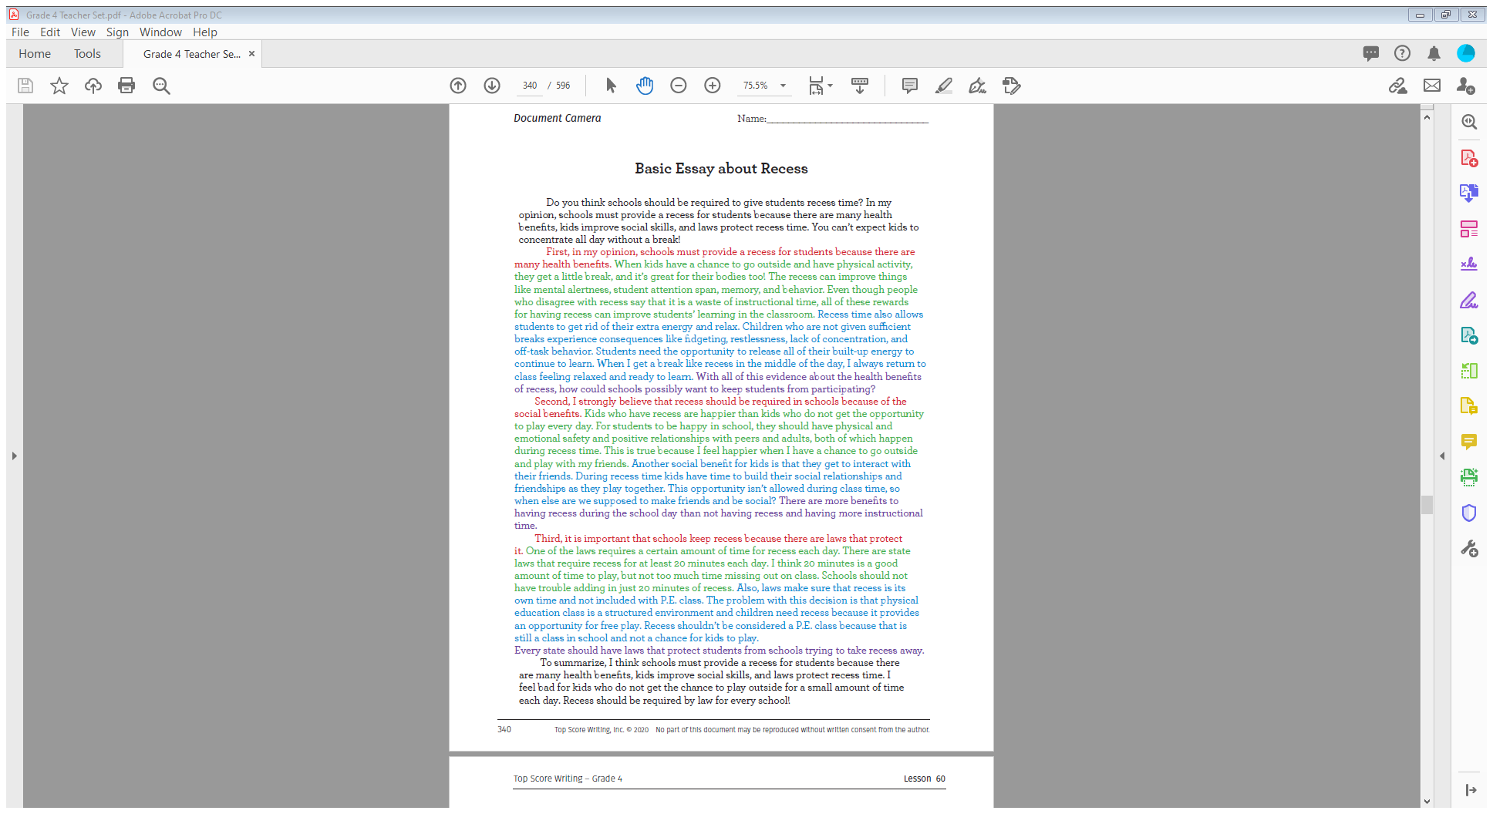
OPINION/ARGUMENTATIVE MIDDLE PARAGRAPHS
R1, R2 & R3
Topic sentence – clearly states opinion
a
I yes – recess
R1 health benefits a. body b. energy
R2 social a. happy b. friends
R3 laws a. 20 minutes b. free play
C yes – recess

Slide 70
OPINION/ARGUMENTATIVE
MIDDLE PARAGRAPH
TOPIC SENTENCES
u
u
First, schools must provide a recess for students because there are many health benefits.
B
B
B
transition word
opinion
reason
Teaching Tip:
For opinion writing, students have to strongly maintain their opinion
throughout the entire essay. A great strategy for this is showing what “side” they are on in their topic sentences. Students should be able to highlight where they showed what “side” they are on in each middle paragraph.

Slide 71
USING EVIDENCE FROM THE TEXT
First, in my opinion, schools must provide recess for students because there are many health benefits. According to the text Recess to Success, when kids have a chance to go outside and have physical activity, they get a little break and it’s great for their bodies, too! Recess can improve things like mental alertness, student attention span, memory, and behavior. Even though people who disagree with recess say that it is a waste of instructional time, all of these rewards for having recess can actually improve students’ learning in the classroom. Recess time also allows students to get rid of their extra energy and relax. Based on what I read in the article Kids Need Recess, children who are not given sufficient breaks experience consequences like fidgeting, restlessness, lack of concentration, and off-task behavior. Students need the opportunity to release all of their built-up energy in order to continue to learn. When I get a break like recess in the middle of the day, I always return to class feeling relaxed and ready to learn.

Slide 72
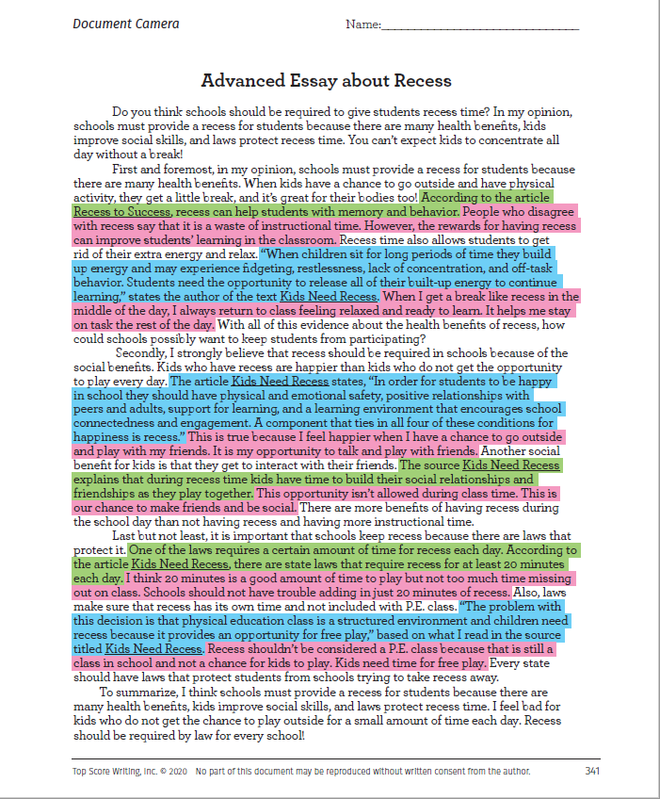
OVERVIEW OF ELABORATIVE TECHNIQUES
Key
Quotes
Paraphrasing
Own thought/idea

Slide 73
OPINION/ARGUMENTATIVE CONCLUSION
EXAMPLE
  To summarize, recess should be required by law for every school. Schools must provide recess for students because there are many health benefits, kids improve social skills, and laws protect recess time. I think all kids should get the chance to play outside each day.
Key
Overview(summary)-opinion
Restate 3 reasons
Thought or feeling
Teaching Tip:
Model writing multiple conclusions for the same plan.

Slide 74
ADDITIONAL ACTIVITIES
AND STRATEGIES

Slide 75
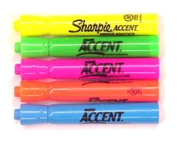
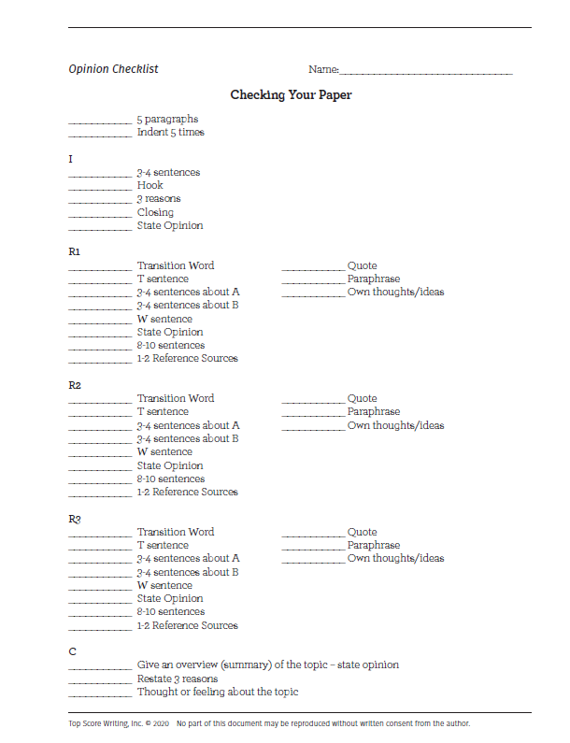

SELF-ASSESMENT TOOLS

Slide 76
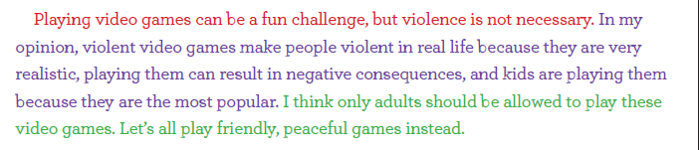
HIGHLIGHTER ACTIVITY
IDENTIFY EACH PART OF A PARAGRAPH
Directions:
Provide students with the key
Model highlighting the class essay
Students self-assess their own paragraphs by color-coding
“C” Paragraph Key
Summary
Restate 3 topics
Thought or feeling

Slide 77
HIGHLIGHTER ACTIVITY
ANALYZE USE
OF ELABORATIVE TECHNIQUES
Directions:
Provide students with the key
Model highlighting the class essay
Students self-assess their own paragraphs by color-coding
T1, T2, T3
Quoted evidence
Paraphrased evidence
Own thoughts and ideas

Slide 78
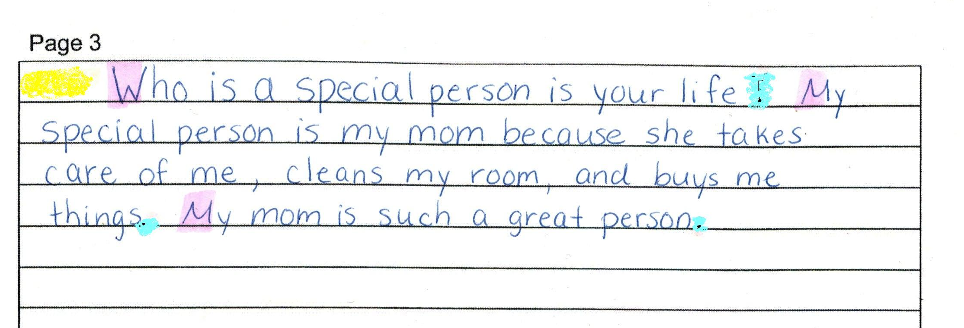
HIGHLIGHTER ACTIVITY
CONVENTIONS
Directions:
Have students write a paragraph.
Write color-code key on board:
    Indent space – yellow
    Capitalization – purple
    Punctuation – blue
Have them highlight, then discuss.
Repeat as they write each paragraph.

Slide 79
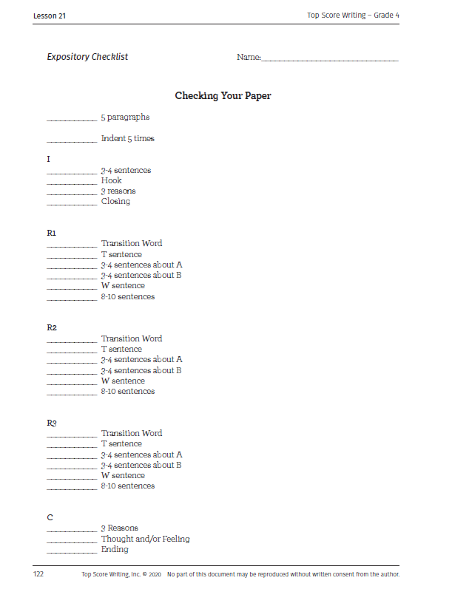
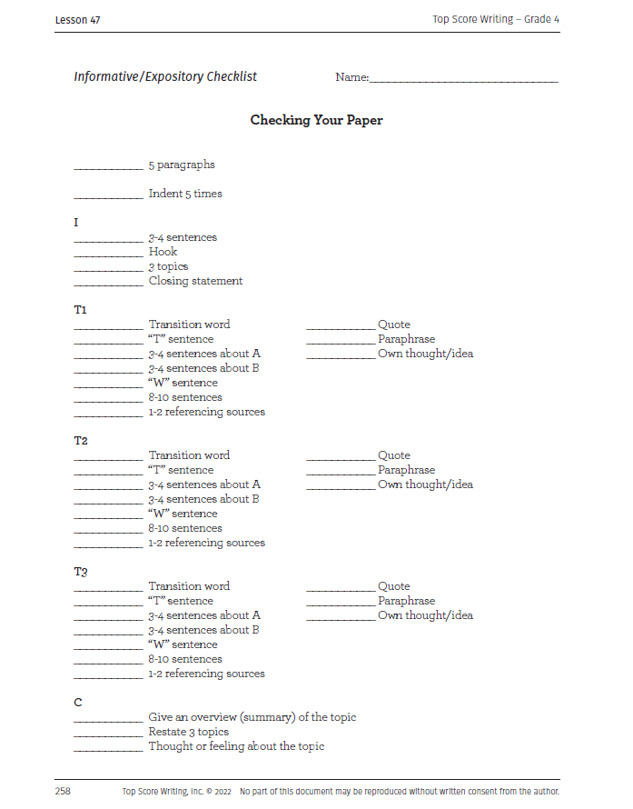
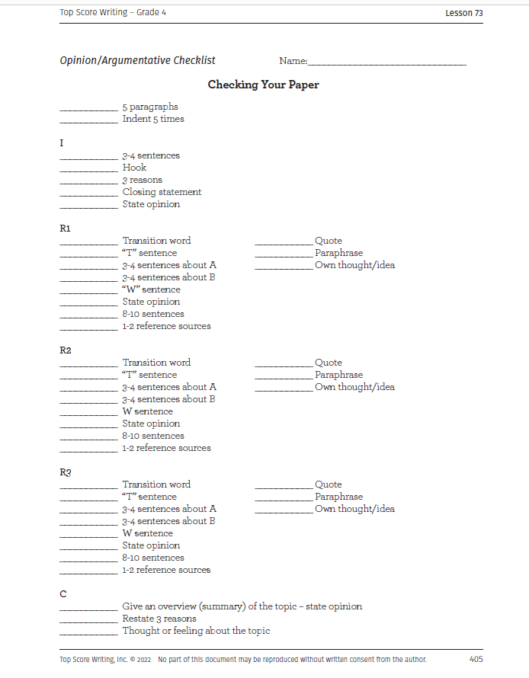
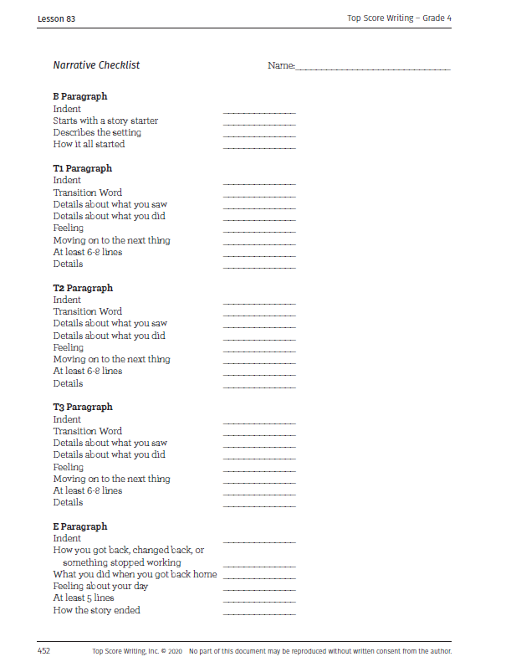
CHECKLISTS
So Many Ways To Use:
Self-assess part of an essay
  Example: if students only wrote their introductions today, they would only use the introduction portion of the checklist.
Self-assess an entire essay
  Example: use during a revision day after an assessment.
Use as a guide while students are writing.

Slide 80
YOU WRITE, THEY WRITE
MODELING AND PACING PRACTICE
Directions:
Read a text set and write a prompt on the board.
Plan for the prompt under the document camera – think out loud.
Students plan for the same prompt (they can’t use your ideas) - set a timer.
Write your introduction paragraph – think out loud.
Students write their introduction paragraph- set a timer.
Write your T1/R1 paragraph under the document camera – think out loud.
Continue this process for the remainder of the essay.
Teaching Tip: Provide extended time for students with accommodations.

Slide 81

RACE AGAINST THE CLOCK
PACING AND ENDURANCE PRACTICE
Directions:
Have students read a text set. Write a prompt on the board.
Get the timer ready and tell students they will have 10 minutes to plan. Go!
After 10 minutes, have students put their pencils down. Anyone who planned correctly in 10 minutes gets a raffle ticket.
Tell students they will have 10 minutes to write their introduction paragraph. Go! *As students are writing, walk around the room and check on their essays.
After 10 minutes, pencils down. Anyone who wrote their introduction paragraph correctly with all three parts gets a raffle ticket.
Tell students they will have 15 minutes to write their R1 paragraph.
Continue this process for the remainder of the essay.
Teaching Tip: Pull a small group or hold conferences during writing.

Slide 82

MAKE WRITING
FUN!
Seminars
Table writing
Writing Around The Room
Partner writing on big Post-its
4th/5th-grade pair-up
Student exchange
Seminars
Table Writing
Writing Around The Room
Partner Writing on Big Post Its
4th/5th Grade Pair Up
Student Exchange

Slide 83

TEACHER VIP GROUP
https://bit.ly/2C0kVAc
A place to share ideas, activities, and resources.
With lots of fun giveaways sprinkled in ☺

Slide 84

STAY IN THE LOOP
Sign up for our EMAIL LIST by grade level
www.topscorewriting.com
-Revisions, new lessons, information, documents, etc.
“LIKE” Top Score Writing on Facebook
“FOLLOW” Top Score Writing on Instagram
-Share ideas for the classroom
Subscribe to the Top Score Writing YOUTUBE channel
-Watch videos on every skill

