Slide 1
Your Path to a Worry-Free Audit by Exceeding the Standard

Slide 2
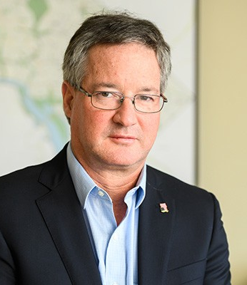
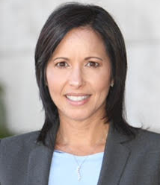
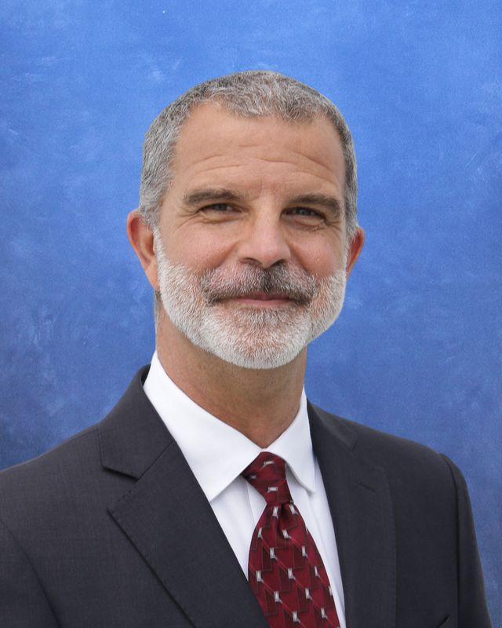
Richard Moreno
President, Southern Region
Building Hope
Office: 954-767-1070
Email: RMoreno@bhope.org
Laura Feinberg
Partner,
SWKJD
Office: 786-536-1865
Email: LFeinberg@swkj-cpa.com
Jose Nodarse
Director of Finance,
True North Charters
Office: 305-749-5725
Email: JNodarse@trueNorthCharter.org

Slide 3
An audit is required every year
Charter School Requirements:
1002.33(j)2. Ensuring that the charter school has retained the services of a certified public accountant or auditor for the annual financial audit, pursuant to s. 1002.345(2), who shall submit the report to the governing body.
1002.33(j)3. 3. Reviewing and approving the audit report, including audit findings and recommendations for the financial recovery plan.

Slide 4
General Parts of the audit
Management Discussion & Analysis
Independent Auditors Report on Financials
Financial Statement
Supplementary Information
Report on Internal Controls
Additional Information
Notes:
Explain the basic parts of the audit and what is in each part

Slide 5
Auditors are required to report...
Material weaknesses - deficiency, or combination of deficiencies, in internal control, such that there is a reasonable possibility that a material misstatement of the financial statements will not be prevented or detected and corrected on a timely basis.
Significant deficiencies in internal controls - a deficiency, or combination of deficiencies, in internal control that is less severe than a material weakness, yet important enough to merit attention by those charged with governance.
Noncompliance with provisions of laws, regulations, contracts, or grant agreements that have a material effect on the financial statements.

Slide 6
Significant Findings for recent years
16% of schools had findings
208 findings total
38 of the findings were material weaknesses
18 of the findings were noncompliance
50% of the audit reports did not have information required by the Auditor General
35% of the reports had issues that were repeated from the year before

Slide 7
Financial Trends
7 audits questioned the school’s ability to continue operations
8% schools reported a general fund deficit

Slide 8
Top 10 Significant Deficiencies
The next slides will review each of the top ten significant deficiencies with recommendations on how to avoid.

Slide 9
#1 - Cash Controls
You must have policies and practices in place to ensure proper control of the school’s funds.
Repeated Report Finding:
For multiple charter schools, the CPAs noted inadequate controls over cash.
They noted control deficiencies included untimely prepared bank reconciliations and inadequately safeguarded cash collections.
These deficiencies increase the risk that unauthorized disbursements or loss of cash could occur and not be timely detected.

Slide 10
#2 - General Expenditures
You must adequately document your purchasing and decision making.
Repeated Report Finding:
For multiple charter schools, the CPAs noted purchasing and other disbursement control deficiencies, such as inadequate documentation to support expenditures.
Lack of controls over purchasing and invoice payment functions could affect a charter school’s ability to demonstrate the appropriate use of public resources.

Slide 11
#3 Purchasing
You should consider policies for purchasing:
Who approves purchases
Dollar limits on approvals
Signature levels on checks
How are decisions documented
Comparing prices is important
Some grants will require it for $500+
Consider using RFPs for larger contracts

Slide 12
#4 – “RFP”s (Requests For Proposals)
What is a Request for Proposal
What types of services should we use this for?
Required for auditor
Required if you are an NSLP school for lunch services
Required if you are utilizing ERate service/reimbursement
Samples available on the Charter Support Unit website:
Accounting Services, Alarm Monitoring, Auditor, Back Office Services, Insurance, Intercom System, Payroll “Processing Services, School Uniforms, Security Surveillance, and Transportation Services

Slide 13
#5 - Records Management
Accounting process must ensure you have reliable record of school funds.
Repeated Report Finding:
For multiple charter schools, recent CPAs noted that accounting and financial records were not properly and accurately maintained.
Deficiencies included transactions either not posted or incorrectly posted to the accounting records and insufficient monitoring and review of account balances.
Such recordkeeping deficiencies may affect the reliability of a charter school’s records and related financial reports.

Slide 14
#6 - Transparency
Pay attention to Government in the Sunshine.
Repeated Reports Found:
For many charter schools, the CPAs noted that the charter schools did not maintain on their Web sites the information required by State law.
According to the reports, the schools’ Web sites lacked required information such as school budgets, independent financial audit reports, and minutes of governing board meetings.

Slide 15
#7 - Payroll and Personnel Admin
Be very careful with payroll requirements.
Repeated Reports Found:
For multiple charter schools, the CPAs noted inadequate controls, or noncompliance with applicable legal requirements related to payroll and personnel administration.
For example, because of inadequate controls, some charter schools did not always calculate Florida Retirement System contributions using correct employee wage amounts.
Such payroll and personnel control deficiencies affect a charter school’s ability to comply with legal requirements associated with payroll and personnel obligations.

Slide 16
#8 - Separation of Duties
Make it so that no one can steal money without someone else noticing.
Repeated Reports found:
For multiple charter schools, the CPAs noted that certain duties and responsibilities were not adequately separated.
Consequently, the charter schools’ ability to properly safeguard assets was limited and there was an increased risk that errors or fraud, should they occur, may not be timely detected.
The CPA’s recommended that, due to the small number of staff members and size of certain charter schools, the charter schools reassign duties and responsibilities or establish compensating controls.

Slide 17
#9 - Budget Administration
Approve your budget, and closely watch your Budget v. Actual statements
Repeated Reports Found:
For many few charter schools, the CPAs noted inadequate controls over budget administration that caused certain budgetary amounts to be over expended.
Weaknesses in budgetary controls increase the risk of inefficient or inappropriate use of financial resources, which may result in a deteriorating financial condition

Slide 18
Separation of Duties
Try to divide up responsibilities as much as possible
Who collects money
Who records money
Who takes money to bank
Who receives invoices
Who writes checks
Who signs checks
Who reconciles the bank account
If you don’t have seven people, how can you build in checks and balances?

Slide 19
#10 - Miscellaneous Findings
Utilize best practices.
Repeated Reports found:
For many charter schools, the CPAs noted various audit findings related to areas such as capital assets, significant delays in providing requested information to the auditor, and emergency preparedness.
Other miscellaneous findings noted charter schools with financial position concerns, including those with total fund balance deficits.

Slide 20
BEST PRACTICES

Slide 21
GASB - Practical Illustrations
An in-depth look at accounting for government organizations

Slide 22
Select and Implement an Accounting System
Determine needs based on growth plans
Outsource or In House
Identify Person Responsible for Implementation
Identify ALL Costs of Accounting System
Quickbooks ?
Data Safety

Slide 23
Adopt and Follow a Policy Manual
Policies: The Board’s direction to staff on operations
Having a ‘policy’ protects the school and staff, especially from helicopter parents
Organize a structure to keep any/all policies approved

Slide 24
Policies to Adopt
Banking Policies
Purchasing
Accounts Payable
Cash Management
Fixed Asset Control
Records Management

Slide 25
Developing Policies and Procedures
Cash controls –
refers to establishing and maintaining an adequate system of internal controls in order to safeguard cash and investments.
Capital assets
should be marked or tagged to indicate ownership by the charter school, all acquisitions should be recorded, and a physical inventory should be conducted annually.
Payroll and personnel administration –
Responsible payroll management is extremely important because failure to pay employee income taxes, federal social security, retirement benefits, or wages and salaries may result in a finding that the school is in a state of financial emergency.

Slide 26
School’s Website – Required Posting
Name/Contact for representative to facilitate parental involvement
Names of governing board members
Annual Budget
Programs offered at the school
Any EMO/CMO associated with the school
Board Meeting Minutes posted quarterly
Fortify FL
Academic Performance
Annual Audit
School Grade

Slide 27
Board Policy - Basic Things To Remember
All official acts must be taken at a public meeting
No two board members may discuss anything that could potentially come before the Board outside of a public meeting
Unilateral communication is okay, discussion is not
Advisory committees are also subject to the sunshine laws
Cannot use liaisons to circumvent the requirements

Slide 28
Stay Informed
The charter landscape changes frequently. Statutes are usually changed annually.
Pay attention to legislation that may change charter school operations.

Slide 29
Richard Moreno
President, Southern Region
Building Hope
Office: 954-767-1070
Email: RMoreno@bhope.org
Laura Feinberg
Partner,
SWKJD
Office: 786-536-1865
Email: LFeinberg@swkj-cpa.com
Jose Nodarse
Director of Finance,
True North Charters
Office: 305-749-5725
Email: JNodarse@trueNorthCharter.org

