Slide 1
Welcome to FCSC Flight 2022
Nonstop Jet service to May 2023
Notes:
On screen prior to participants entering – if either of you know how to loop the video please do!

Slide 2
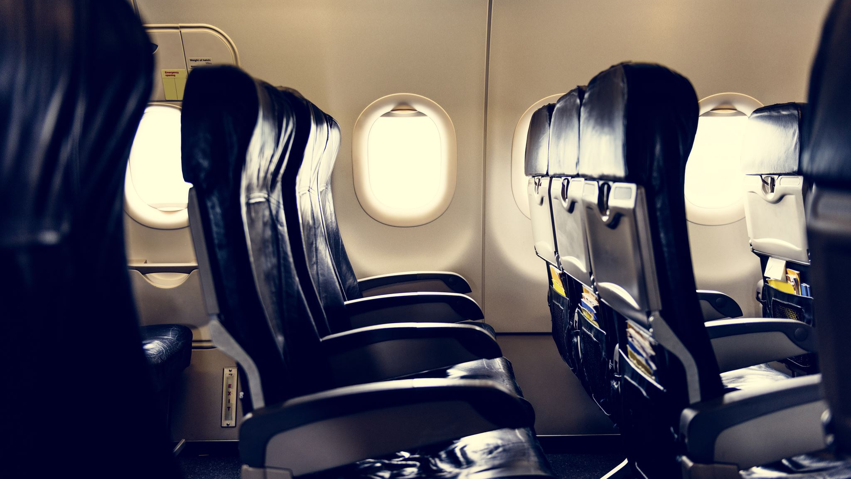
Please find your seat and stow all belongings under the seat in front of you
Notes:
As folks take their seats we can go to this slide, thank people for having their seatbacks in the upright position!

Slide 3
Kindly give your attention to the inflight crew as we review some important safety announcements
FCSC
Flight
2022
2022
FCSC ​
Flight ​
2022​
Flight ​​
2022​
2022
Notes:
When we are ready to begin we will ask folks to give us their attention while we review the safety information for today's flight - - I know the whole speech so I'll go over the exits, flotation devices (we will all model this part) then the oxygen mask demo! Once we have attention we'll go to the next slide which introduces us then we will do the routine!

Slide 4
Your Inflight Crew for Today's Flight:
CSUSA Based Crew:
Christina Hamlin
Deputy Director Area 5
Rachel Windler-Freitag Deputy Director Area 2
Tracey Jones Saxon
Director of School Support
FCSC ​
Flight ​
2022​
Flight ​​
2022​
2022
2022
2022
2022
Notes:
Following introductions we will go over the routine for pre-flight

Slide 5
Please place YOUR oxygen mask on first
before trying to assist others
FCSC
Flight
2022
FCSC ​
Flight ​
2022​
Flight ​​
2022​
2022
2022
2022
2022
Notes:
When we get to this part one of us will need to switch to this slide.....we will break and ask the participants the questions on the next slide....

Slide 6
How often do you put on someone else's oxygen mask first?
Why
do you put your oxygen mask on first, before assisting others?
Notes:
Essential questions for the day....

Slide 7
Flight Plan
Our Current State
Personal
Research
Sharing of Solutions
File your own flight plan!

Slide 8
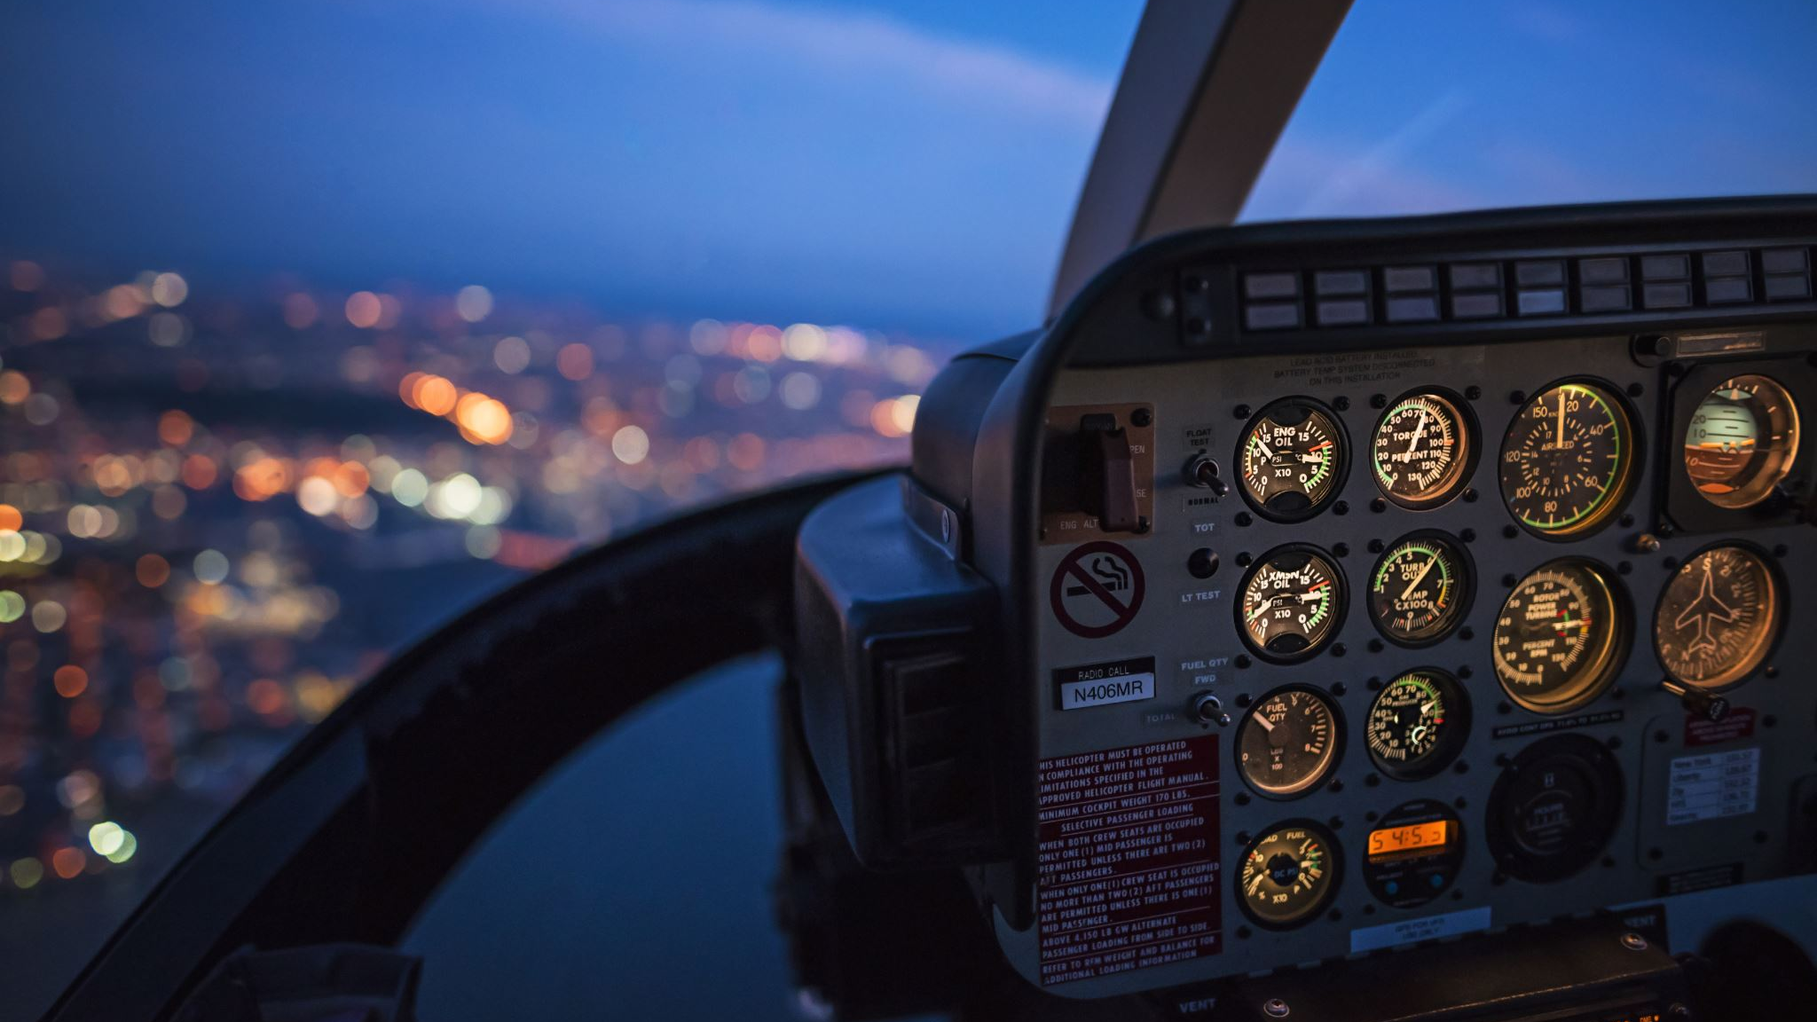
What are YOUR biggest stressors at work?
Who gets the first oxygen mask at your school?
Co-Pilot Conversation
Turn & Talk
Share one or two words that describe a quality that is shared by school administrators
Notes:
Circulate and allow folks to share out - - understand that there will be a variety of attendees, mostly admin.

Slide 9
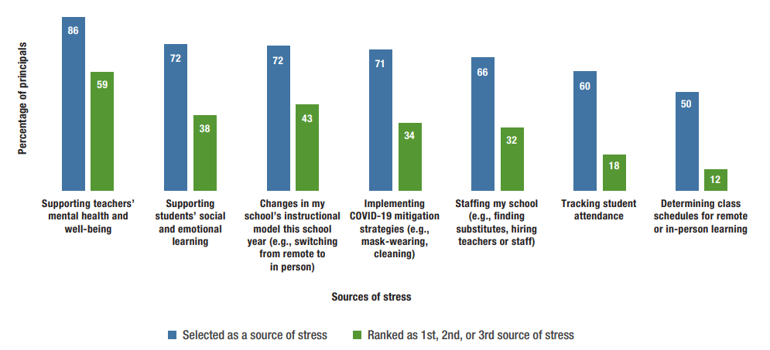
1,686 Principals across the country took part in the RAND Corporation's annual Learning Together Survey in 2022.
When asked to indicate sources of stress they said:
Notes:
RAND Corporation Data (2022) from the LTS Survey

Slide 10
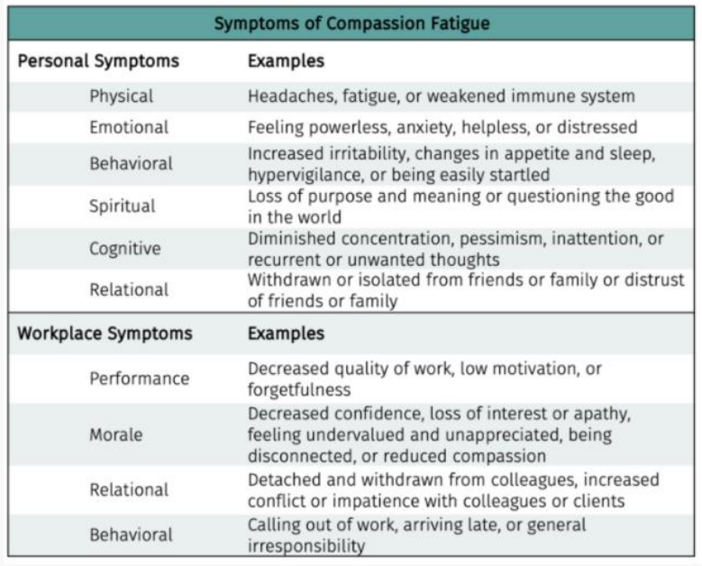
Compassion Fatigue

Slide 11
How do we put our oxygen mask on first?
5 Strategies to Help You Breathe Easier
This Photo by Unknown author is licensed under CC BY-NC-ND.

Slide 12
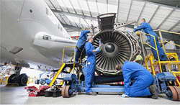
Strategy 1: Distributive Leadership
Let others help lift the load –
it will make you feel better, and they will feel more connected.
“Self-care is not skipping out on work to heal mentally. Self-care is the incorporation of healthier practices into your life that reduce stress. Working with our staff to be mindful of how they are doing and ways to create true self-care instead of procrastination was critical. "
Principal Brian E. Cox
Johnson Junior High School, Cheyenne, WY
Navarra, Katie. "Burnout Busters: 5 Strategies to Help School Leaders Combat Pandemic Fatigue". K 12 Dive. August 2021. www. K12dive.com

Slide 13
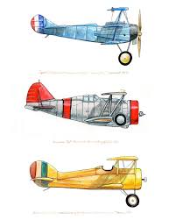
Strategy 2: Stay Connected
Leverage your online connections with other leaders, associations and peers.
Superintendent Ken Wallace of Maine Township High School District 207 in Illinois started Project 3x3. Through this initiative, he checked in with three connections daily via tweets and encouraged others to do the same to amplify the benefits. Each person then was able to reach three more colleagues.
Navarra, Katie. "Burnout Busters: 5 Strategies to Help School Leaders Combat Pandemic Fatigue". K 12 Dive. August 2021. www. K12dive.com

Slide 14
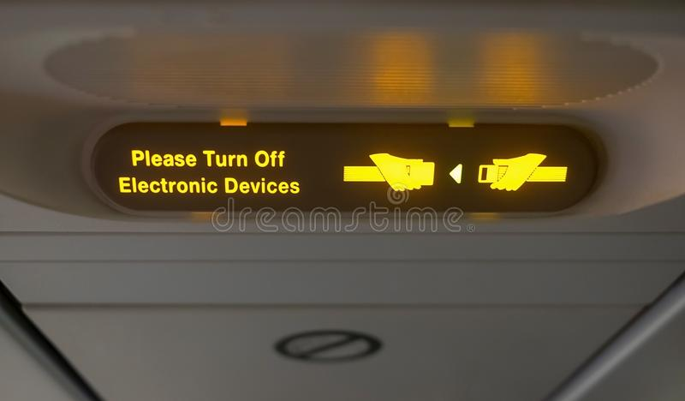
Strategy 3: Do Not Disturb
Be in the moment at ALL times, even away from school
Sabreen Mutawally, AP at Page High School, Greensboro, NC, said she often found herself checking and responding to emails first thing in the morning or as she laid in bed at night, which ultimately led to a lack of sleep and feelings of anxiety and frustration. Using the DND or Bedtime Mode for all electronics honors your personal time and space and allow you to break from your work.
Navarra, Katie. "Burnout Busters: 5 Strategies to Help School Leaders Combat Pandemic Fatigue". K 12 Dive. August 2021. www. K12dive.com

Slide 15
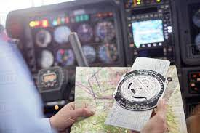
Strategy 4: Pace Yourself
Your flight plan should be adjusted gradually – not all at once
One way Principal Cox paced himself was through using feedback from climate surveys and informal communications to gauge student, staff and parent pressures. That feedback has allowed for changes to be made in an efficient and more timely way. It also allows him to make smaller changes over a longer period which reduces stress if the decision is incorrect.
Navarra, Katie. "Burnout Busters: 5 Strategies to Help School Leaders Combat Pandemic Fatigue". K 12 Dive. August 2021. www. K12dive.com

Slide 16
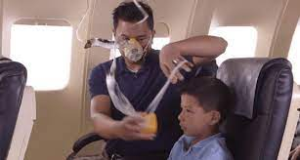
Strategy 5: Put "Your Self" First
Servant Leadership does NOT equal self-sacrifice
“Make sure you are eating and sleeping well. Plan your meals so the business of the day does not overwhelm you. The most important part of self-care when you are experiencing burnout is self-compassion. You are doing your best right now, and while it may not feel good enough, it’s all anyone can ask of you. Release your self-guilt and continue doing the best you can.”
Laurie Cure
CEO of Innovative Connections
Navarra, Katie. "Burnout Busters: 5 Strategies to Help School Leaders Combat Pandemic Fatigue". K 12 Dive. August 2021. www. K12dive.com

Slide 17
We are preparing for our descent into May 2023
FCSC
Flight
2022
2022
FCSC ​
Flight ​
2022​
Flight ​​
2022​
2022
Share with a partner one idea you may try for self care
Notes:
When we are ready to begin we will ask folks to give us their attention while we review the safety information for today's flight - - I know the whole speech so I'll go over the exits, flotation devices (we will all model this part) then the oxygen mask demo! Once we have attention we'll go to the next slide which introduces us then we will do the routine!

Slide 18
This presentation and additional materials, articles and our contact information can be found in your WHOVA App!
Please stay seated until we arrive
and feel free to review the materials
attached to our presentation!
Notes:
Essential questions for the day....

Slide 19
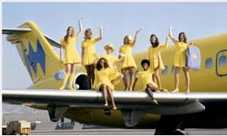
On behalf of the CSUSA-based flight crew, we hope you have enjoyed your flight!
Wherever your travels may take you – make sure you take care of yourself!
It has been our pleasure to serve you and we hope to see you on another flight!

