Slide 1

The Path to Finding and Funding your Forever Home
Florida Charter Schools Conference 2022

Slide 2
We’ve missed being together
Empathy
Notes:
First, we want to acknowledge, it’s been a tough two years. We’ve missed being together! Have you been able to visit the therapy dogs in the expo hall? I know we have… (empathy)

Slide 3

Education innovators – thank you!
You get more done with fewer resources than traditional public schools
You have (too often) a DIY model for facilities, operations, marketing, transportation and more
Thank you, Charter School leaders
CSC FOR FL| 3

Slide 4
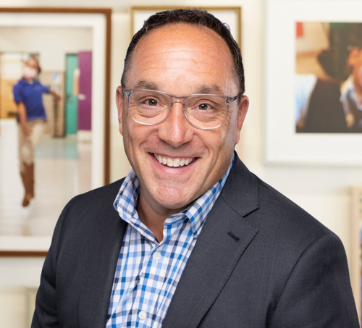
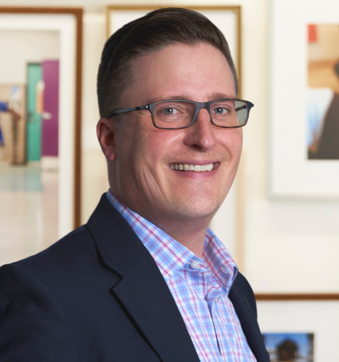
Defining a path to your forever home
Jon Dahlberg
Senior VP of Business Development & Facilities
Milestones for our talk, your journey
Your schools’ wants and needs
A plan for success
Your money options
Making the decision
Designing your school
Let’s move!
Matthew Gardner
Client Services Representative
CSC FOR FL | 4

Slide 5
Every path is different
Notes:
A path to your forever home is different for everyone. So, let’s dream a little as we create milestones along the way. – (Stability)

Slide 6
01 Dreaming: your wants (and needs)
1
2
3
Needs
Understand your wants and dreams and your needs for your facility
Space
An inviting space inside and out which is functional will create a nurturing environment for your school
Budget
Examine your budget carefully and realistically to ensure long term sustainability
CSC FOR FL | 6

Slide 7

Want / Need
Requirements Considerations
Total Space is a combination of what you NEED and what you WANT ​
  NEED is a function of your charter
  WANT is a function of what you can afford, and your dreams for the future
Make sure you account for bathrooms, hallways, offices and conference rooms​
“Curb appeal”, colors, textures, intentional aromas help create a nurturing environment
Academic Mission
Growth plan for attendance
Specialty requirements
Local considerations
What can we afford?
Remember to consider existing reserves, ongoing % of revenue, fundraising, and funding alternatives.
CSC FOR FL | 7

Slide 8
10-20% of revenue is sustainable
Facilities budget and your school revenues
10% Facilities cost/ rev 15% facilities cost/ rev 20% facilities cost/ rev
Potential project budget
Annual school revenue
CSC FOR FL | 8

Slide 9

Pick a path that will last
Authenticity
Notes:
As we look to map our dreams with reality, our goal is to pick a path that will provide stability so the school and community will outlast everyone in this room. (Authenticity)

Slide 10
02 Plan for success
1
2
3
Timeline
Set a realistic timeline that minimizes disruption to students and programs
Prepare
Prepare for setbacks; assume that any renovation project is going to take longer than expected
List
Make a list of must-have features. Go back to your charter, mission, and board to determine what your facility must have.
CSC FOR FL | 10

Slide 11
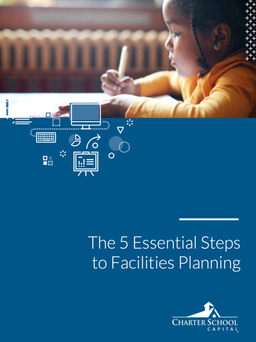
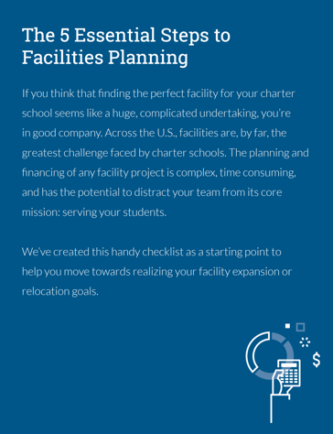

02 Plan
A written plan is a powerful tool
Involve your entire team
A facility expansion or move will likely involve your entire team!
Learn from other schools
Find out how long it’s taken other schools to accomplish similar projects
Revisit your mission
Revisit your mission when making decisions about what is truly critical for your school
Assume that any building or renovation project will take longer than expected.
Time it for minimal disruption
Tip: Download the eBook
Read The 5 Essential Steps to Facilities Planning for more details on this stage!
*LCFF is short for “Local Control Funding Formula,” a large portion of your state receivable.
CSC FOR FL | 11

Slide 12
Build a new beginning
Approachable
Notes:
Planning a new beginning – exploring new dreams, new spaces – can breathe energy into your approach to your school. Enjoy this process. (Approachable)

Slide 13
03 Consider money options
1
2
3
Options
Know all the options that exist for your charter school, including lesser-used options.
Pros & Cons
Weigh the pros and cons of each objectively, without bias.
Evaluate
Evaluate which option is best for your school – now and in the future.
CSC FOR FL | 13

Slide 14


03 Types of Money
You may have more options than you think
Criteria | Cash | Bank | Bond | Long Term Lease | No-Cost Bond Alternative
Cash needed to close | $7M | $1.4M+ | $0 – 200K | $0 – 100K
Annual cost (example) | $0 | $350 – 700K | $600 – 800K | $630 – 700K
Underwriting | None | Min 5 yrs. Surplus Assets + Revenue | Min 3 yrs. Debt coverage Surplus Rating? | No minimum Academic success Flexible
Security interest | None | Real estate + all assets | Real estate + all assets | None
Growth options | Cash = Build | Refinance risk Rate risk | 10 yr minimum Refinance risk Covenants | Scalable, expandable
Considerations/ challenges | Reserves? | 20% + equity 5-20yr term and amortization | Annual compliance. Transaction costs , “Road show” | 100% financing No amortization Buy Out Option
Tailored to
your needs.
Let’s talk together.
CSC FOR FL 14

Slide 15
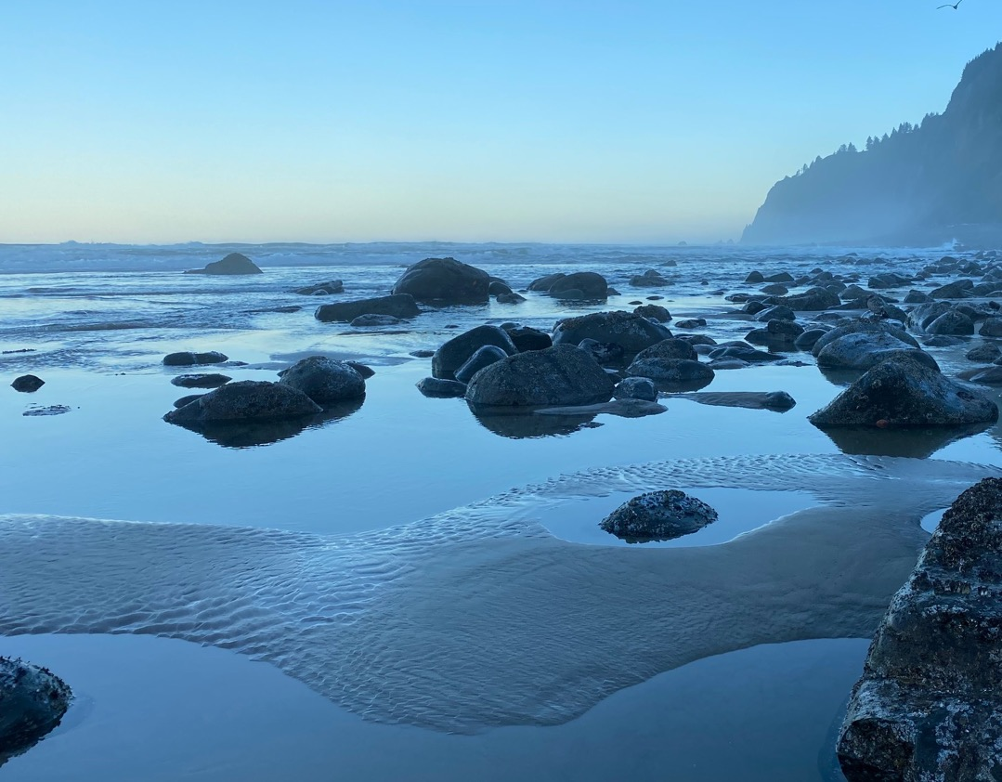
Reflect on your options
Notes:
Let’s pause for a moment to reflect on the new money options available to us. Decisions are best made when heads and hearts are aligned. Be in that space when as best you can. (Authenticity)

Slide 16
04 Making your decision
1
2
3
Lease vs. Purchase
Determine whether the best path for your school is a lease or a purchase
Site
Find the site that’s best for your charter school.
Restrictions
Understand how your school’s requirements stack up against local or site restrictions
CSC FOR FL | 16

Slide 17

04 Decision
Lease vs. purchase is about control vs. ownership
Consider:
Management time and expertise
Note: There will be more time/ expertise required for a bond than a lease
Long-term, local real estate trends
Fluctuations of the broader market
Tip: Anticipate Zoning Challenges
Consult other successful charter schools, land-use attorneys and experienced consultants in the charter school space.
*LCFF is short for “Local Control Funding Formula,” a large portion of your state receivable.
If the building is zoned for education
CSC FOR FL | 17

Slide 18
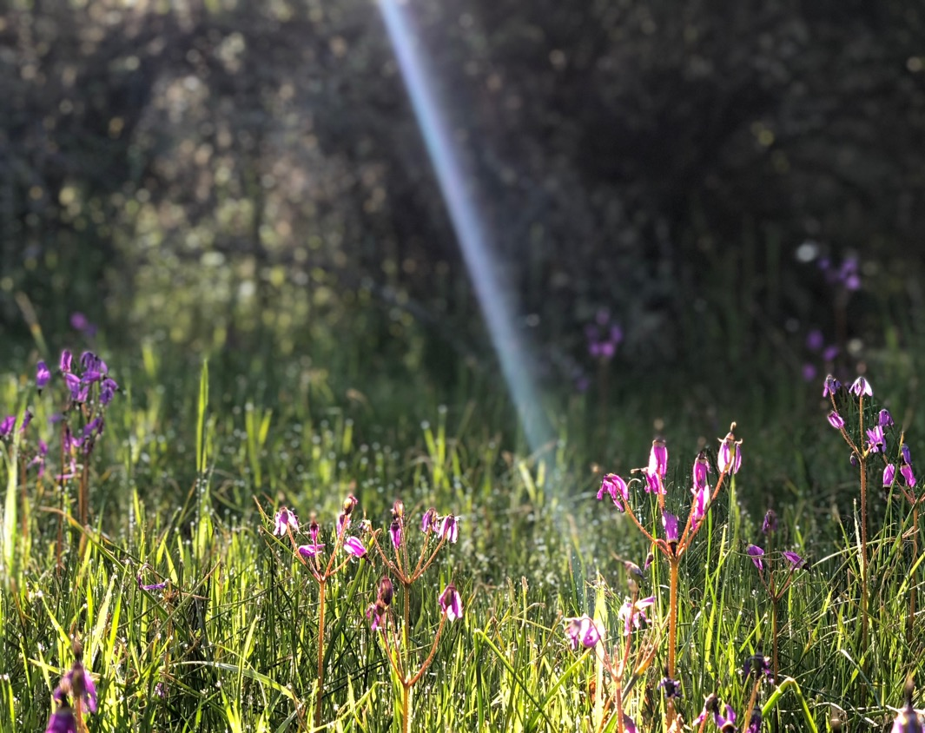
Decisions invite renewal
Notes:
Once you’ve been able to make the tougher decisions, we hope you’ll feel a sense of renewal, and creativity. (renewal)

Slide 19
05 Designing your school
1
2
3
Mission
Design with your mission in mind and consider what would be most affordable and effective for your mission
Team
Find a team of professionals who have proven charter school facilities experience and can provide the advice you need.
Permits
Ask your funding partners, commercial real estate agent, designers, and contractors about the permits that you’ll need.
CSC FOR FL | 19

Slide 20
05 Design
Considerations
Revisit your mission at this stage. What can you do to meet that in your design?
A good design should have input from all your constituent groups – admin, teachers, students, authorizers, board, etc.
Consider what would be affordable and effective for your mission and students (today and in the future)
Choose architecture, engineering, and construction professionals who are experienced in charter schools and who can adapt to your project
Ask about the permits that you’ll need. These are different for renovation vs. rehab vs. new build
Tip: Consider enrollment & costs
There’s no requirement that everything must be done all at once if you have enough room for your students and there’s not a significant financial disadvantage.
*LCFF is short for “Local Control Funding Formula,” a large portion of your state receivable.
CSC FOR FL | 20

Slide 21

Dreams can become a reality
Optimism
Notes:
This is where you begin to SEE your future is now! Optimism

Slide 22
06 Let’s move!
1
2
3
Project Manager
Decide on a project manager or owner’s representative for your charter school
Communicate
Show your students, families and community videos and pictures of the project progress!
Move
Create an in-depth plan to smooth the complex transition into your space.
CSC FOR FL | 22

Slide 23
06 Move
You have options for who help will oversee logistics
Project managers
They typically work for the contractor and focus on keeping the project on schedule and on budget
These are independent third-party professionals that look out for your best interests throughout every phase of the project, including site selection, design, construction, and relocation
Owner’s representatives
The move plan:
Creating an in-depth plan can help to smooth a complex transition and help your students and staff know what to expect
Moving is always challenging! If you’re relocating to another facility, try to do it during the summer or another significant school break
Tip: Communicate Often!
Hold an open house and give tours to your students and their families in advance of the school year. Share videos and images!
*LCFF is short for “Local Control Funding Formula,” a large portion of your state receivable.
CSC FOR FL | 23

Slide 24

Let’s go! The future is now
Notes:
And now, we’re here! Together… - Optimism

Slide 25
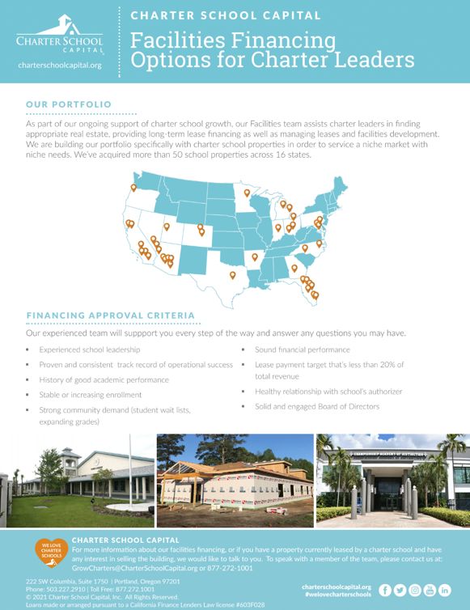
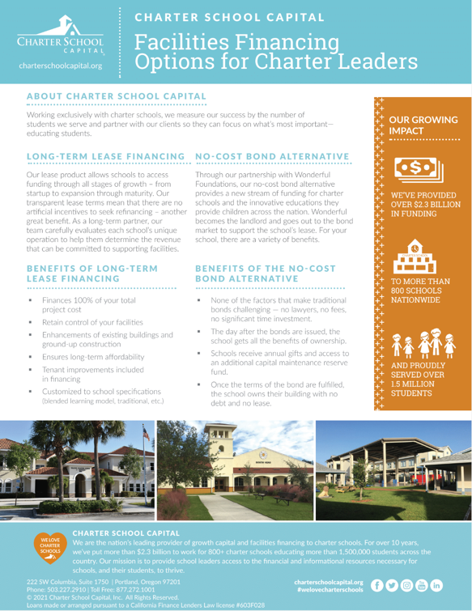
More information
Long-term leases and no-cost bond options for forever schools
charterschoolcapital.com/facilities
CSC FOR FL | 25

Slide 26
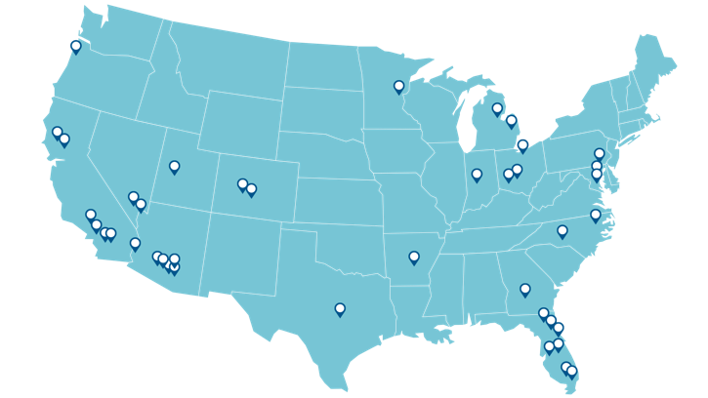
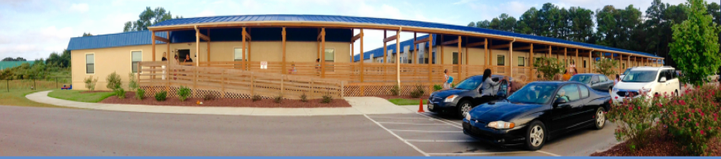
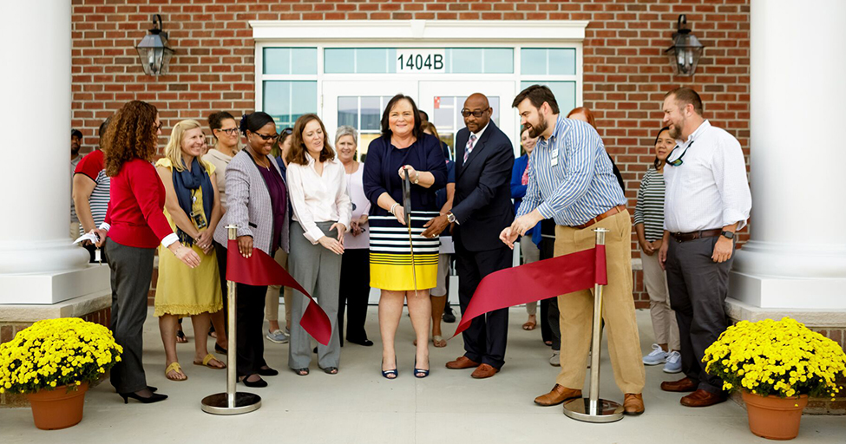
More than 70 school buildings
Actively helping schools become forever homes
*LCFF is short for “Local Control Funding Formula,” a large portion of your state receivable.
And growing!
CSC FOR FL | 26

Slide 27
​Charter schools are the innovators in education. We support the charter school leaders through providing a steady, reliable stream of money and other resources, helping them find their forever schools, and filling their school classrooms. ​
1.8mm
Students and families
A history of service
800+
Charter schools
$2.3B+
Invested in charter schools’ and communities
CSC FOR FL | 27

Slide 28
“Education is the most powerful weapon which you can use to change the world”
Nelson Mandela
CSC FOR FL | 28

Slide 29
Jon Dahlberg
Senior VP of Business Development & Facilities
Thank you!
Matthew Gardner
Client Services Representative
CSC FOR FL | 29

Slide 30
Helping schools get into their forever homes
Moving you forward
Helping you get where you’re going.
Providing a stable, reliable flow of Money to schools
Filling school classrooms with students

