Slide 1
Grants Galore!
Managing any grant for success

Slide 2
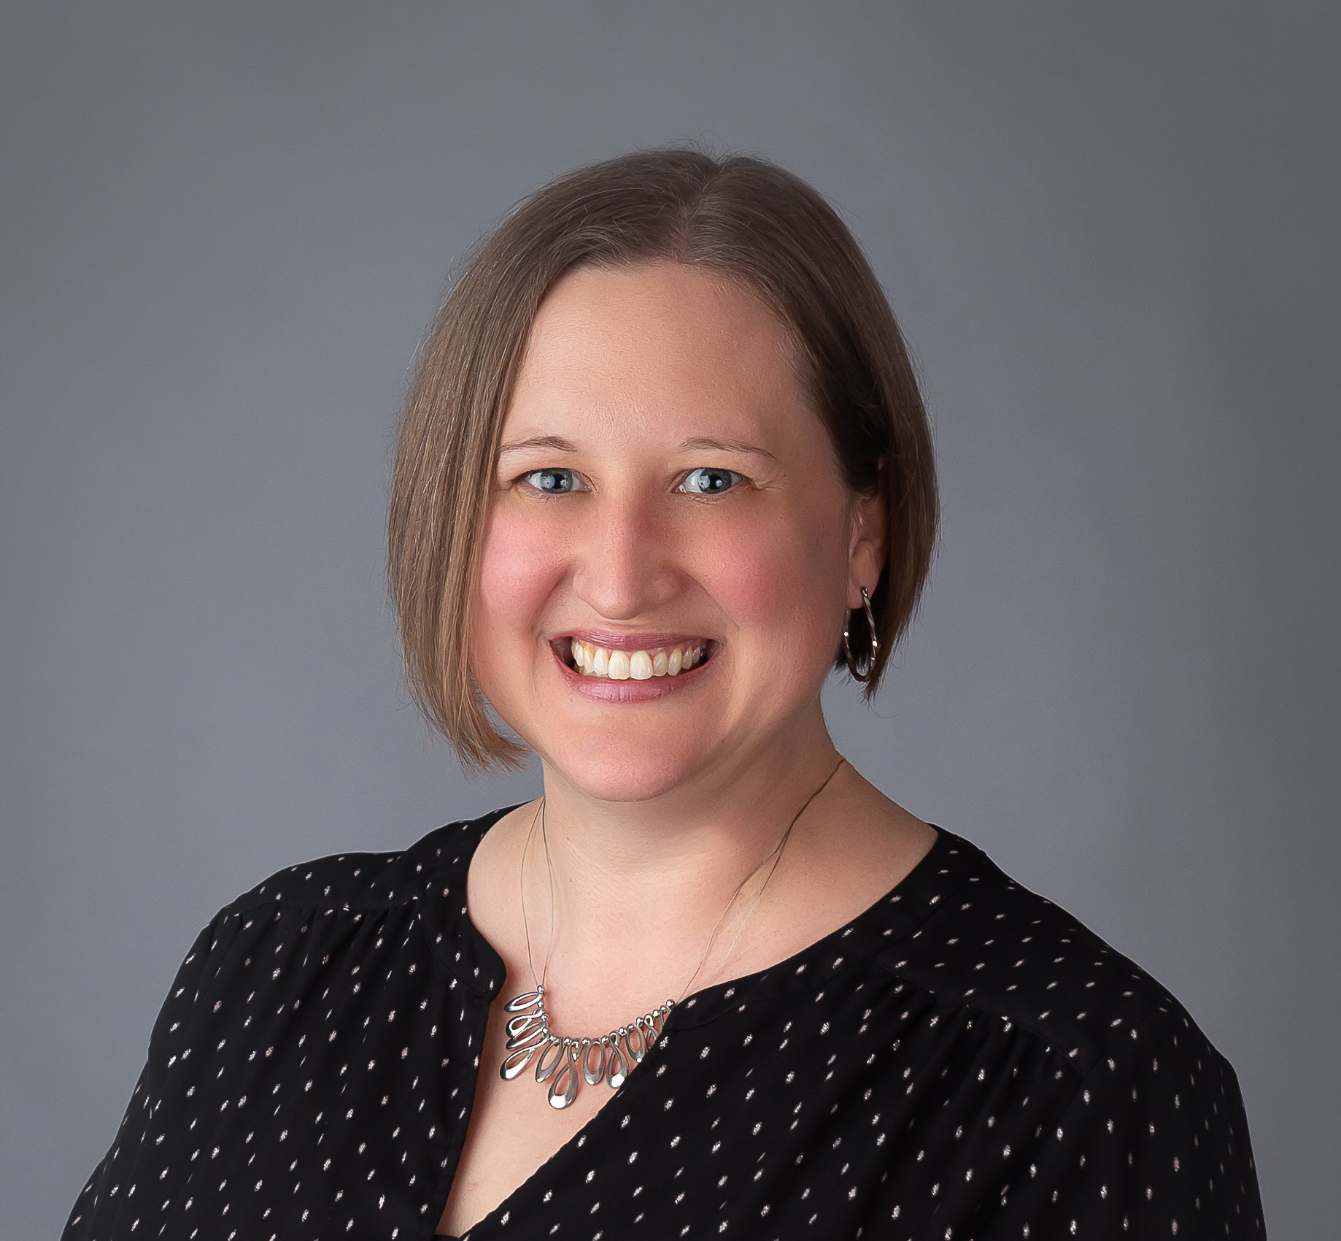
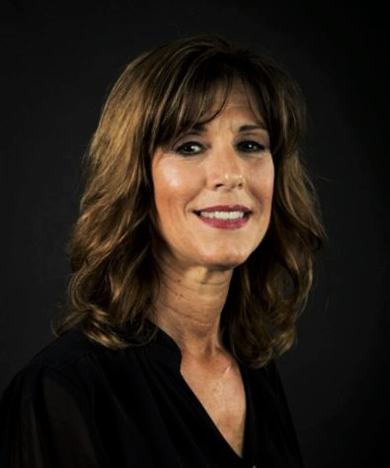
Presenters
Trisha Leitem (850) 848-4757 TLeitem@bhope.org
Building Hope
Director of Charter School Operations
Manage School Payroll and Grants
Former Charter School Principal
Former Charter School Board Member
Former Music Teacher
Ann Levene-Eisenberg (561) 533-9917 AnnL@pbsfa.org
Palm Beach School for Autism
Executive Director
Sixteen years as ED
Business Operations
Grants, Foundations, Operations
Staffing & Training
Marketing & Development

Slide 3
Budgets
“A budget is telling your money where to go rather than wondering where it went..”
– Dave Ramsey

Slide 4
Be Intentional
 | Bad | Good
Consider the intention of the grant and phrase your descriptions accordingly | P.E. Teacher | Additional P.E. Teacher for the 2022-23 school year (including benefits) in order to reduce class size allowing for greater social distancing $68,000
Be specific (what, who, why, where) without boxing yourself in (brands, employee names, hours of work) | iPad to be used by Mr. Jones during afternoon Math class | (54) Tablets at $250 each for student use to meet the 1:1 ratio needed for social distancing
Clear per-item costs | Projectors for the classroom (2) at $240 and (2) $300 plus installation and shipping | (4) Projectors for the classrooms at $300 each including shipping
Clear personnel costs that don’t restrict you | (6) After school employees to work from 3:00-6:00 on reading tutoring for 1st grade at an average rate of $15.00 | Tutoring outside of school at $15.00 per hour to close the achievement gap
ESE should be a separate line item (Function code 5200 instead of 5100) | Chairs for classrooms | Alternative seating for ESE students to meet their individual needs (5) at $35 each
Do your homework | Rushing the budget process | Take the time needed to get accurate quotes

Slide 5
The grant cycle
Purchase According to Grant
Track Expenses
Prepare Paperwork
Submit Reimbursements
Receive Funds
The Fiscal Agent

Slide 6
Purchasing
“The odds of going to the store for a loaf of bread and coming out with only a loaf of bread are three billion to one.~ Erma Bombeck

Slide 7
Purchase exactly what is on your budget:
Item
Cost
Quantity
Size

Slide 8
Personnel - follow your budget
Type of Employee
Part Time vs. Full time
Position
Pay Type
When?
Teacher, Coach, Contracted Vendor?
Part Time vs. Full Time
Salary vs. Hourly
Rate of Pay
During School, After School, Saturdays?
Number of Hours
Number of Employees

Slide 9
Tracking
“For every minute spent organizing, an hour is earned.”
~ Darren Hardy

Slide 10
Track EVERYTHING!
Purchases
Personnel & P.D.
Quotes
Why you chose your vendors
Purchase Orders
Delivery slips
Packing Slips
Inventory
Invoices
Payments
Cancelled Checks
Bank Statements
Credit Card Statements
Time and Effort
Employee hire/fire
Signatures on logs
Benefits
Professional Dev:
Who attended?
When?
Why?
How Long?
Follow up Assignment?

Slide 11
Find a tracking tool that works for you
Sample Tracking sheet

Slide 12
Reimbursements
“You must spend money to make money” ~ Palutus

Slide 13
Organization is ESSENTIAL
Find out what the specifics are for your District
Is there an order they prefer
Do they want all pages of bank statements or just 1
Do they want cancelled checks?
Should invoices be listed on check copies?
Are packing slips required (virtual items too?)
Professional Development requirements
Keep EVERYTHING in order
Reimburse Often
Comply with the Districts requests when at all possible

Slide 14
Amendments
Timing
Try to amend only once per year
Pricing
Obtain quotes for accurate pricing
Board
Board Approval is Needed for State/National Grants
Wait
Be prepared to wait.

Slide 15
ESSER Grants
“Keep calm and plan on.”
~ A smart school leader

Slide 16
What are your experiences and questions?
What have you budgeted that has been helpful?
How have you organized your backup documents?
What tricks of the trade do you have to share?

Slide 18
Presenters
Trisha Leitem (850) 848-4757 TLeitem@bhope.org
Building Hope
Ann Levene-Eisenberg (561) 533-9917 AnnL@pbsfa.org
Palm Beach School for Autism

