Slide 1
Now That We Have Them,
How Do We Keep Them?
Presented by
Judi Ackerman, Retired Palm Beach County Schools
Karla Branch, Palm Beach County Schools
Lisa Helfrich, Retired Palm Beach County Schools
Notes:
Welcome- tell about us- This training aims to build upon the professional knowledge and experience in the room and to leverage the power of collaborative work

Slide 2
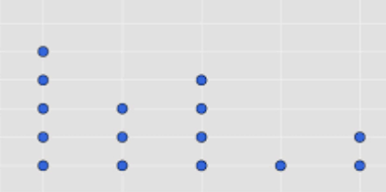
Warm Up
Using the dot stickers provided, please place one for each category-
What is your current position?
How many years as an educator?
Fold your index card in half long side- see my name card☺
Write your first name on both sides in LARGE print☺
Notes:
Welcome- tell about us- This training aims to build upon the professional knowledge and experience in the room and to leverage the power of collaborative work

Slide 3
Notes:
Four headlines from anywhere -
‘Never seen it this bad’: America faces catastrophic teacher shortage - Washington Post 8/2022
New Legislation headline - florida
Texas too
Florida's teachers union said the state has more than 8,000 teaching vacancies, creating a crisis in the classroom
1 in 5 new Texas teachers were hired without certification last year (Dallas Morning News)
5 things to know about how military veterans in Florida can teach without certification
New Federal Data: Too Few Applicants in K-12 Schools
More than half of public schools were understaffed at the start of the school year, and 69% reported the primary challenge was that too few teacher candidates were applying for open positions.
9/27/22 us news
Nearly 400 veterans have applied to become teachers in Florida under DeSantis-backed program 9/21/22 NEws4Jax

Slide 4
What is Happening to our New Teachers?
Between 2008 and 2019, the number of students completing
traditional teacher education programs in the U.S. dropped by more
than a third (AACTE, 2022)
Forty-four percent of new teachers leave teaching within five years
(Ingersoll, 2016)
Teachers at Title I schools turnover at rates 50% higher than other schools (Carver-Thomas, D. &
Darling-Hammond, L., 2017)
Alternatively certified teachers are 25% more likely to leave their school (Carver-Thomas, D. &
Darling-Hammond, L., 2017)
In Florida, there are about 8,000 teacher vacancies, up from 5,000 at the start of
school last year (FEA, 2022)
Notes:
There are many reason ‘why’ we have a teacher shortage. There are many out of our control- however, there are many within our control to RETAIN the teachers we already have and will hire this year! Retention is a MAJOR cause of teacher shortage. Other impacts- cost of replacement, reputation in community, student achievement, etc.

Slide 5
Timeline Activity
How do you support new educators at your school?
Please write one support per sticky note and include the month when the support would take place.
Use as many sticky notes as you need.
Share with your table
Notes:
Other presenters will collect stickys at the end and post on timeline

Slide 6
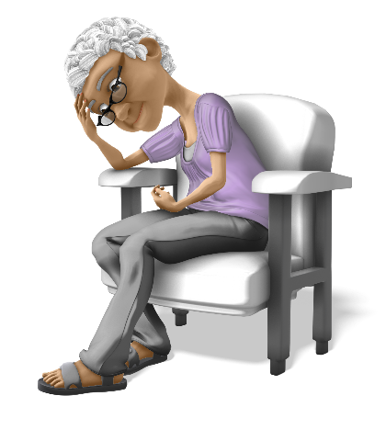
Concerns of New Educators
Relationship with students, parents, colleagues, and supervisors
Work load, time management, and fatigue
Knowledge of subject matter and curriculum
Evaluation and grading
Autonomy and control
Appearance and identity
McCann & Johannessen
Notes:
SAY:
Will students like me? Will they accept me as a bonafide teacher? What will I do if a parent is upset with me? Will my colleagues believe that I know what I am doing? Will I satisfy the expectations of an evaluator?
How can I get it all done?
What is really important to teach?
What am I measuring? What should I do when numbers don’t match my subjective impressions?
Can I teach in the way I believe is best? (More new teacher will stay in the classroom if administrators give them time, space, and support to foster human connections and creativity. When teachers feel empowered to create personal meaning and community at school, they stay…)
How will students judge someone like me?

Slide 7
NTC Cycle
Notes:
When discussing what happens during phases (write sticky notes prior to presenting) and add them to the timeline. Walk the timeline while presenting.

Slide 8
Reality Shock
The idealized perception of “teaching to make a difference” turns into the reality of…
Discipline
Administrative paperwork
Collecting money and forms
Substitute parenting
TESTING, TESTING, TESTING...
Notes:
You’ve met those bright-eyed, energized new teachers who come to school with an abundance of knowledge that they want to share, only to be faced with the reality of management, classroom: classroom, student and clerical.

Slide 9
Support Activity
How does the lack of support for new educators affect the entire school staff?
Turn and talk about this question.
Debrief and share.
Notes:
2 min turn and talk - below use in longer situations
Need large sticky pad at each table and markers.
Each group will share their findings with other groups.
The habits formed during the induction years become the teacher’s disposition toward professional practice throughout his or her career.

Slide 10
How Lack of Support Affects Entire Staff
Cafeteria
Bus drivers (school and parent)
Other teachers
Media Center
Custodians
Front office staff
Clinic (Front office)
Dismissal (Parents)
After School Care

Slide 11
What is a Beginning Teacher Assistance Program ?
“A formal, systematic effort to provide
ongoing assistance to a new teacher
during the induction period.”
Gordon and Maxey

Slide 12
Establish a School-Site BTAP!
THE PAYOFF:
Ease the transition of new educators into the culture of the school
Provide for consistency in course curriculum and the implementation of school rules/discipline
Increase the retention of qualified teachers
Provide a positive impact on student achievement

Slide 13
Mentor Preparation/Selection
Current mentors must have completed Clinical Educator Training
Professional Certificate with a minimum 3 years of effective teaching
Be familiar with the Educator Accomplished Practices
Be able to establish positive relationships
Be able to model effective teaching practices
Have a proven classroom management plan
Be skilled in effective planning and time management
Notes:
On Person:
Backpack holds mentor tools - Clin Ed Training, Familiar with FEAP, certificate min 3 years effective teacher
Heart - positive relationships
Hands - model effective teaching practices
Eyes in the back of head or eyeballs - proven classroom management plan
Brain - effective planning and time management

Slide 14
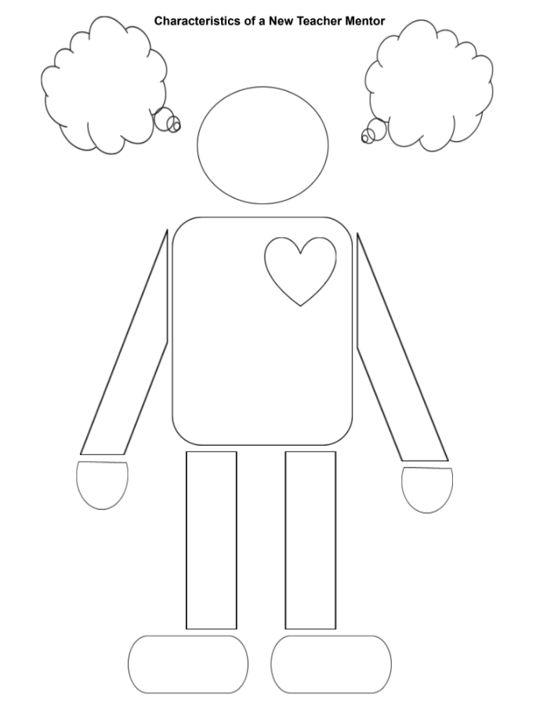
Let’s Build Our Perfect Mentor Together
Use your handout to follow along . . . . . . . . . . . .

Slide 15
Characteristics of a Good Mentor
Approachable
Ethical
Enthusiastic
Competent
Sincere
Ability to listen
Willing to spend time
Cooperative
Confident
Positive outlook
Tactful
Receptive
Commitment to the profession
Effective educator
Notes:
Pick four or five and talk about them.

Slide 16
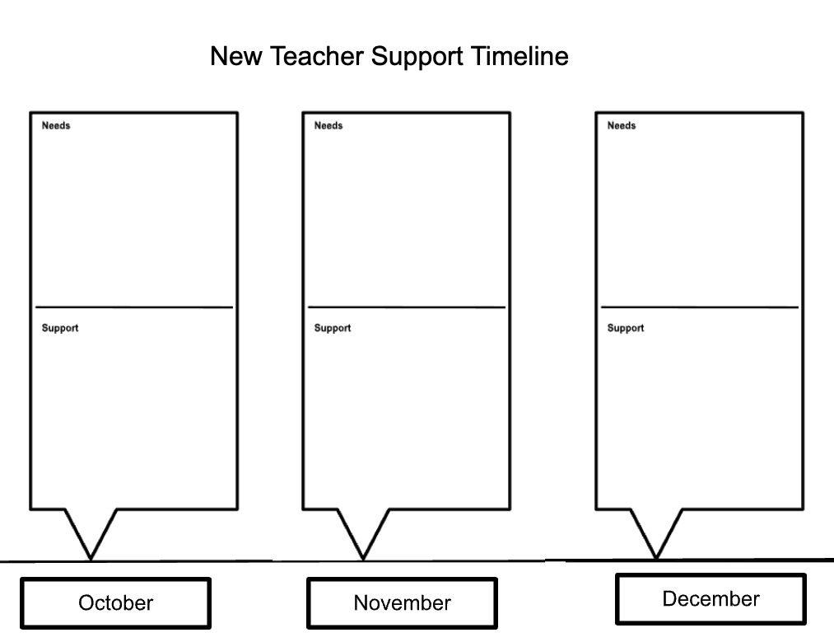
What Do New Educators Really Need?
Let’s make some plans to support your new educators!
What do they need?
How to meet
their needs?
Notes:
WOrk on November/December
Back to timeline
Principal Toolkit
Onboarding Activities

Slide 17
Thank you for joining us!
Judi Ackerman, Retired Palm Beach County Schools
Karla Branch, Palm Beach County Schools
Lisa Helfrich, Retired Palm Beach County Schools

