Slide 1
Liability Minefields to Avoid
October 20st, 2022
Notes:
OPENING
Not here to give you an insurance 101 presentation.
Critical aspects of a strong insurance and RM program
Lessons learned
Final exam joke?

Slide 2
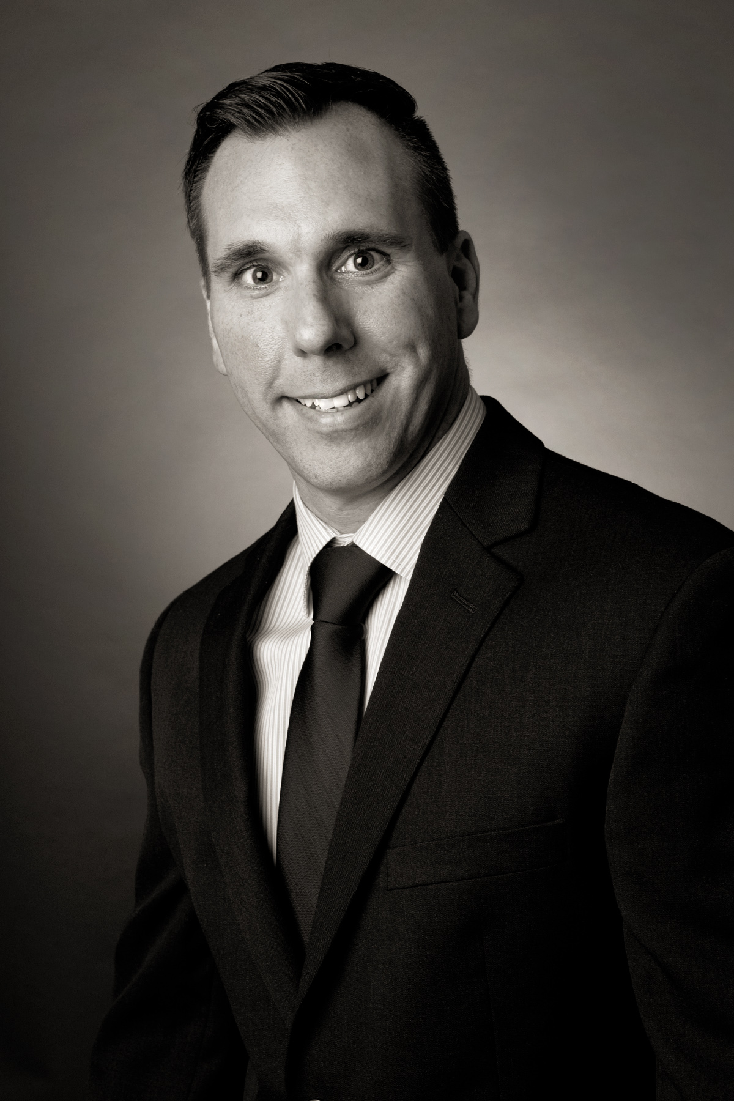
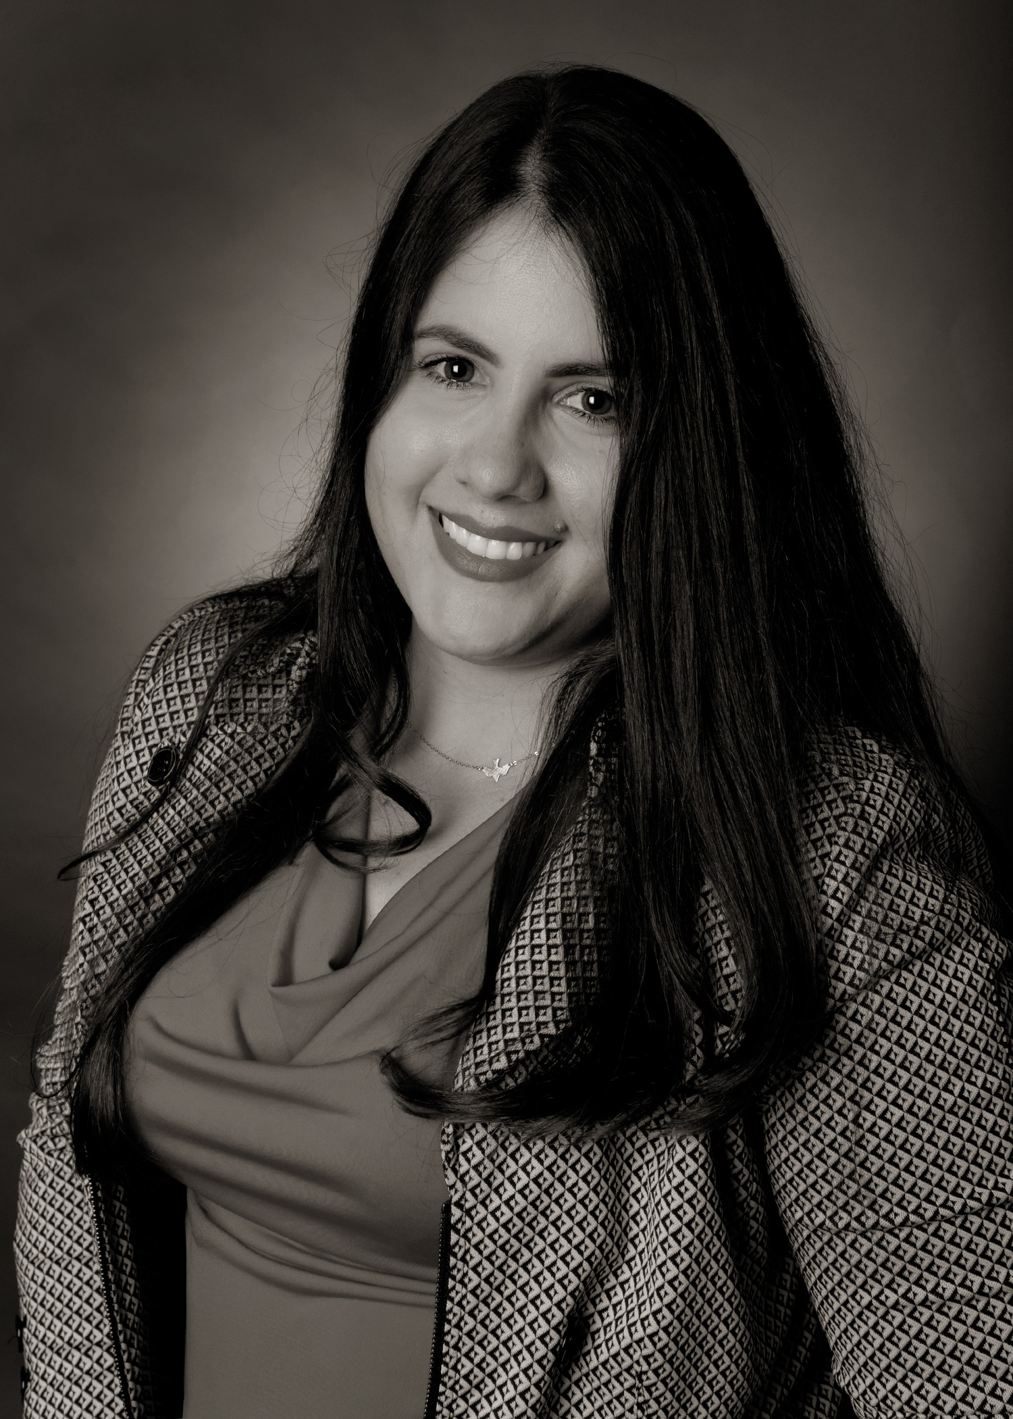
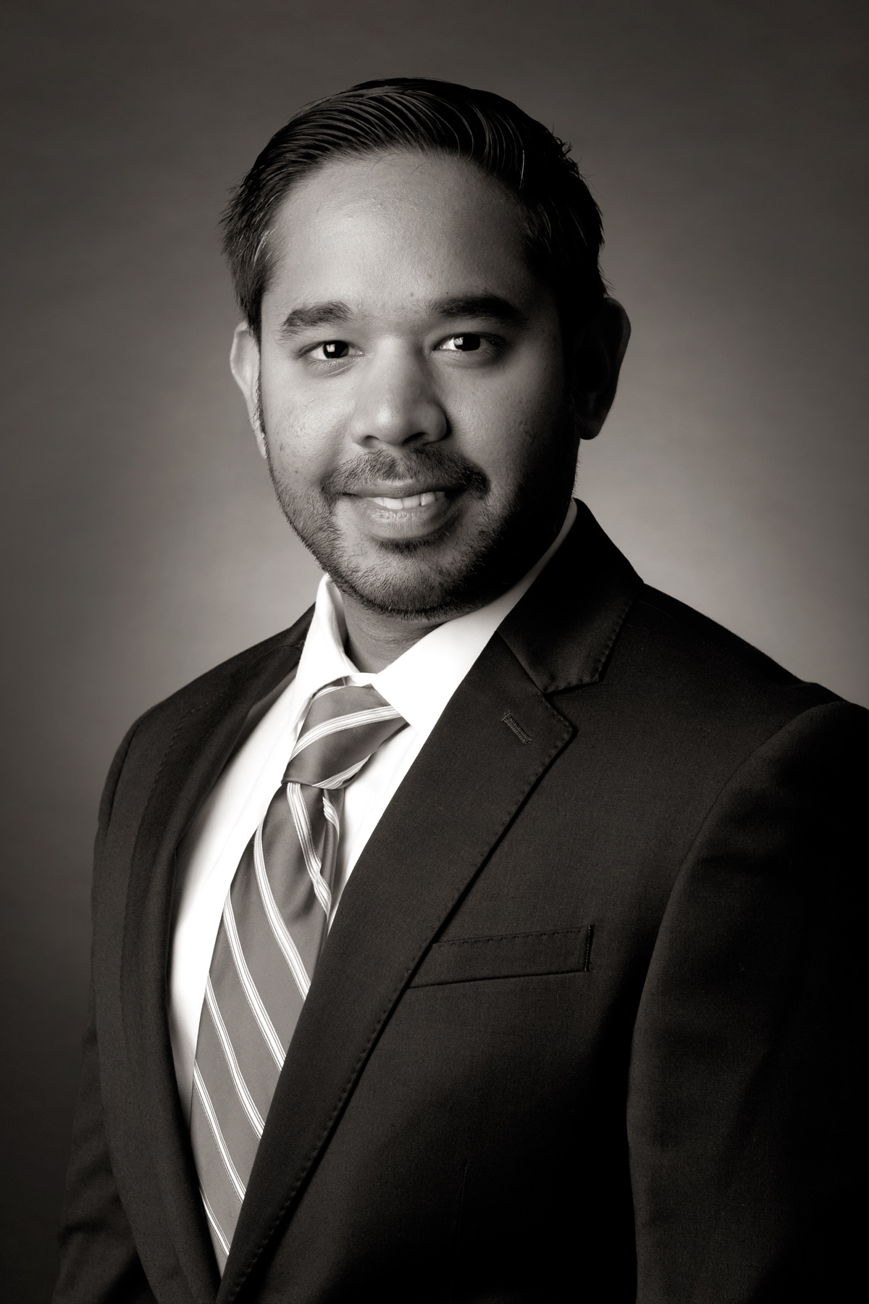
Presenters
Brent Grimmel,
SVP, Agency Operations
Ismary Cardoso,
VP, Public Entity Risks
Ryan Rupnarain,
Manager, Loss Control Services
Notes:
Brent & Ismary – agency perspective
Egis core focus, 240 schools (250 joke?)
Ryan – carrier’s perspective
Trust, coverages and RM
1000 public entities in FL, including those 240 schools with our agency

Slide 3
Agenda
General Liability
School Leaders Liability
Employment Practices Liability
Cyber
Transportation
Student Accident
Special Events
Risk Transfer Considerations
Discussion Topics
Notes:
In keeping with the theme of today’s presentation, we’re going to share with you some unique aspects of the public charter schools claims we’ve seen and best practices to avoid or minimize the impact in regards to GL, SLL/ELL, EPLI, Cyber, and Auto exposures
Benefits of complimenting your insurance program with Student Accident or Special Events coverage
Looping in Ryan throughout the presentation for risk mitigation strategies to help avoid or minimize the impact of some of these pitfalls

Slide 4
School District Insurance Coverage Requirements
IMPORTANT: INSURANCE REQUIREMENTS VARY BY SCHOOL DISTRICT
School Districts define their own Charter School insurance requirements.
This can create differences in coverage requirements by county that may apply to:
Charter contract number or
School location
Knowing each county’s requirements is important to ensuring proper coverage.
Notes:
How much coverage do I need?
Reviewing Charter: Important 1st step

Slide 5
School District Insurance Coverage Requirements
Notes:
Not all school districts have the same insurance requirements for charter schools
The minimum limits and even coverages can vary greatly as you can see in this table
I often find that even schools within the same District may have different insurance requirements (most often in the School Leaders Liability and Crime sections)
Most common areas where a school may not be in compliance with its charter are on the SLL/ELL (Often called E&O) and the Crime coverages
While reviewing the charter is an important 1st step when evaluating your program, you should also review some other key contracts
renting - lease agreements;
own - lender requirements
Often hold a much higher standard on the property coverages and sometimes on the liability coverage
If you’re current agent has never reviewed these documents for you, we recommend you have it done as it may reveal some areas you could be out of compliance.
Loss control team reviews to paint a better picture of exposure, i.e. maintenance requirements, sidewalks, etc

Slide 6
General Liability Example
ABC Great Charter School (“ABC”) is having a Spirit Day and the school hires Terrific Event Coordinators (“Terrific”) to come on-site at the school and manage the event.
One of the most popular events is Sumo Wrestling in air inflated Sumo costumes. While Sally is “wrestling” with her classmates, she falls and hits her head and she alleges injuries due to Negligent Supervision by the vendor Terrific.
The plaintiff (Sally) names both ABC and Terrific in a lawsuit that ultimately resulted in:
Defense Cost $102,000
Claim Settlement $160,000
Notes:
By the way, this example they did not have a contract. Makes it easier to “tender” claim to vendor.

Slide 7
General Liability
Most frequent causes of liability claims:
Slips, trips, and falls
P.E./Athletics related injuries
Physical altercations/fighting
Horseplay
Failure to maintain
Negligent Supervision
GL policies pay legal obligations up to the policy limits.
3rd party policy covering negligence of school or school personnel
Bodily Injury and Property Damage
Personal and Advertising Injury
Notes:
Not here is a coverage I’m sure most of you are familiar with, but it’s important to understand what may or may not be covered by your GL policy.
Trends in sexual abuse claims (employee, volunteer, vendors)
Does your school have a social media policy?
Many of these claims start with teachers communicating directly with students on social media
Vendor claim – Swim instructor?
Substitutes
TikTok challenge/social media
While some of these causes may come as no surprise to you all, there are a couple that are worth further discussion (failure to maintain, negligent supervision)
Two key factors when it comes to liability, claims, and suits – the merit of the complaint and the strength of the defense and you have more control over the latter
TikTok challenge/social media -use of the TikTok platform to create “challenges” for other users to complete and record as a sort of “look at me” phenomena resulting in damage to property or injury to others.

Slide 8
General Liability Trends
Abuse & Molestation claims on the rise
Employee exposures
Volunteer exposures
Vendor exposures
Social Inflation
Shifting sentiment
Capitalizing on emotions
Desensitization to $$$$
Notes:
Abuse & Molestation claims on the rise
Employee exposures - With extracurricular activities spread out across empty classrooms, gymnasiums and athletic fields, it’s impossible to monitor every student and staff member all the time.
Volunteer exposures
Vendor exposures
.
Even the strictest background checks will inevitably fail to catch every bad actor, and they do not address risks posed by other students. Jessica Lunsford Act
Does your school have a social media policy?
More and more of these types of claims are starting with teachers communicating directly with students on social media. It’s uncertain whether the pandemic has increased or decreased the number of abuse incidents. But at-home learning planted the seeds for future abuse as it established the normalcy of online relationships.
Failure to exercise sufficient care in the selection of staff
Failure to properly supervise the abuser
The school allowed the abuser to continue working with children after abuse was suspected
It’s a combination of three things: increasing sentiment that favors individual plaintiffs over organizations, the way plaintiff’s attorneys capitalize on that sentiment and play to jurors’ emotions, and the desensitization to large monetary figures. Together, this is leading to higher settlement or verdict values that we would not have seen previously.
n 2019, a grade school softball player was awarded $1.1 million after she was hit in the head by a bat during a practice when the students were not wearing helmets. The lawsuit argued that her New York school district failed to provide training for coaches and to implement policies for coach-to-student ratios that would have ensured proper supervision.²
Vendor claim – Swim instructor?
Substitutes

Slide 9
General Liability - Medical Payments Coverage
Preventing Ripples From Becoming Waves
"Medical Payments Coverage" protects from accidents on school grounds.
Policy pays small limit (typically between $2,500 - $5,000) and
Paid regardless of fault. Note: Not all carriers provide
Medical Payments Coverage is one method for compensating parents for out-of-pocket student medical expenses.
Not designed for students that participate in athletic events.
Designed to handle routine injuries efficiently or expeditiously.
Notes:
Some GL policies like the one we offer through FIA, includes Medical Payments Coverage or “MedPay” which is a great way prevent a ripple from becoming a wave.
Quite often, a plantiff may sue simply because they feel like no one cares or they are being ignored. By getting involved early on and making some limited funds available for their out-of-pocket expenses, it helps to address their concerns and may prevent them from seeking an attorney.
It’s also important to have an SOP for incident reporting, i.e. desigating an “incident captain” such as a school nurse or administrator who will communicate to the parent/guardian. This person would be guided by best practices including, not admitting fault, diagnosing an injury, and have familiarity with the school’s options.

Slide 10
School Leaders Liability
What are typical wrongful acts alleged against Charter Schools Governing Boards?
The failure to educate students;
Disciplinary decisions;
Mismanagement of public funds;
Violation of Florida’s Sunshine Laws
Less commonly known “wrongful acts”
Offers comprehensive protection to charter school board members, employees, and authorized volunteers from “wrongful acts” committed while performing their duties as leaders of their school.
“Wrongful acts” means any act, error or omission by any person the policy identifies as being covered
Notes:
Are there any board members in the room?
This is the coverage for you. Coverage for the board, any employee, or any authorized agent of the board
Essentially an enhanced D&O coverage but if it’s coming from a carrier specializing in charter schools is going to be called SLL or ELL
Protection for:
Even your students while participating in internship programs
Anyone here in the early phases of opening a new public charter school? You may be asking yourself when do you need this coverage.
Claim against a school before they even opened. Not only was the board named in the suit, but also an individual board member requiring a separate defense for that individual.
Failure to Educate Claim
Parents alleged the school failed to follow the Individualized education plan
They wanted to not only be compensated but also see modifications to the way the IEP was managed
Total Cost: $125,000 ($85,000 in settlement, and $40,000 in legal fees)

Slide 11
Employment Practices Considerations
Coverage for “wrongful employment practices” arising from the management of school employees which include:
Wrongful:
Termination
Deprivation of career opportunity
Discipline
Discrimination
Sexual Harassment
Retaliation
Failure to employ, promote, or grant tenure
Failure to provide an adequate workplace environment
Pre-termination coverage
Notes:
Key Coverage
The COVID Pandemic forced employers across the state to quickly develop and implement policies and procedures.. in that process employers had to make significant decisions in a fast-moving landscape. Not surprisingly, we saw many COVID-19 related lawsuits filed against employers.
Even before COVID, EPL lawsuits have been one of the most frequent type of lawsuits brought against school board officials.
Pre-termination coverage offered by some carriers may help to reduce the likelihood of an EPL claim or EEOC complaint.
It’s typically a small limit for the school to have an attorney review a potential termination and make sure the everything has been property documented, that termination is indeed justified, and consider any other actions to prevent any unintended repercussions for the school.
**Importance of an employee handbook and documenting it was received by an employee
Create a fair and unbiased employment application
Create well-designed, specific job descriptions for each position in your school
Communicate expectations clearly, in writing
Base employment terminations on performance or conduct

Slide 12
Cyber
Cyber Risk - Risk of harm, including financial, reputational, legal and compliance impacts, to an organization resulting from the failure or disruption of its computer systems.
Cyber Threats:
Spoofing / Phishing (Social Engineering)
Data Breach / Unauthorized Disclosures
Ransomware
- What to do, who to call?
Notes:
Ransomware: Ransomware is a type of malware that threatens to publish the victim's personal data or permanently block access to it unless a ransom is paid
- Disconnect all devices from the network immediately
- Notify leadership and subsequently authorities immediately
- Implement an “Incident Response” plan with a designated team
- Comply with all notification requirements (parents, students, vendors, etc)
- Ensure proper back-up of data. Consider using a cloud-base service to store school’s data and verify they follow minimum security requirements (limit liability, frequent back-ups, easier to recover)
- Conduct vulnerabilities and cyber threats assessments / audits periodically
What to do, who to call?
- Best practice is to prepare a plan beforehand – prevention. Fast response is crucial. Assess who are the main players and create and Incident Response Team and Manual if possible with names and direct numbers of the team members: IT department designated person, insurance agent, legal council, Public Relations / Crisis Management agent or designated employee, Compliance officer or designated employee (handle notifications requirements), relevant law enforcement local office or appropriate department. It also helps to have a draft of the media communication release, and a script for incoming calls so the message to the public is consistent. Additionally, vendors contact readily available in case there is any involved that needs to partake in the incident response.
Spoofing: Cyber criminal impersonating a trusted entity or person to incite the victim to act to its detriment (email from boss asking to send a gift card for niece’s birthday)
Phishing: Cyber criminal attempting to steal victim’s sensitive information such as passwords, credit card details, address, bank account info by tricking them to click malicious links, which leads to installing malware (text from bank saying account has been frozen.)
Data Breach / Unauthorized disclosures: Security violation and unauthorized access to private, sensitive information leading to the publishing, stealing, or sharing protected data (PII and PHI). Need not be fraudulent, can be human error (Employee sending sensitive data to wrong recipient)
- Always confirming with the actual trusted entity / person.
- Use strong email passwords and multiple factor authentication
- Use spam filter
- Antivirus updated
Denial of Service: Cyber criminal overflowing information systems (emails, websites, online accounts) with service requests or traffic, until the targeted system collapses, unable to respond to so many simultaneous requests.
- Install firewall and configure it to restrict traffic
- Keep antivirus updated
- Evaluate security settings to avoid unnecessary access to certain systems
*Training of personel!

Slide 13
Cyber Controls
Train and re-train your staff
Human Factor
Develop a staff culture of cybersecurity
Institute an additional verification
Backups, backups, backups
Patches and updates
Notes:
We could have an entirely separate presentation on cyber risk management but here are a view controls that recommend school’s keep in mind.
Train your staff: Be sure your staff can recognize forged and spoofed emails. This can be done using general cybersecurity awareness training.
Human Factor – I mention general training because while cyber hacking is becoming more sophisticated, the majority of cyber claims still involve some sort of human factor. Reliance on technological solutions in isolation can leave schools vulnerable and create complacency that cyber criminals exploit.
Develop a staff culture of cybersecurity: It’s important to encourage a healthy amount of suspicion of every attachment, every link, and every request for a payment modification. Especially think twice when a contact seems to be applying emotional pressure.
Institute an additional verification policy: Add a layer of verification for any requests to modify payment methods, routing numbers, or the like. Staff should always check with a district supervisor and verify with third-party vendors before making large payments or changing payment arrangements.
Backups, backups, backups: The most effective defense against a ransomware attack is to have effective backups ready to put into production. Since ransomware locks up your existing network configuration, backups allow you to roll back to a version of your network infrastructure undamaged by the malicious software.
Patches and updates: Every day, new malware variants and new common vulnerabilities and exposures (CVEs) are discovered. Antivirus and firewall companies pass this new threat information to your network via updates and patches. If you are not incorporating these patches and updates into your system, you are vulnerable. Discuss your patch and update policy with your IT team and make sure you are secure!

Slide 14
Cyber
Cyber Coverage – Coverage for lost or stolen data as a result of a cyber incident, as well as fraud, extortion, business interruption and third-party liability.
Security and Privacy Liability
Network Interruption and Recovery
Network Extortion
Social Engineering Fraud
Reputational Damage
Notes:
Cyber vs. Crime
Security and Privacy Liability
Coverage is provided for the misuse or unauthorized access of an insured’s computer network that results in personally identifiable information being released.
Network Interruption and Recovery
Coverage is provided for the restoration of lost data and the loss of business income that is incurred during the recovery period.
Network Extortion
Reimbursement payments are available to insured for any payments made to eliminate a network extortion event. (Includes ransomware and DoS)
Social Engineering Fraud (add example/scenario)
Coverage is provided for an event in which a third-party misrepresents themselves and as a result causes an insured’s employee to release sensitive information.
Reputational Damage
Coverage is provided for the loss of net income as a result of a network event.
Risk Transfer opportunity with 3rd party vendor
There are resources from the carriers such as cyber experts (breach consultants, lawyers, forensic experts etc)

Slide 15
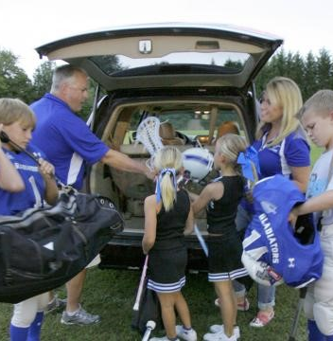
Transportation
Employees driving their own autos on behalf of the school
Verify your insurance includes Hired & Non-Owned Auto Liability Coverage
Develop driver safety program standards
Access Motor Vehicle Reports
Verify Personal Auto Liability coverage and limits
Negligent Entrustment
Notes:
Some schools have huge bus fleets, and some don’t
If you have a contract with a 3rd party vendor providing transportation, you want to make sure you’re reviewing their policy every year (adequate limits, added school as AI
contract indemnification language
Even if you don’t have any insured autos, important to have HNO coverage on the policy
Protects schools if named in a suit due to an employees accident in their own /or rented vehicle
Very inexpensive, typically a few hundred buck
Employees personal auto policy is primary
Important to carefully select which employees can drive on behalf of the school
Select those with higher the liability limits
Clean driving record
Teacher accident
Can only look to their own policy for PD
Andy HNO Coach Claim - $300K

Slide 16
Transportation
TRANSPORTATION SAFETY PROGRAM
Why you should develop a Safety Program
Demonstrates Duty of Care
Screens for safe drivers
Sets safety standards / protocols
The program should include:
Driver qualification and criteria
Insurance verification
Vehicle standards
Code of Conduct
Safety standards
Emergency procedures

Slide 17
Student Accident Coverage
Provides for medical expenses
Coverage for injuries sustained while attending school
Includes physical education
Organized sports-related injuries
Includes coverage for domestic day or overnight field trips
Typically, standard limits provide up to $25,000 of medical expense coverage
Catastrophic coverage available up to $1,000,000
Notes:
Medpay typically excludes sports related
Almost all the schools have this coverage but it’s often underutilized
Very low-cost policy - school takes out on behalf of their students
Coverage applies for:
Student: (1) at school (2) on way to and from school, (3) field trips (4) athletics
Volunteers
In 2020 most carriers even covered students while learning from home
Excess, over any other policy
Reimburse out of pocket expense such as health insurance deductibles
If no other insurance, policy becomes primary
Typically, base policy lower limits ($25k - $50k) but we often recommend adding the catastrophic student accident ($1M limit).
Average cost per student:
Base: $3-5 (PK-8), $6-$8 (9-12) except tackle football closer to $18
Excess: $1-2
Volunteers: <$200
Florida HS Athletic Assoc - $1M Requirements if member

Slide 18
Special Events
Special Events Coverage (SEC) provides liability coverage for a specified period, typically in 24-hour increments.
SEC should be secured when the general public is invited to a school or PTO event.
Fairs, Festivals, Carnivals
Fundraisers, Walk / Run Events
Food & Beverage Sales
Use of Vendors for Special Events
Notes:
Almost all the schools have this coverage but it’s often underutilized
Very low cost policy - school takes out on behalf of their students
Coverage applies for:
Student: (1) at school (2) on way to and from school, (3) field trips (4) athletics
Volunteers
In 2020 most carriers even covered students while learning from home
Excess, over any other policy
Reimburse out of pocket expense such as health insurance deductibles
If not insurance, policy becomes primary
Typically, base policy lower limits ($25k - $50k) but we often recommend adding the catastrophic student accident ($1M limit).
Andy Claims Perspective
Andy Question: Average cost per student:
Base: $3-5 (PK-8), $6-$8 (9-12) except tackle football closer to $18
Excess: $1-2
Volunteers: <$200

Slide 19
Why is Risk Transfer Important?
Remember the sumo scenario?
The question becomes whose insurance is primarily responsible for defending and handling the claim?
The answer is straightforward: If there is an agreement in place and ABC is properly named as an “Additional Insured” on Terrific's policy as evidenced on their COI, then Terrific's insurer will be primary, otherwise the burden falls on ABC.

Slide 20
Executing Risk Transfer
Risk Transfer is most effective as a layered approach:
Hold Harmless & Indemnification
Certificates of Insurance
Additional Insured Status
Notes:
Risk transfer, as with most strategies related to risk management, is most effective as a layered approach. This includes a combination of certain language and requirements in contracts, hold harmless and indemnification being an important example. It also includes certificates of insurance which we will spend some time discussing, as well as additional insured status.

Slide 21
Hold Harmless & Indemnification Provisions
fer
Properly worded contracts and agreements can provide the most comprehensive protection.
Includes insurance requirements (coverage lines, limits, additional insured)
Outline responsibilities of each party
Vendor agrees to hold harmless and indemnify the school
Notes:
We’re starting off with contracts and agreements as the first part of a risk transfer strategy because it typically the most important. If they are worded properly, they can provide the most protection for your school. Agreements should ideally include insurance requirements, i.e. what your vendor needs to have in place including naming you as AI. It’s also a tool that can be used to clearly define the responsibilities of each party, and last but certainly not least it would have language where the vendor agrees to hold harmless and indemnify the school. What this would mean is that the vendor would agree to assume responsibility for a loss including reimbursement for any associated damages.
You may have seen this type of language incorporated into construction contracts, service job contracts, purchase order agreements, lease agreements, rental contracts, and consulting agreements.

Slide 22
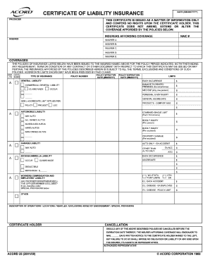
What is a Certificate of Insurance?
COI is a form that is issued by an insurer or their authorized representative and provides evidence that a company carries insurance.
It is the customary method of showing that the party providing the certificate has met their insurance requirements.
The certificate summarizes the essential terms, conditions, and duration of the specified policy at the time that the certificate is prepared.
Notes:
The next important part to risk transfer is the COI or certificate of insurance.
Some examples of the various types of contractors / vendors where a COI should be required:
Any contractor who provides you with a service (electrical, plumbing, etc.)
Bus Company
Inflatables Provider
Performer/Speaker
Architects/Engineers
Food Service
University or School
Organizations that use your facilities; including non-profit organizations

Slide 23
Additional Insured Status
The main advantage of being an additional insured on an insurance policy as opposed to being a certificate of insurance holder for that same policy is that the additional insured has certain rights under the policy.
Additional insureds are only covered for operations that involve the named insured in some way.
Notes:
Additional Insureds
The purpose of being an additional insured on a policy is to provide you with insurance coverage and rights to
defense under the other party’s policy. This provides the coverage necessary in the event that a claim arises from
the actions of your vendor, subcontractor, supplier, etc.

Slide 24
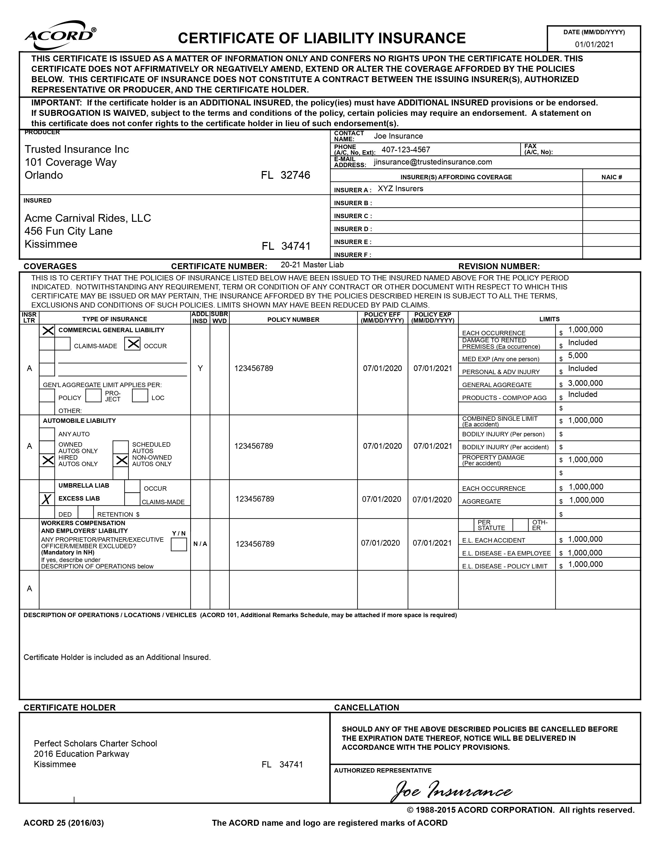
Does the COI show AI?
Again, the COI by itself may not convey Additional Insured Coverage rights on the policy to your school unless it is completed properly.
Two things to check for include
Confirming that the ADDL INSD box is checked with a Y or X.
Ensuring that you are listed as an additional insured in the Description of Operations section.

Slide 25
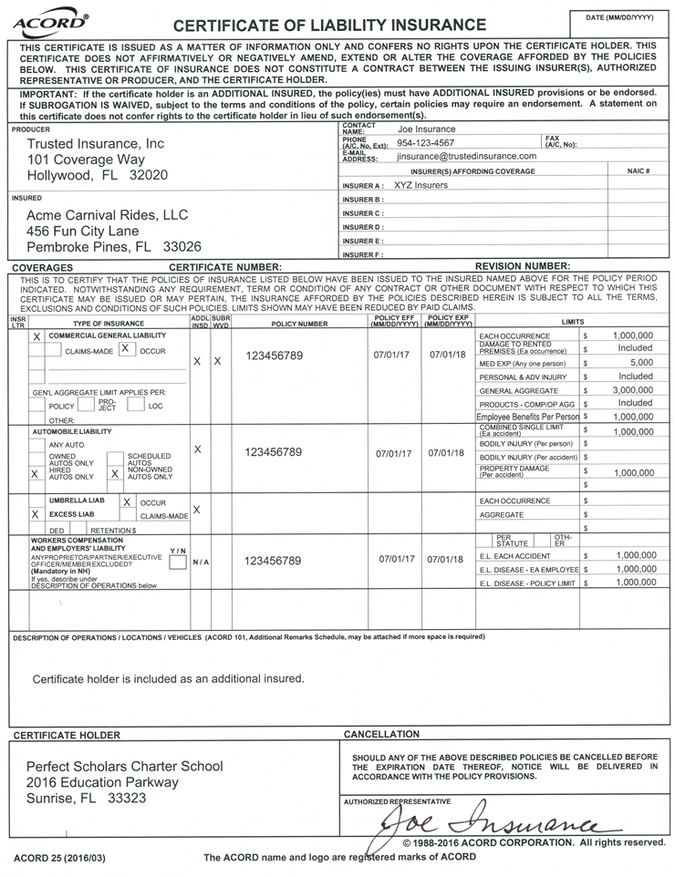
Risk Transfer Considerations
Description and Name of Certificate Holder
YOUR SCHOOL HERE
Notes:
Almost all the schools have this coverage but it’s often underutilized
Very low cost policy - school takes out on behalf of their students
Coverage applies for:
Student: (1) at school (2) on way to and from school, (3) field trips (4) athletics
Volunteers
In 2020 most carriers even covered students while learning from home
Excess, over any other policy
Reimburse out of pocket expense such as health insurance deductibles
If not insurance, policy becomes primary
Typically, base policy lower limits ($25k - $50k) but we often recommend adding the catastrophic student accident ($1M limit).
Andy Claims Perspective
Andy Question: Average cost per student:
Base: $3-5 (PK-8), $6-$8 (9-12) except tackle football closer to $18
Excess: $1-2
Volunteers: <$200

Slide 26
Questions?

Slide 27
About us
Brent Grimmel
Sr. VP, Agency Operations
Email: bgrimmel@egisadvisors.com
Phone: (321) 320-9866
Ismary Cardoso
VP, Public Entity Risks
Email: icardoso@egisadvisors.com
Phone: (321) 320-9866
Personalized Approach
In-depth Analysis and Ongoing Communication
Training and Education
Trust Administrator, Florida Insurance Alliance
Property, Casualty, and Workers Compensation Insurance
Risk Management Services
Member Advocacy
Florida Charter Schools & Special Districts
Over 1,000 Public Entities
240 Public Charter Schools
Leading Charter School Insurance Services Provider
Ryan Rupnarain
Manager, Loss Control Services
Email: rrupnarain@egisadvisors.com
Phone: (321) 323-0042

