Slide 1
FLORIDA EDUCATION FINANCE PROGRAM (FEFP) FUNDING
Charter School Conference
October 2022

Slide 2
Topics
  General FEFP Overview
  Full-time Equivalent (FTE) Student Membership Survey Overview
  FTE Recalibration
  Components of the FEFP
  Charter Revenue Worksheet
  Class Size Reduction
  Charter School Administrative Fee
  New Topics for 2022-23

Slide 3
Florida Education Finance Program
Primary mechanism for funding operating costs of Florida school districts
Established by the Florida Legislature in 1973
Calculated five times per year based on FTE
Distribution of funds to school districts is based on the FEFP
Funded through both state and local revenue sources

Slide 4
Minimum Hourly Requirement
Section 1011.60(2), F.S., requires 180-day term or hourly equivalent. The hourly requirements are specified in rule 6A-1.045111, FAC.
720 Hours of Instructional Time for Prekindergarten through Grade 3 Students (180 days x 4 hours per day)
900 Hours of Instructional Time for Grades 4-12 Students (180 days x 5 hours per day)

Slide 5
FTE Eligibility
Each PK-12 student must meet the membership requirement to be eligible to be reported and the attendance requirement to be eligible for funding.
Meeting the membership requirement means that:
  The student is officially assigned to a course or program by a school or district.
  The school captures the student course schedule for each student on the membership roll during survey week on date certain.
  Each student must be in attendance one of the five days of survey week or one of the six days prior to survey week in which school was in session.
Date Certain is always the Friday of survey week.

Slide 6
FTE Surveys
Survey Period 1 (July) is from the beginning of the fiscal year (July 1) to the beginning of the defined 180-day school year.
Survey Period 2 (October) is the first 90 days of the 180-day school year.
Survey Period 3 (February) is the second 90 days of the 180-day school year.
Survey Period 4 (June) is the period from the end of the 180 day school year to the end of the fiscal year (June 30).
All FTE reporting deadlines can be viewed at:
http://www.fldoe.org/core/fileparse.php/7574/urlt/2122-surveydates.pdf
The FEFP is calculated by the legislature and recalculated four times each year using projected and reported FTE as reported during the FTE surveys.

Slide 7
Recalibration to 1.0
A student may not earn more than 1 FTE (except DJJ students, who are served during the summer).
School districts report all FTE regardless of the 1.0 FTE cap.
DOE recalibrates FTE to 1.0.
  DOE recalibrates FTE to 0.5 if a student has enrollment in only one survey (Survey 2 or Survey 3).
FTE recalibration is annualized (Surveys 1, 2, 3, 4).
The 1.0 FTE cap includes:
  All FTE for instruction provided by the district of enrollment.
  All dual enrollment FTE.
  All FTE for instruction provided by other school districts, including Florida Virtual School.

Slide 8
Recalibration to 1.0

Slide 9
FEFP Calculations
The FEFP is calculated five times each year.
First Calculation (May) - Completed by the Florida Legislature using projected FTE for all surveys. Used to establish WFTE caps.
Second Calculation (July) - Uses projected FTE from all surveys, includes certified school taxable values for school districts.

Slide 10
FEFP Calculations
Third Calculation (December/January) –First calculation of the year to include actual FTE. Uses actual FTE for October and projected FTE for February.
Fourth Calculation (April/May) –Uses actual FTE for October and February.
Fifth/Final Calculation (September/October)

Slide 11
2022-23 Program Cost Factors
Basic Programs | Grade Levels | Cost Factor
101 | K-3 | 1.126
102 | 4-8 | 1.000
103 | 9-12 | 0.999
ESE Programs | Grade Levels | Cost Factor
111 | K-3 | 1.126
112 | 4-8 | 1.000
113 | 9-12 | 0.999
254 | K-12 | 3.674
255 | K-12 | 5.401
ESOL (ELL) | Grade Levels | Cost Factor
130 | K-12 | 1.206
Career Education | Grade Levels | Cost Factor
300 | 9-12 | 0.999

Slide 12
Base Funding Calculation
FTE
Full-Time Equivalent Student
X
PCF
Program Cost Factor
=
WFTE
Weighted Full Time Equivalent Student
X
BSA
Base Student Allocation 2022-23 = $4,587.40
X
DCD
District Cost Differential
=
BASE FUNDING

Slide 13
2022-23 FEFP Second Calculation
FTE Students 2,983,464.64 | × | Program Weights | = | Weighted FTE Students 3,278,046.87 | × | Base Student Allocation (BSA) $4,587.40 | × | District Cost Differential (DCD) Calculation | =
Base Funding $15,040,409,554 | + | Sparsity Supplement $62,052,226 | + | State Funded Discretionary Contribution $40,506,858 | + | 0.748 Mill Compression $357,756,951 | + | DJJ Supplemental Allocation $3,461,325 | +
Safe Schools $210,000,000 | + | ESE Guaranteed Allocation $1,091,466,597 | + | Supplemental Academic Instruction $717,239,273 | + | Instructional Materials $246,978,361 | + | Student Transportation $515,009,084 | +
Teachers Classroom Supply Asst. Program $54,143,375 | + | Reading Allocation $170,000,000 | + | Federally Connected Student Supplement $13,716,468 | + | Mental Health Assistance Allocation $140,000,000 | + | Total Funds Compression Allocation $66,255,577 | +
Turnaround Supplemental Services $17,288,675 | + | Teacher Salary Increase Allocation $800,000,000 | + | Total FEFP = $19,546,284,324
Notes:
13

Slide 14
2022-23 FEFP Second Calculation
Total FEFP
$19,546,284,324
-
Required Local
Effort
$8,854,248,311
Proration to the
Appropriation
($34,435,453)
Net State FEFP
$10,657,600,560
+
=
Net State FEFP
$10,657,600,560
Class Size
Reduction
Allocation
$2,896,071,526
Total State Funding
$13,553,672,086
+
=
Required Local
Effort
$8,854,248,311
0.748 Mill
Discretionary
Local Effort
$2,106,443,151
Total Local Funding
$10,960,691,462
+
=
Total State Funding
$13,553,672,086
Total Local Funding
$10,960,691,462
TOTAL FUNDING
$24,514,363,548
+
=
Notes:
14

Slide 15
ESE Guaranteed Allocation
Historically, the FEFP has included cost factors for Exceptional Student Education matrix levels 251, 252 and 253. During the 2000 legislative session, the additional funding generated for special services was combined into one fund, the ESE Guaranteed Allocation. Each district now receives an amount calculated in the FEFP, initially calculated in the FEFP Conference Report and recalculated in the FEFP Third Calculation.
Gives districts more flexibility in allocating funds for students.
Reduces workload – districts are no longer required to complete matrices for these students.

Slide 16
Virtual Charter Schools
Charter schools may offer virtual instruction to K-12 students under s. 1002.33, F.S.
All FTE must be reported on a successfully completed credit basis and is limited to 1.0 unweighted FTE per student.
1.0 unweighted FTE shall consist of six full credit completions or the prescribed level of content that counts toward promotion to the next grade level.
Credit completions may be a combination of full-credit courses and half-credit courses.

Slide 17
Revenue Estimate Worksheet
The Charter Revenue Worksheet can be found here:
https://www.fldoe.org/finance/fl-edu-finance-program-fefp/charter-school-revenue-estimate-worksh.stml

Slide 18
Revenue Estimate Worksheet

Slide 19
Revenue Estimate Worksheet

Slide 20
Revenue Estimate Worksheet

Slide 21
Class Size Reduction
Class Size Reduction Allocation
Class Size funds are provided to meet the constitutional requirement that the class sizes for grades PK-3, 4-8, and 9-12 must be no greater than 18, 22 and 25 students, respectively, for core-curricula courses.
The following funds are provided (per WFTE):
CSR Factor per student
Grades PK-3 $ 964.60
Grades 4-8 $ 920.98
Grades 9-12 $ 923.21
WFTE
1,000.00
DCD
0.9830
CSR $948,202
CSR Factor
$964.60

Slide 22
Class Size Compliance
Class Size Reduction Compliance
Class Size Compliance
  Measured at the school-wide average for charter schools.
  Measures class size for core courses only.
  Excludes virtual and blended learning courses.
  Class size funding adjustments are made for each student that causes the classroom or school-wide average to exceed the class size maximums.
  Funding adjustments for charter schools, district-operated schools of choice and traditional public schools are made independent of each other.
  Section 1003.03(3), F.S., provides acceptable methods for meeting class size requirements.
Memorandums
School Class Sizes, Process and Time Line for Appeals
Calculations of Reductions to Class Size Operating Funds (Prior to Appeals)
Class Size Categorical Allocation, Recommendation for an Alternate Reduction
Class Size Operating Categorical Reallocation and Restoration Calculations

Slide 23
Class Size Reduction Compliance
Initial Class Size reduction
  Class Size Reduction categorical funding amount for each FTE student over the cap.
  100% Base Student Allocation ($4,587.40) multiplied by the
  district cost differential for each FTE student over the cap.
Commissioner may recommend an alternate reduction amount by February 15, subject to approval by the Legislative Budget Commission, for following reasons:
  Extreme emergency
  District unable to meet requirements despite appropriate effort to do so
  Appeals process

Slide 24
Class Size Funding Adjustments
Reallocation to charter schools in compliance
  Up to 5% of the Base Student Allocation multiplied by the charter school’s total number of students
  Not to exceed 25% of total charter school funds reduced
Restoration to charter schools not in compliance that submit a compliance plan by February 1.
  Balance of funds remaining, which is 75% of the calculated reduction.
The Commissioner is authorized to withhold the distribution of the class size categorical allocation to ensure the availability of sufficient undistributed funds to support the implementation of the calculated reduction.

Slide 25

Administrative Fee
School district must provide certain services to charter schools in exchange for withholding an administrative fee:
  Contract management
  FTE and data reporting
  ESE administration
  Test administration
  Information services
  Other services related to the federal lunch program
Administrative
Fee
Authority:
s.1002.33(20),
F.S.

Slide 26
Administrative Fee
Administrative
Fee
Calculation
Total fee shall be calculated based upon up to 5 percent of the available funds listed below, except for when 75% or more of the students enrolled in the charter school are exceptional students as defined in 1003.01(3), F.S. in which case 5% of those available funds shall be calculated based on unweighted FTE:
  FEFP, state and local
  District Discretionary Lottery
  Discretionary Millage
  Class Size Reduction (Categorical)
A sponsor may withhold only up to 5 percent for charter schools with an enrollment up to and including 250 students, or 500 students for charter schools that meet the requirements in s. 1002.33(20)2.a.(II), F.S.
A sponsor may not charge or withhold any administrative fee against a charter school for any funds specifically allocated by the Legislature for teacher compensation according to s. 1002.33(20)(a)3, F.S.
Authority:
s.1002.33(20),
s. 1002.33(17)
F.S.
*For high-performance charter schools, a sponsor may withhold a total administrative fee of up to 2% for enrollment up to and including 250 students per school.

Slide 27
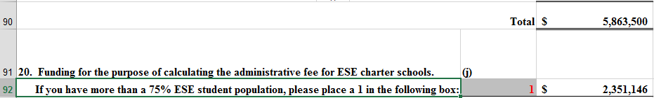
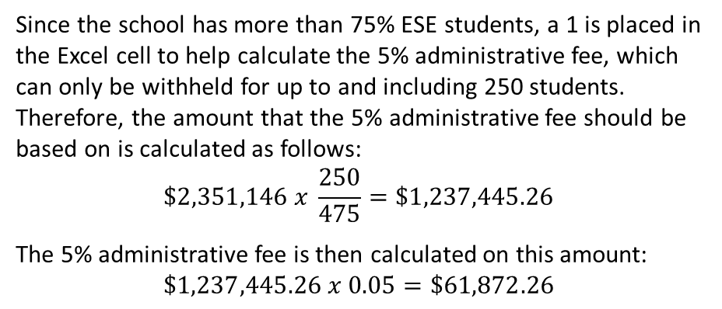
Administrative Fee
Administrative
Fee
Calculation
Example: A charter school has 475 students, of which more than 75% are ESE.
Authority:
s.1002.33(20),
s. 1002.33(17)
F.S.
Since the school has more than 75% ESE students, a 1 is placed in the Excel cell to help calculate the 5% administrative fee, which can only be withheld for up to and including 250 students. Therefore, the amount that the 5% administrative fee should be based on is calculated as follows:
$$\$2,351,146 x \frac{250}{475}=\$1,237,445.26$$
The 5% administrative fee is then calculated on this amount:
$$\$1,237,445.26 x 0.05=\$61,872.26$$

Slide 28
2022-23 Changes
The BSA was increased by $214.49.
An additional $250 million was allocated for the Teacher Salary Increase Allocation, for a total of $800 million.
The Mental Health Assistance Allocation was increased by $20 million, for a total of $140 million.
The Reading Allocation was increased by $40 million, for a total of $170 million.
The Safe Schools Allocation was increased by $30 million, for a total of $210 million.

Slide 29
Useful Tools
Charter School Revenue Estimating Worksheet https://www.fldoe.org/finance/fl-edu-finance-program-fefp/charter-school-revenue-estimate-worksh.stml
FEFP Calculations https://www.fldoe.org/finance/fl-edu-finance-program-fefp/fl-edu-finance-program-fefp-calculatio.stml
FTE General Instructions https://www.fldoe.org/finance/fl-edu-finance-program-fefp/fte-info/index.stml
FTE and Transportation Reporting Deadlines http://www.fldoe.org/core/fileparse.php/7574/urlt/2122-surveydates.pdf
Financial and Program Cost Accounting and Reporting for Florida Schools (Red Book) https://www.fldoe.org/finance/fl-edu-finance-program-fefp/financial-program-cost-accounting-repo.stml
Class Size http://www.fldoe.org/classsize/

Slide 30
Contact Information
Contact Information
Office of Funding and Financial Reporting
(850) 245-0405 http://www.fldoe.org/fefp/
James Andrews, Office of Funding and Financial Reporting
james.andrews@fldoe.org
Josh Bemis, Office of Funding and Financial Reporting
josh.bemis@fldoe.org
Mark Eggers, Assistant Deputy Commissioner
mark.eggers@fldoe.org

